Slide 1
Guler Orgun

Slide 2
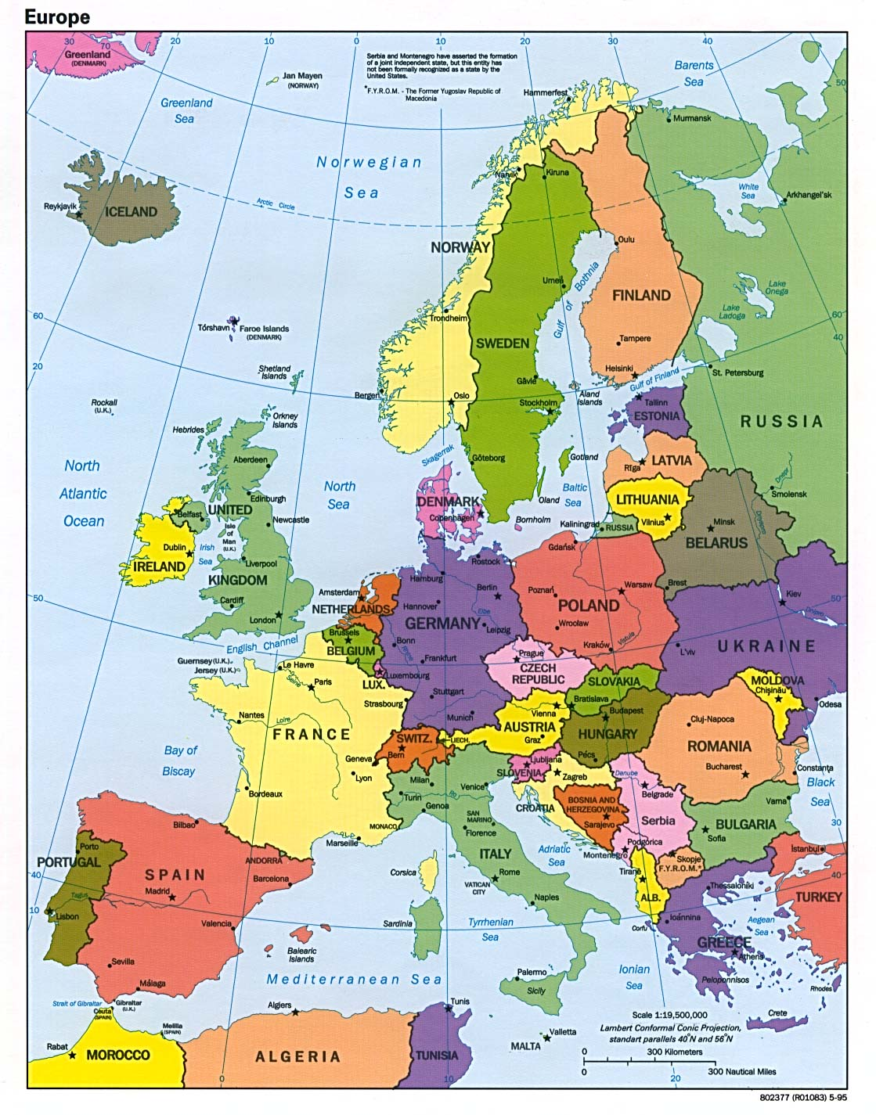
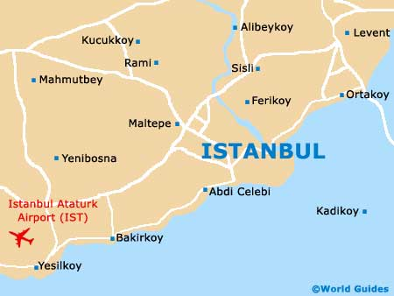
Country
Guler was born in Istanbul in 1937, but shortly after she was
born her family moved to Europe.

Slide 3
Politics
During the 1930s Europe became an ugly place. There was a tax called the wealth tax that financially ruined many people. But because Guler’s family was considered Islam they were not taxed to that extreme.

Slide 4
Religion
Guler was born a Muslim but her families mixed heritage complicated the fact of her absolute religion. She calls herself a Turkish-Jewish-Muslim. And because of the confusion she was never severely persecuted for being a Jew.

Slide 5
Education
As a younger child Guler received a formal education but never pursued a certain job or occupation. After she grew older she returned to school at Cervantes Institute to learn Spanish, she was 65 years old.

Slide 6
Timeline
1937 1930
Guler Orgun was born After the family
In Istanbul to a muslim moved to Europe the
household. Shorlty after political situation
Her birth the family became very unstable.
Moved to Europe. She described it as an
“ugly”place to be.

Slide 7
Timeline
1939
The second war started which caused a major uproar in Europe. Her father was also sent away in the war.
1945
Her father came home from war and decided to begin to rebuild the family business.

Slide 8
Timeline
1950
This is the year her father fell ill of meningitis. The nurses said he would not make it but he survived.
1952
She met a man named Ceki Karasu and they fell in love. She converted to Judaism so they could be together.

Slide 9
Timeline
1954
She married Ceki in Neve Shalom Synagogue. Sadly a few years later they seperated
1957
She met Gunel Orgun while horseback riding, they had an immediate connection. He was also Muslim.

Slide 10
Timeline
1965
She married Gunel in a civil ceremony and they both kept their religions.
1966
She ahd her first son Orhan. He was healthy boy and eventually became a wealthy doctor.

Slide 11
Timeline
1968
Her daughter Gun was born. She also grew up to become a doctor and married a Scottish man.
1997
Her mother died of old age and left behind an extreme legacy for her 17 grandchildren.

Slide 12

Guler as a child.

Slide 13

Her parents.

Slide 14

Guler’s graduation picture.

Slide 15

Guler with her degree in Spanish.

Slide 16

Guler’s second marriage ceremony.

