Slide 1
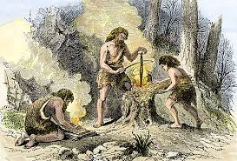

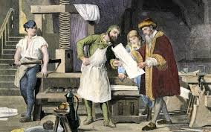
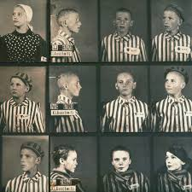
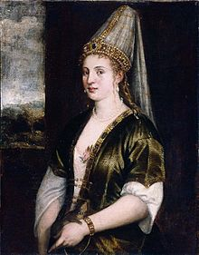
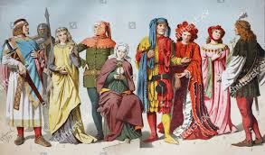
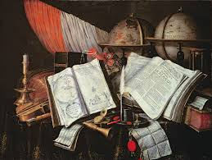
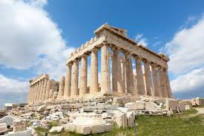
What We Live, is History!
Ms. Arık’s Class!

Slide 2
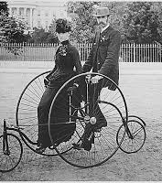
Warm-up
In Breakout rooms, discuss the following questions with your partner. Take notes.
1) What comes to your mind when you hear the word
‘history’?
2) Why is it important to look to the past?
3) How do we learn best about ‘history’?
4) What are primary and secondary sources of history?
How are they different?
5) List primary sources of history that you can think of.

Slide 3
You will now watch a video about two Holocaust survivors telling their life stories.
WHILE VIEWING THE VIDEO, think of the
following issues:
1- What parts of the video are primary sources
of history and what parts are secondary
sources of history?
2- Try to find at least ONE thing that you did not
know before?

Slide 4
A Centropa film: ‘Return to Rivne’ https://youtu.be/BOrd3wuJ4aY
Shelly Weiner and Raya Kizhnerman, the
survivors in this video, live in North Carolina, but
they were born in the bustling city of Rivne, (in
Poland at the time, nowadays Ukraine).
In 1941 there were 20,000 Jews living in Rivne.

Slide 5
Share your answers to the given questions.
So, what are your answers?
1- What parts of the video are primary sources
of history and what parts are secondary
sources of history?
2- What is the ONE thing you learned from
watching this video that you did not know
before? Is there more?

Slide 6
Challenge yourself!
In what context were these words used in the film?
Lime
Livestock
Relocation
Massacre
Possession
Premonition
Eaves
Lice
Bunker
Liberate
Raid
Decree
Confiscated
Deprivation

Slide 7
Lime | a white substance
Livestock | animals that are kept on a farm
Relocation | moving to another place
Massacre | act of killing a lot of people
Possession | something that you own
Premonition | feeling something unpleasant is about to happen
Eaves | part f a roof that sticks out over the walls
Lice | insects that live on the skin
Bunker | shelter, usually underground
Liberate | set free
Raid | a sudden attack
Decree | an official decision made by the ruler of a country
Confiscated | taken away as punishment
Deprivation | absence of something important

Slide 8
POST VIEWING:
1- What new insight did you gain from viewing this
film?
2- Describe a moment in the film that you found
particularly heartbreaking.
3- Can you think of a moment of serendipity in the film?
Explain.
4- What kind of fears did Shelley and Raya feel
throughout their childhood years do you think?
5- If you could ask one person in the film a question,
who would you ask and what would that question
be?

Slide 9
Create a primary source of history
Today, due to Covid-19, the world is experiencing
a variety of fears like fear of losing loved ones,
fear of the unknown, fear of separation or fear of
loneliness.
Our lives have changed drastically and, this too,
will become history.
In what ways can YOU document your life as a
student during the Covid-19 pandemic for
future generations and historians?

Slide 10
Assignment:
Create a source of history for future generations
Create a product through which you explain how your daily life has
changed as a student in the year 2020 with the start of the pandemic.
Try to include as many details as possible so that historians and/or
people who live in the far future can learn about your daily life during
the Covid-19 period?
Remember that your product will be a source of history ☺
Title: ‘MY LIFE AS A STUDENT IN THE YEAR 2020’
Choose one of the below:
A 3 minute video
3 TikToks
A diary of a week
A photo album of 7 photographs on PowerPoint
Subtitles should be provided for the video and TikTok options, and
explanatory text is required for each photo in the album.

