Slide 1
Why is a civic society important? How to create a Civic Society?
Andrzej Goniak Lazar Nikolic
Ana Boban Lipibc Shalini Sarkar

Slide 2
Goals
Why is a civic society important is a lesson to encourage high school students to become active citizens in their community.

Slide 3


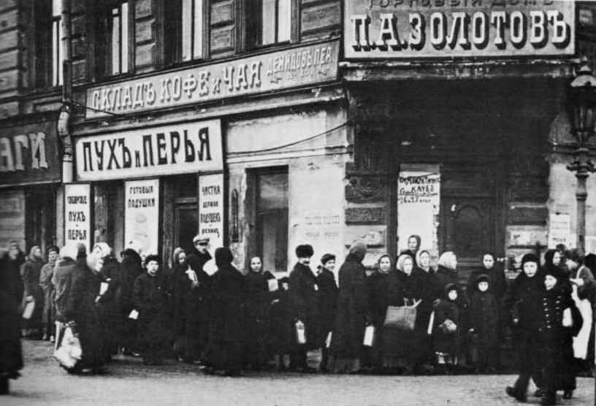
Students analyze their place in society

Slide 4

Survival in Sarajevo
Students will watch Survival in Sarajevo
Students will list various ways citizens organized to create and maintain their community

Slide 5


Research
Students will reflect back to their community
Students will research 1-2 NGOs that address their struggles in society
Students will then create posters/display about local NGOs and display them around the school to inform other students

