Slide 1
TOGETHER
A CROSS – CULTURAL PROJECT

Slide 2
WHO?
COUNTRIES:
CHICAGO, USA
BERLIN, GERMANY
SKOPJE, MACEDONIA
TEACHERS:
JEFF ELLISON
MARTINA DETHLOFF
BRANKA DIMEVSKA KOCEVA
NUMBER OF STUDENTS:
Between 90 - 100

Slide 3
When?
OCTOBER 2015 – MAY 2016

Slide 4
WHERE?
WWW.EDMODO.COM
SKYPE

Slide 5
HOW?
PREDICTING WHAT STUDENT LIVES ARE LIKE IN OTHER COUNTRIES. OFTEN THEY BASED THEIR PREDICTIONS UPON STEREOTYPES DERIVED FROM TELEVISION AND MOVIES
DESCRIBING THEMSELVES AND THEIR FAMILIES
STUDENTS CREATED FILMS ABOUT THEIR SCHOOLS AND CITIES.

Slide 6
HOW?
STUDENTS PROVIDED SHORT HISTORICAL NARRATIVES EXPLAINING HOW MINORITIES CAME TO THEIR COUNTRIES AND THE PARTICULAR PROBLEMS THEY FACED.
STUDENTS CONDUCTED INTERVIEWS WITH MEMBERS OF MINORITIES IN ORDER TO BREAK DOWN STEREOTYPES

Slide 7
WHY?
TO BREAK STEREOTYPES
TO STOP AND STEP UP AGAINST ANY FORM OF DISCRIMINATION
TO RESPECT, LOVE AND SHOW EMPATHY FOR OTHERS
TO REALIZE THAT ONLY TOGETHER WE CAN MAKE GREAT THINGS

Slide 8
Why do we create the other?
Matea S.
I think that we don't create "the other", but in some cases our opinion is based on the opinion of our parents, friends and all the people that are around us, so we inherit these opinions. I think these opinions are created because people can't tolerate someone that is different in any other aspect.
Jeremy S.
I think we create the other and marginalize other groups because people need to make their groups feel more superior. I think it is something along the lines of people find scape goats to make themselves feel better. A lot of times it is the minority that becomes that scape goat for discrimination.
Judah H.
We create the Other in order to feel superior. We create the hate. Just as bullies bully other to feel better about themselves, we create hate and inferiority in order to feel better about ourselves

Slide 9
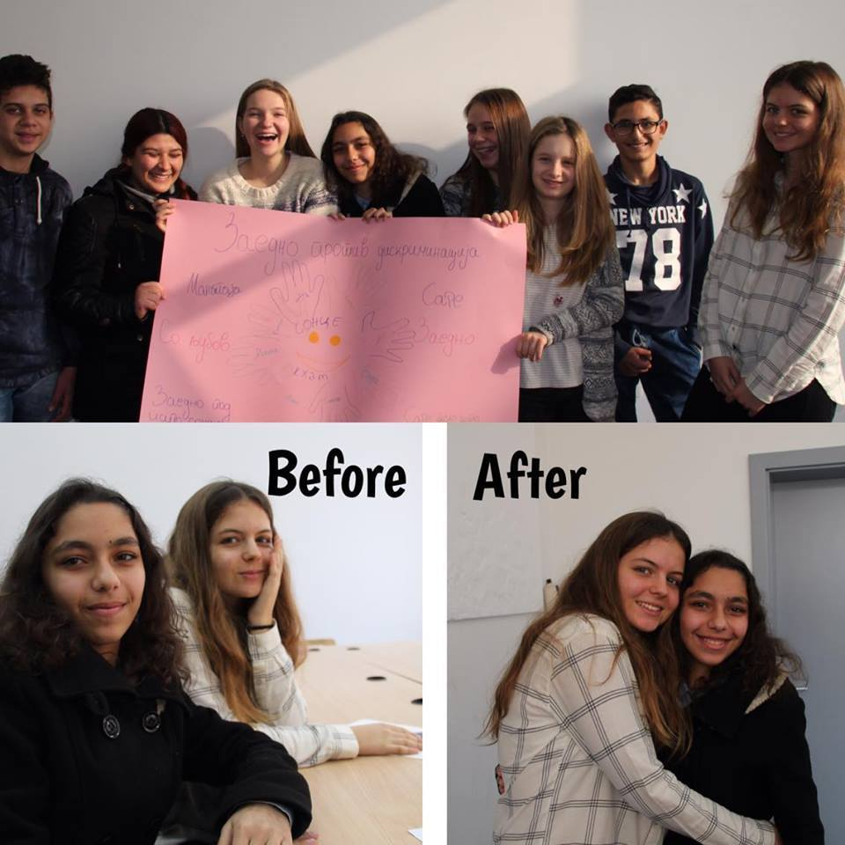
interviews
Vera L.
This is my new friend Indira, she is a part of the Roma minority group here in Macedonia. She surprised me when she said that she never felt discriminated so far. I was very happy to hear that and I felt like there is still hope for discrimination to stop.
She said she would never judge anyone by their appearance, by the color of their skin, or because they are not like her. We both wish that everyone is equal or even if someone is different we need to treat them the way we want to be treated. If you treat someone the way you don’t want to be treated one day someone will treat you the same you did. So do everything you can to stop discrimination and always remember are all people despite the differences we may have.

