Slide 1

Helpful advices to realize Centropa‘s exhibiton
Survival in Sarajevo properly in your area

Slide 2








Slide 3
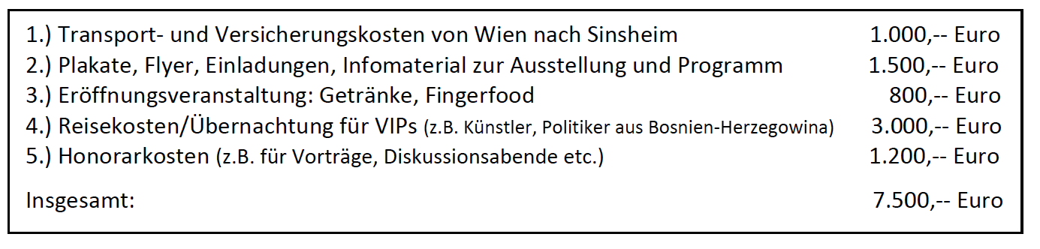
Advice:
Fundraising

Slide 4
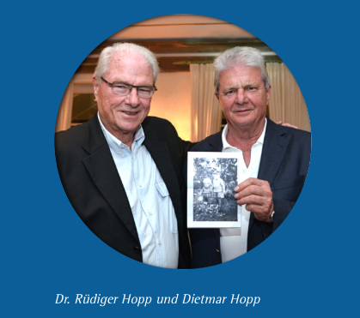
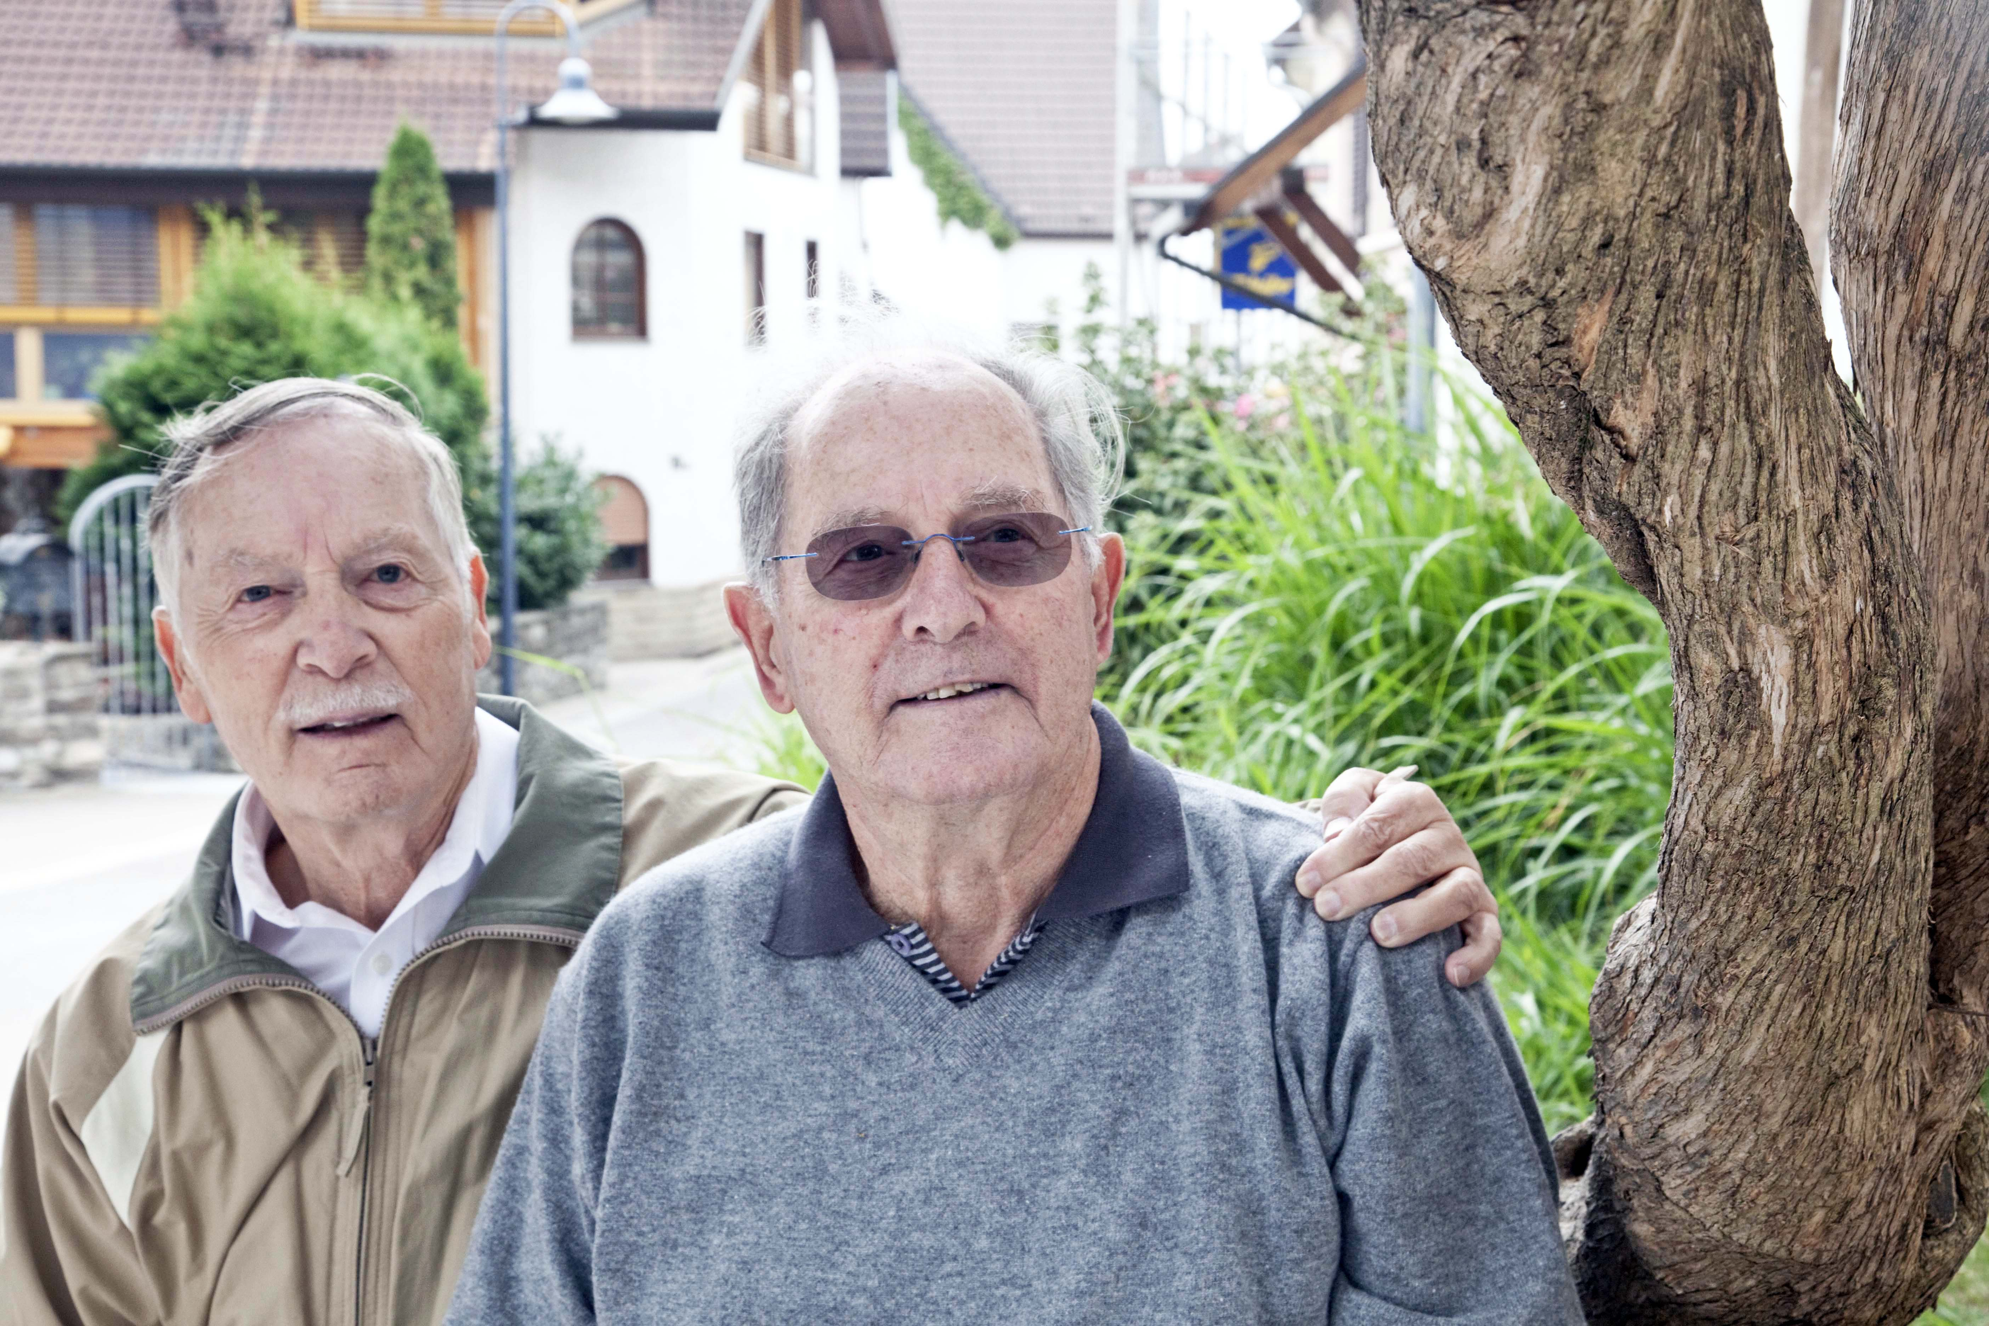


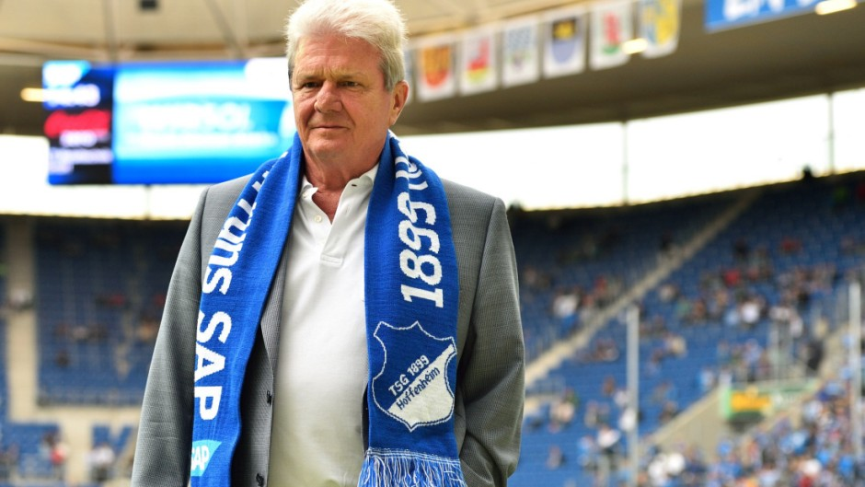
Fred Raymes & Dr. Menachem Mayer

Slide 5
Fourth advice:
Make a personal presentation to
Potential donors!

Slide 6
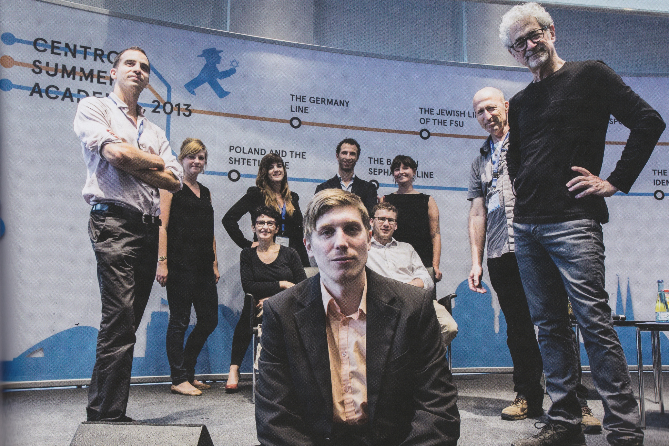

Slide 7
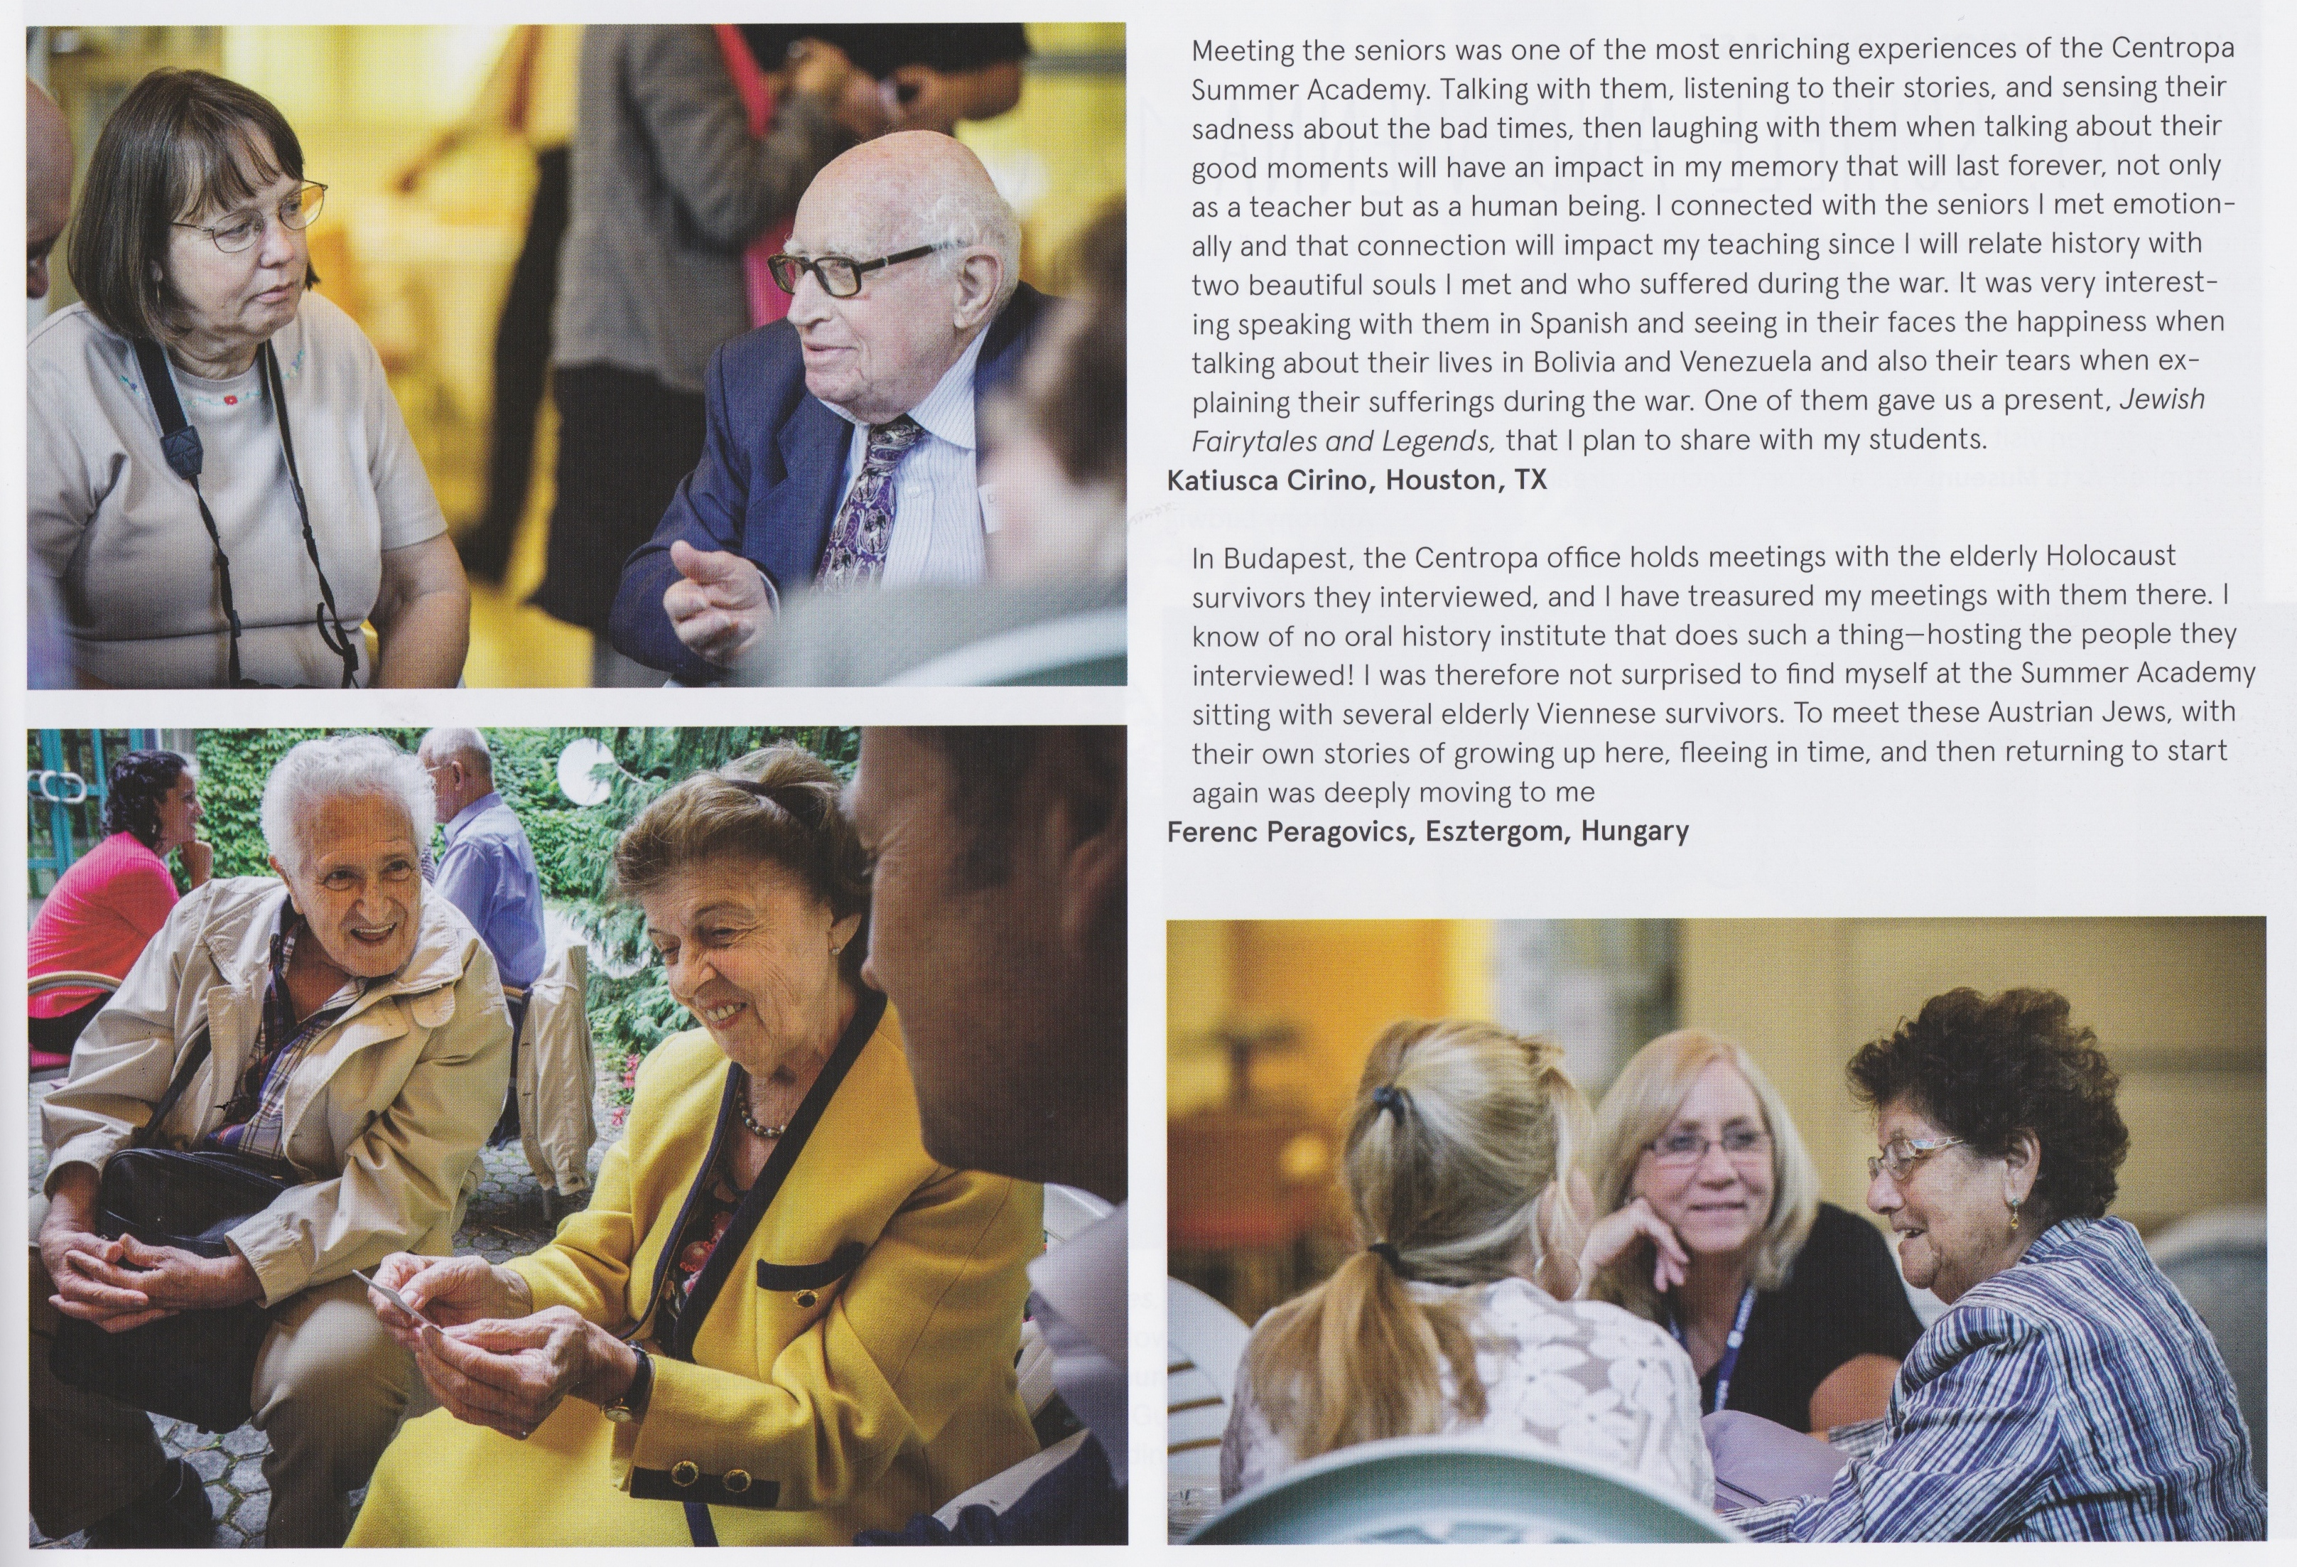

Slide 8


Slide 9
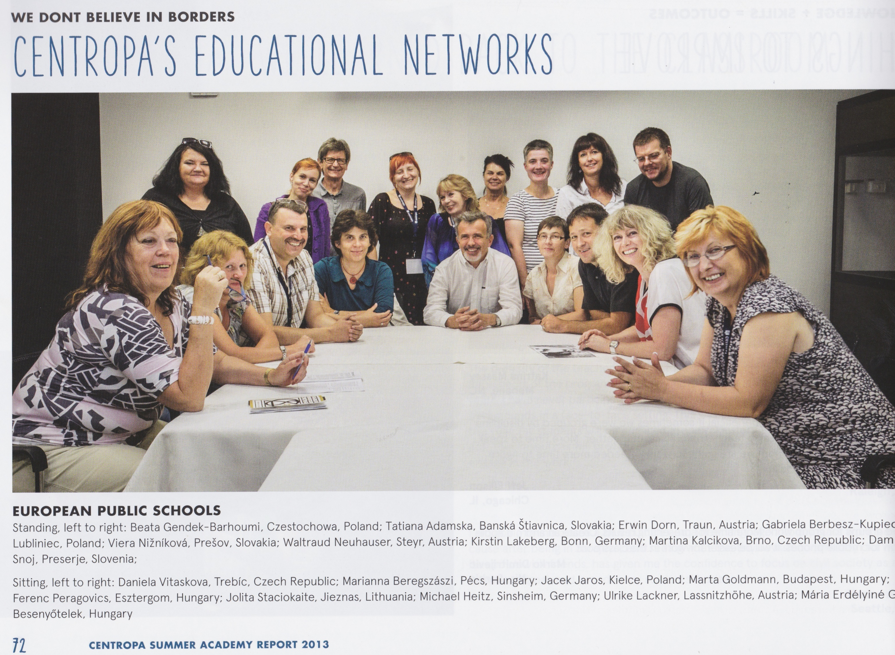

Slide 10
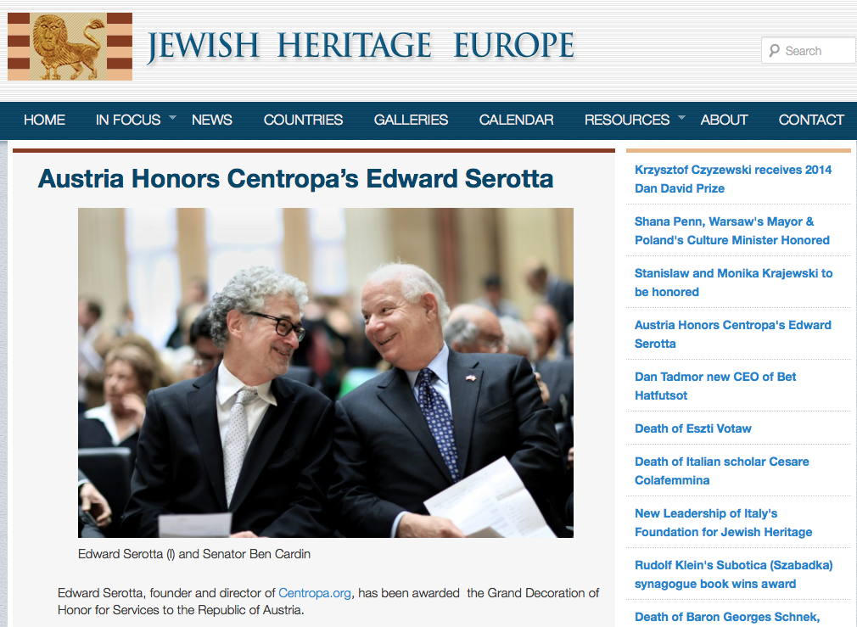

Slide 11
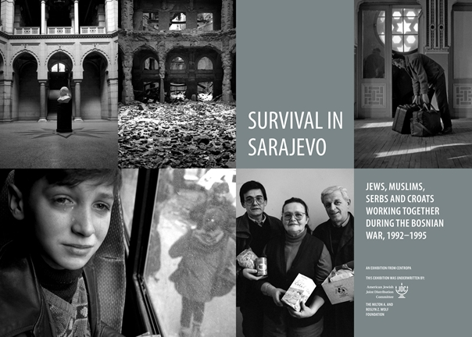

Slide 12
A common project by
Albert-Schweitzer-Schule Sinsheim
Hartmanni-Gymnasium Eppingen
Ottheinrich-Gymnasium Wiesloch
Anpfiff-ins-Leben e.V.
Erlebniszentrum Mühle Kolb Zuzenhausen
Jüdisches Leben Kraichgau e.V.
VHS Sinsheim

Slide 13


Slide 14
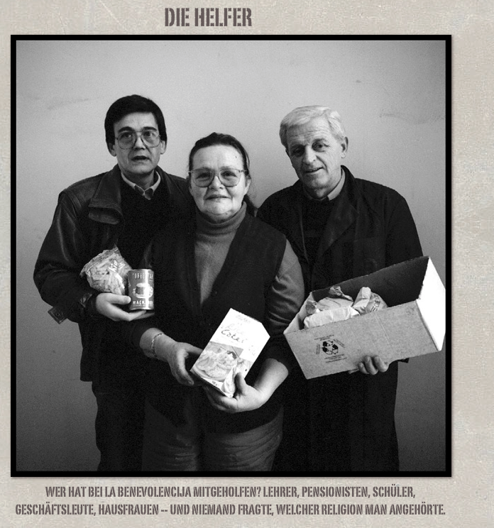

Slide 15
The (young) visitors should be sensitized towards tolerance
and should be couraged to stand up for one‘s beliefs
Encourage teenagers to commit themselves getting
along with people having a different cultural and religious
background.
Our area should be experienced as open, tolerant and worth
living by teenagers coming from different countries.

Slide 16
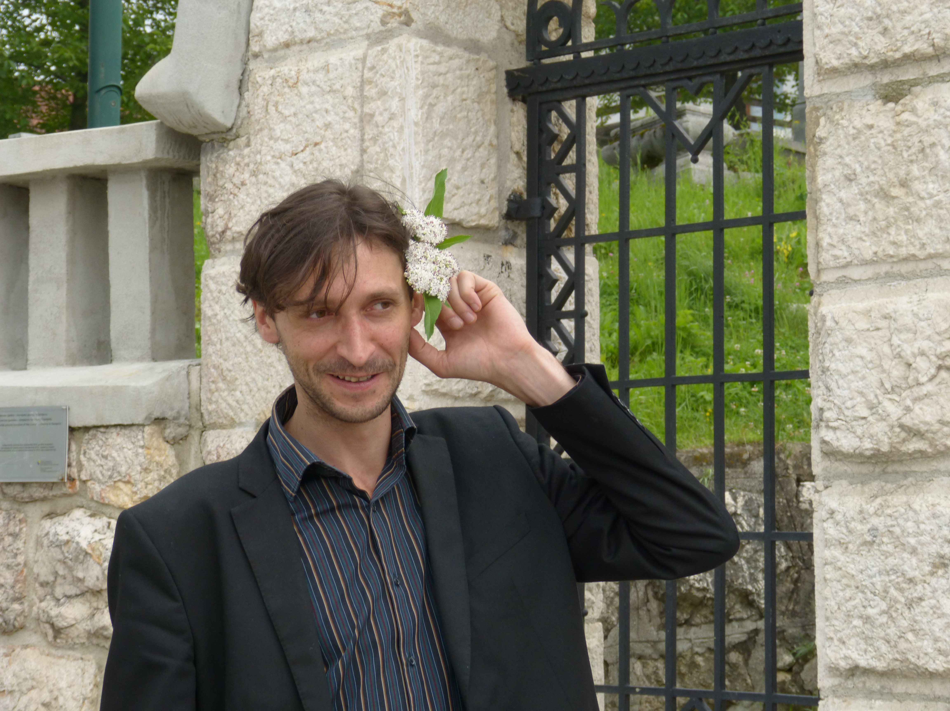

Slide 17
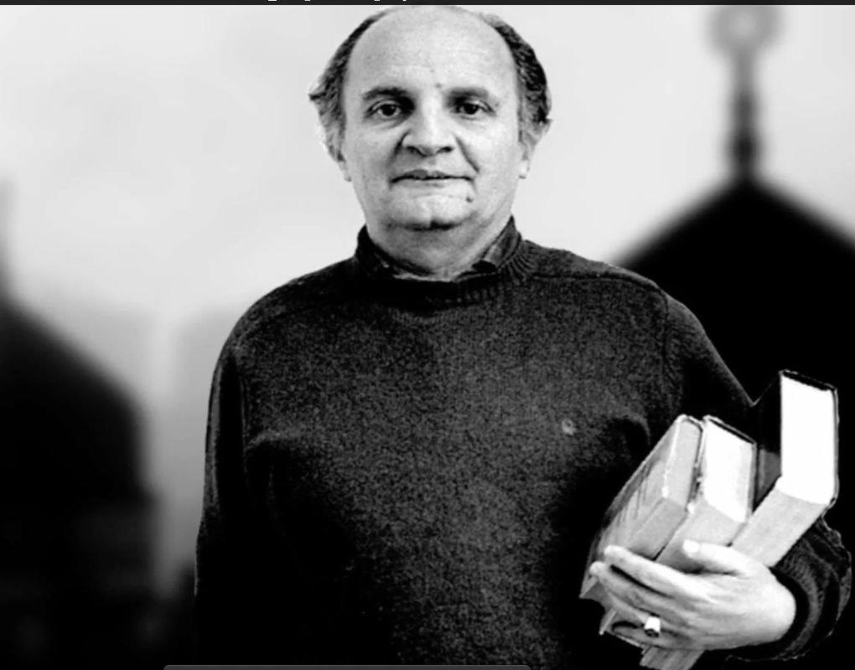

Slide 18
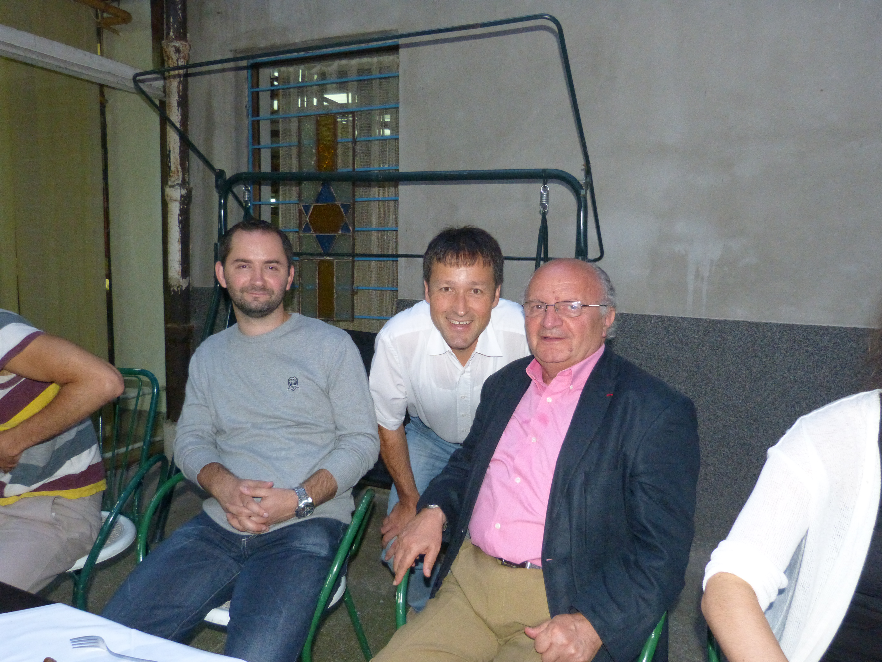
Asmir Begovic
Jakob Finci
Sarajevo, July 2014

Slide 19
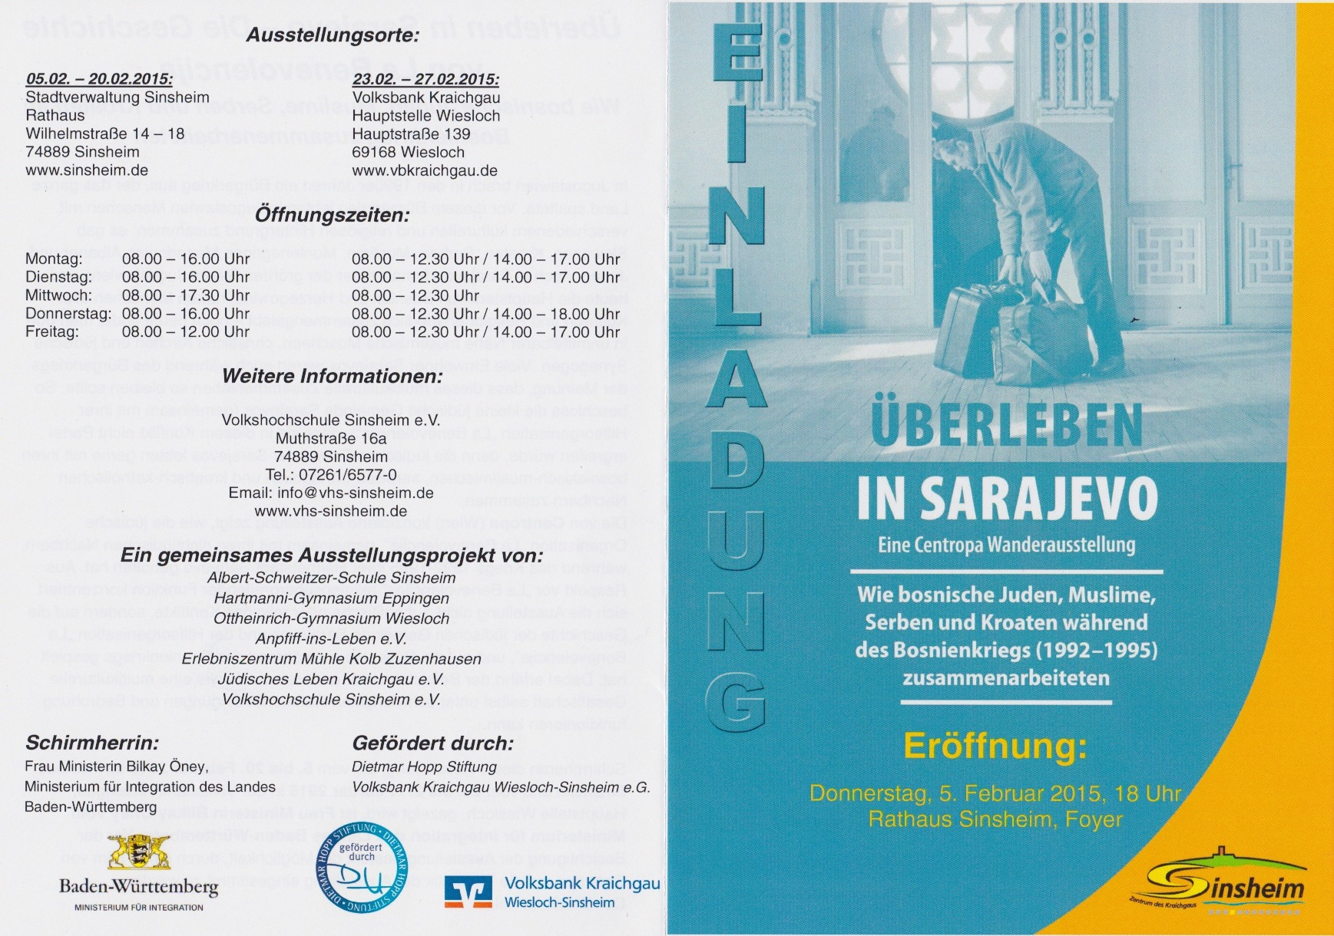

Slide 20
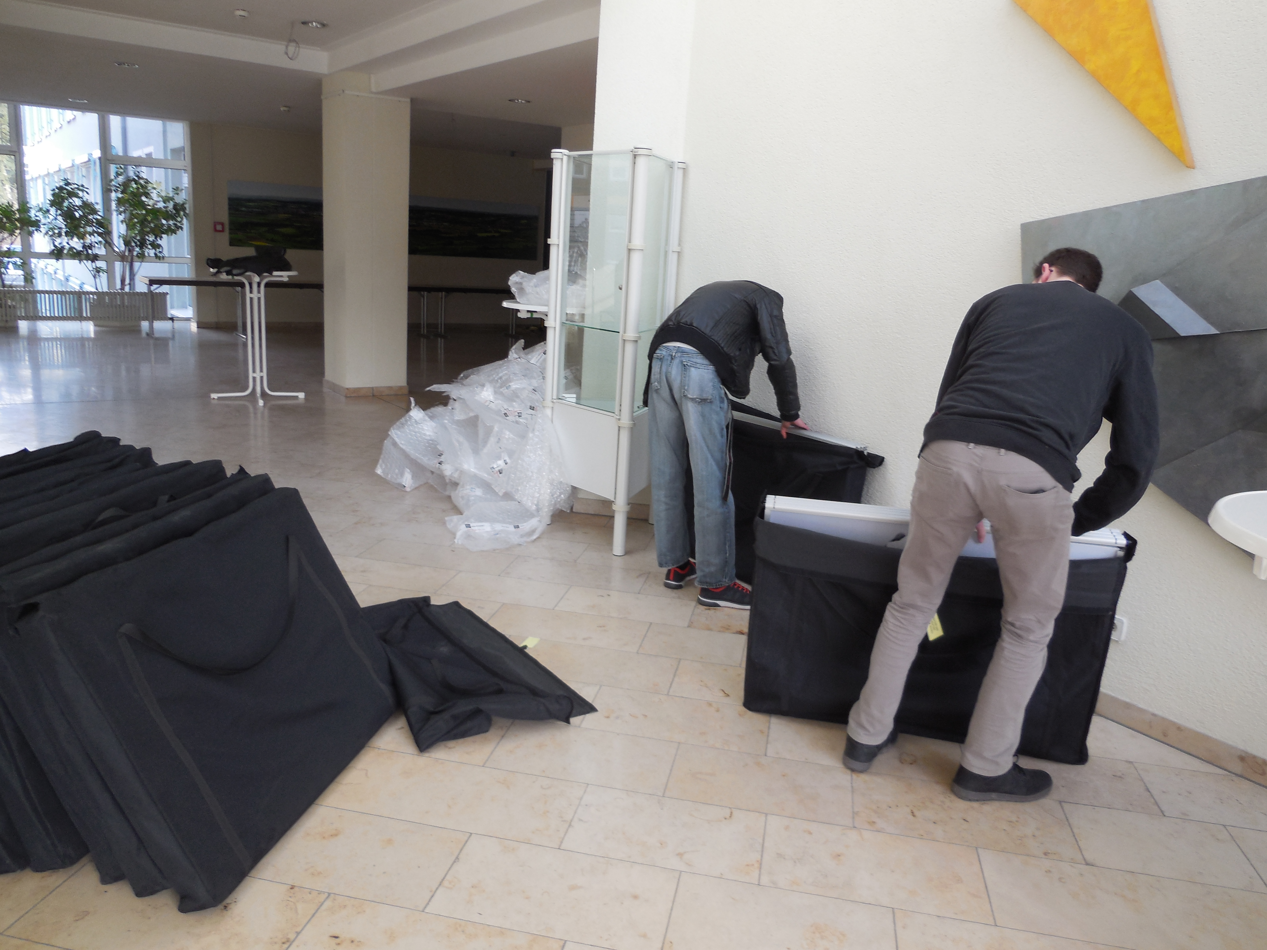
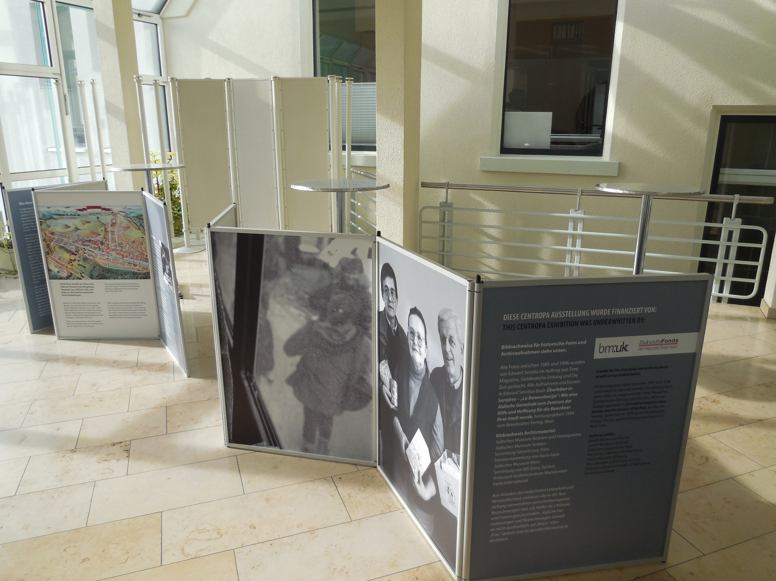
Be careful ☺
Be covered

Slide 21
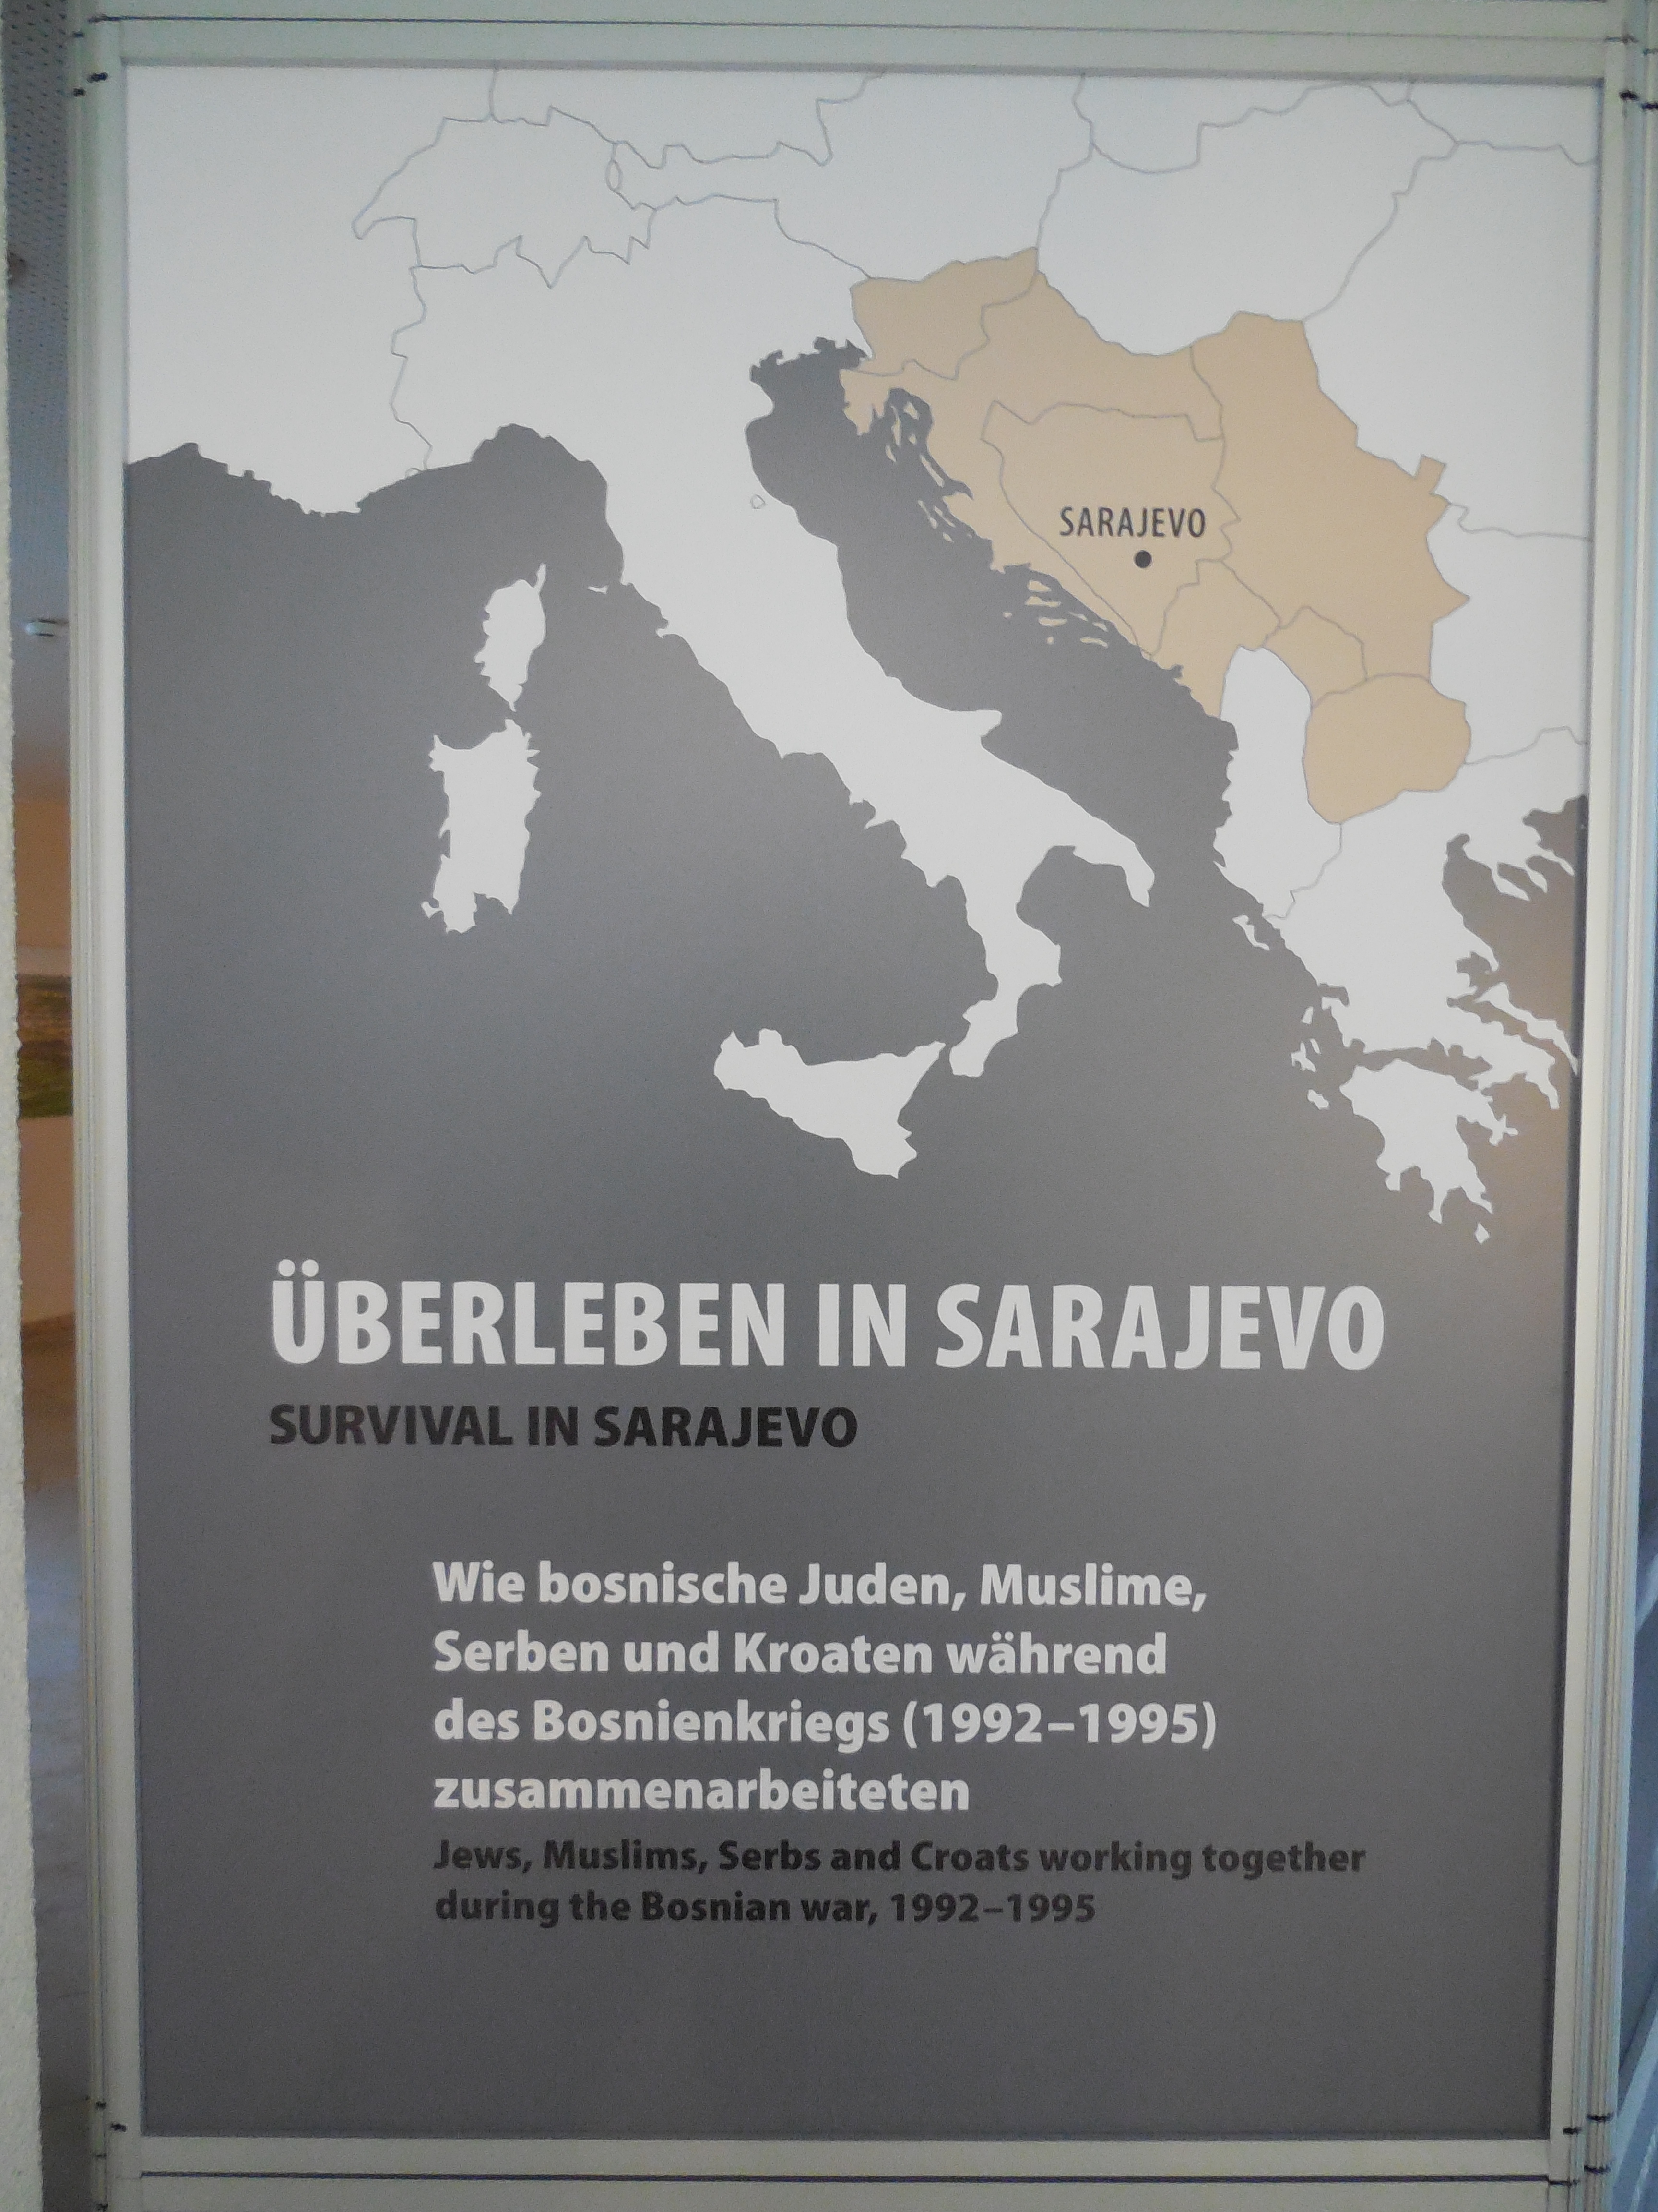
Opening ceremony

Slide 22
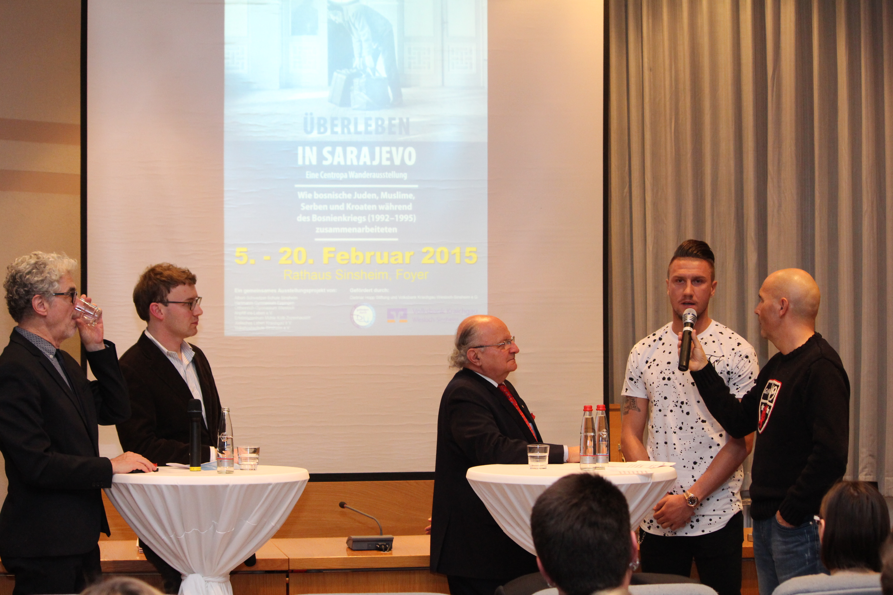
Interview with Jakob Finci and
Ermin Bičakčić, professional
soccer player of TSG 1899
Hoffenheim and member of
the national team of Bosnia and
Herzegovina

Slide 23
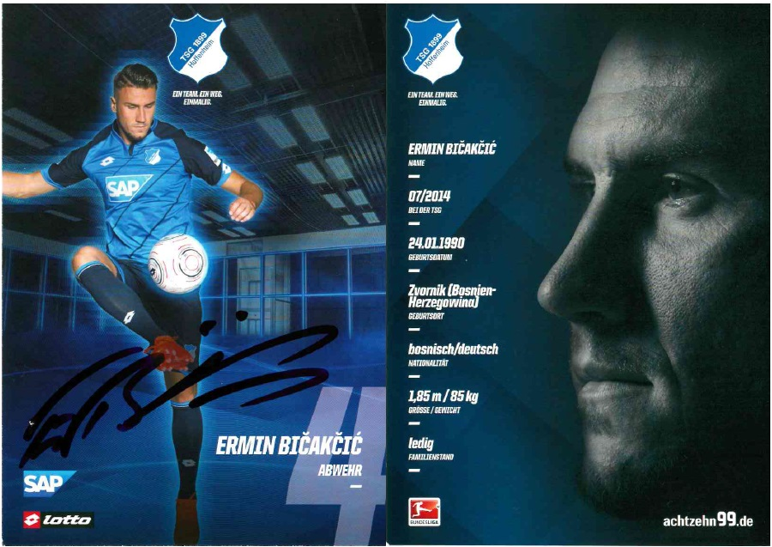

Slide 24
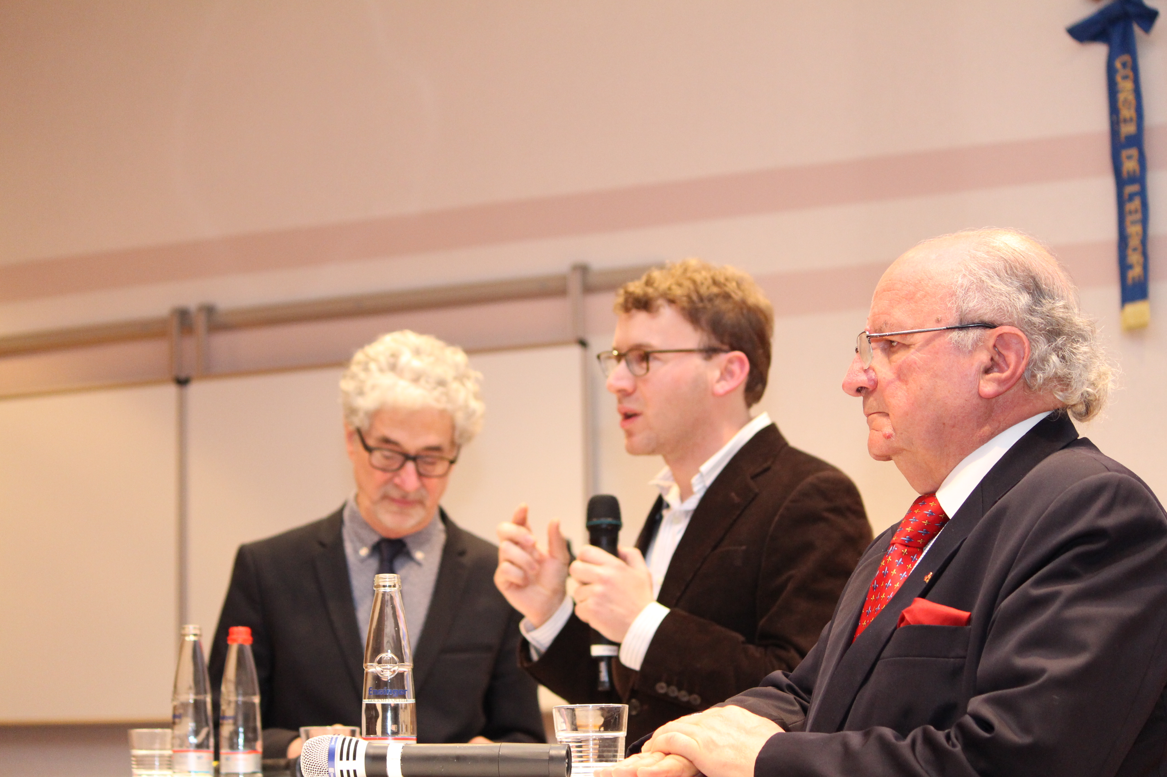

Slide 25
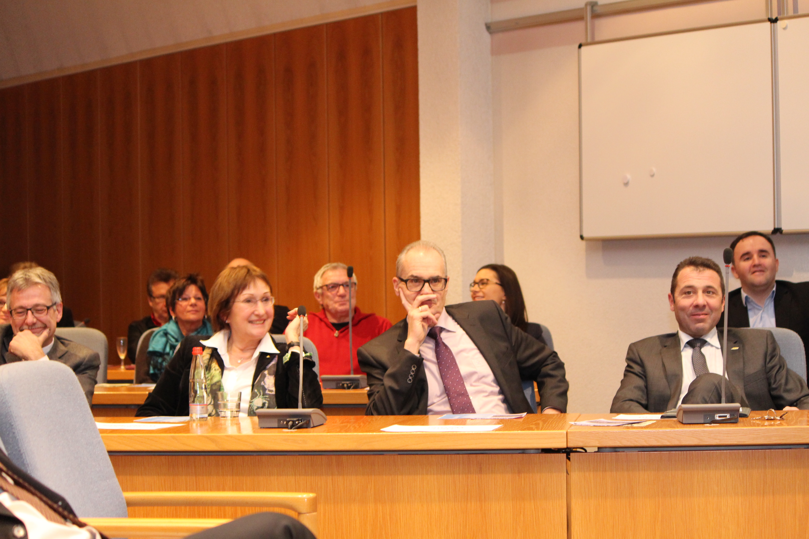
Invite
Important people !

Slide 26
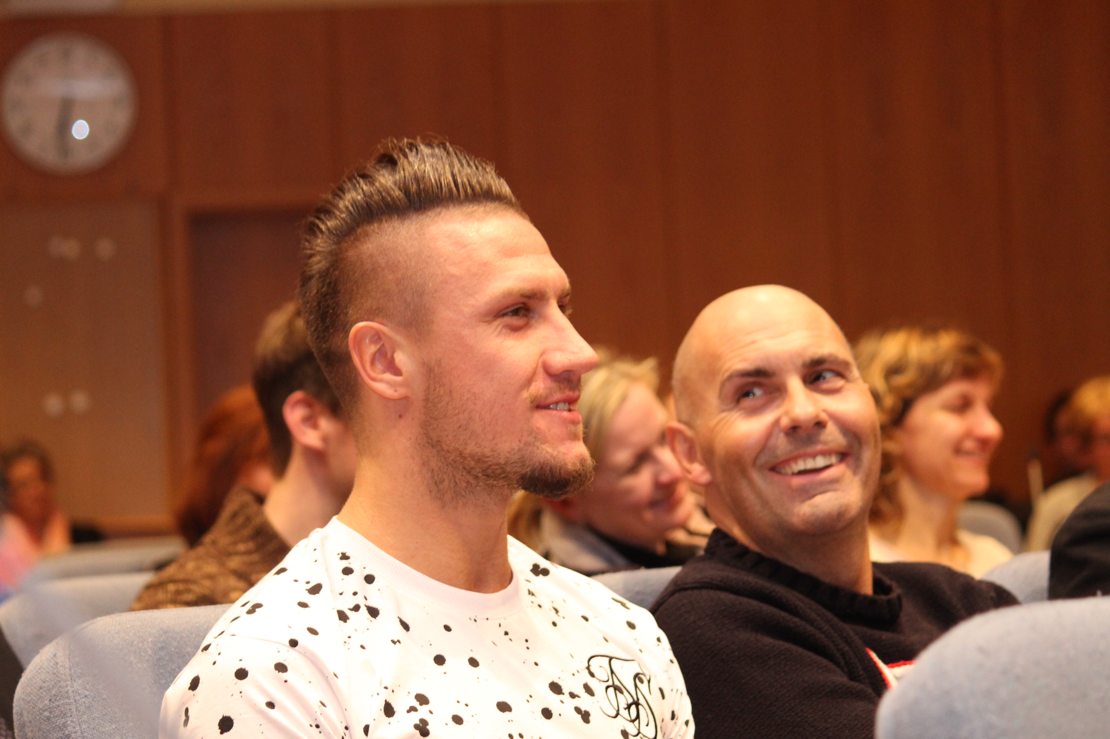
Seems that Ermin really enjoyed being
involved in this opening ceremony

Slide 27
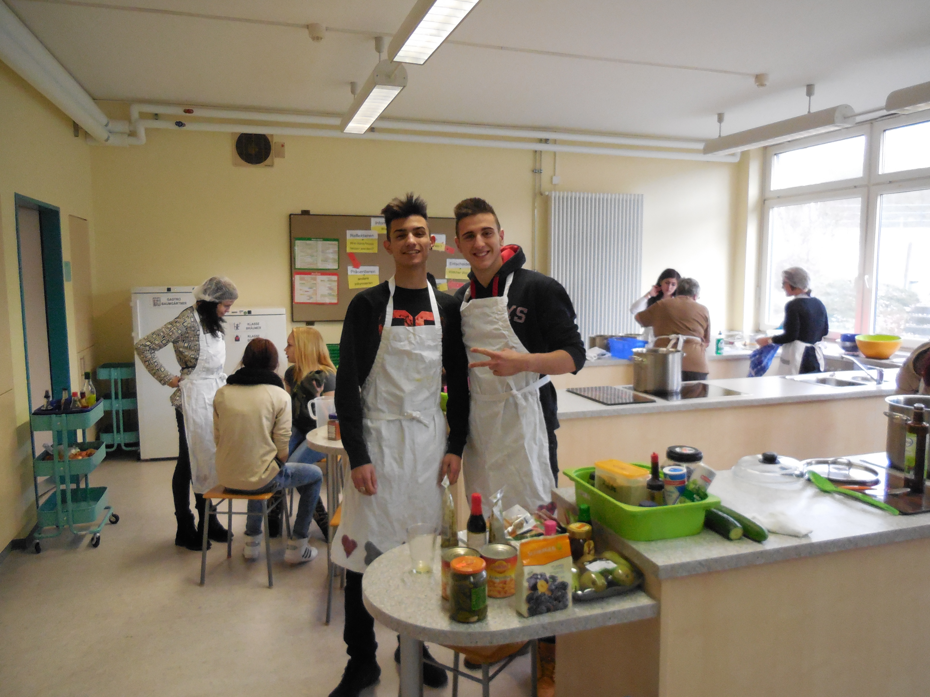
Multicultural catering team
Albert-Schweitzer-Schule Sinsheim

Slide 28
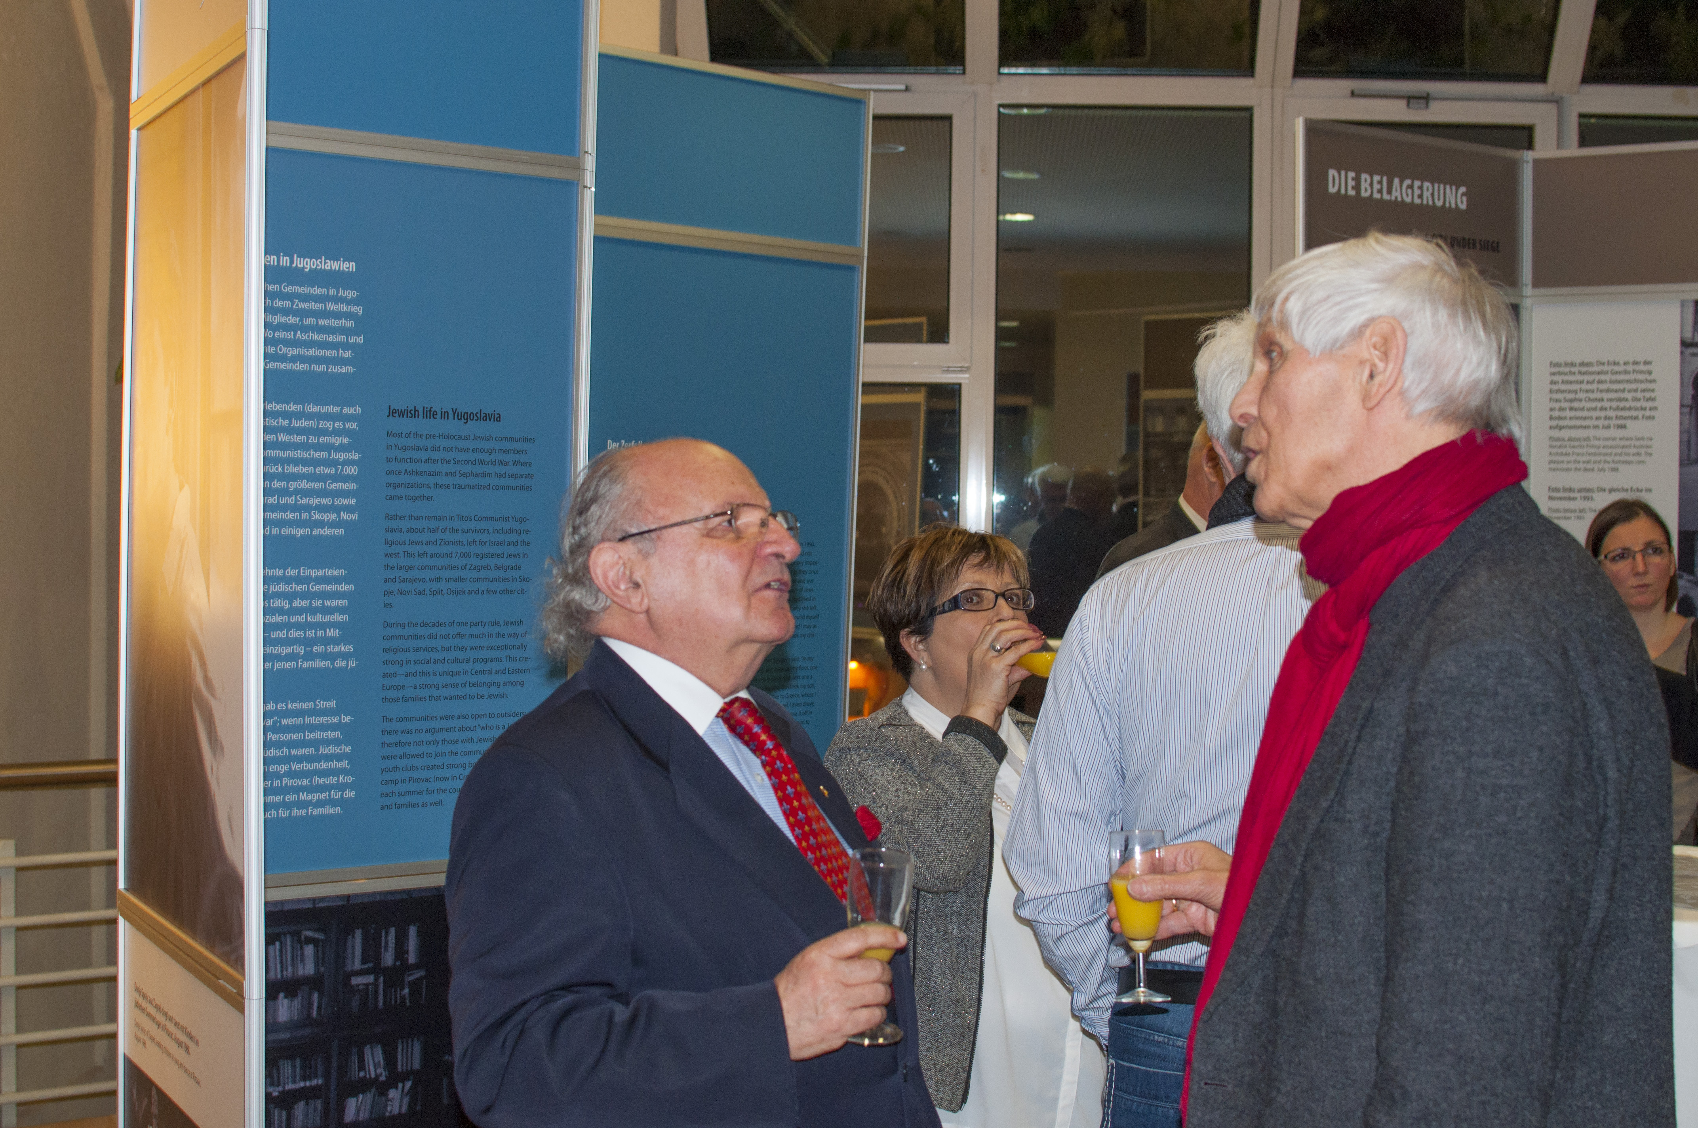
Jakob Finci with Prof. Gert Weiskirchen, former member
of the Deutsche Bundestag Berlin (1976-2009) and co-ordinator of the OSZE.

Slide 29
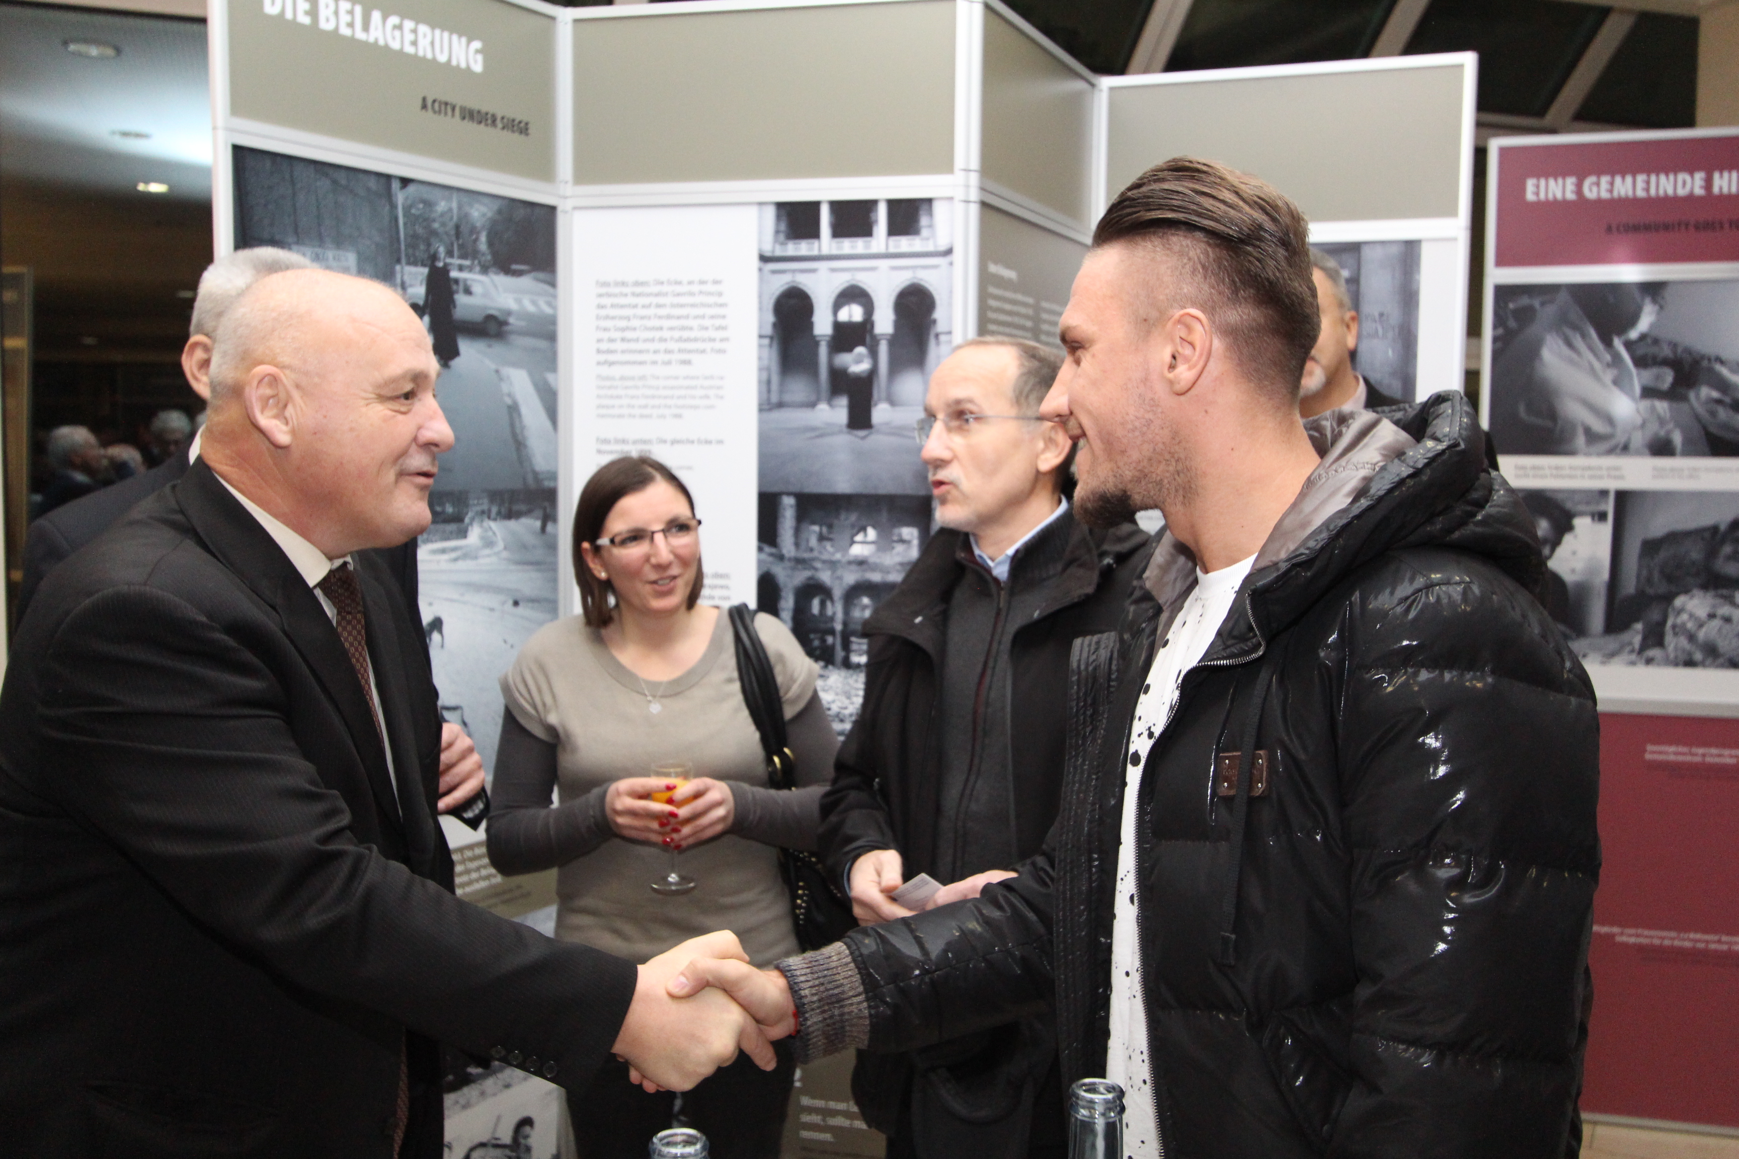
Ermin Bikakcic and the Consul of Bosnia and Herzegovina

Slide 30
What should they learn?
combating:
prejudices,
antisemitism,
racism
intolerance

Slide 31
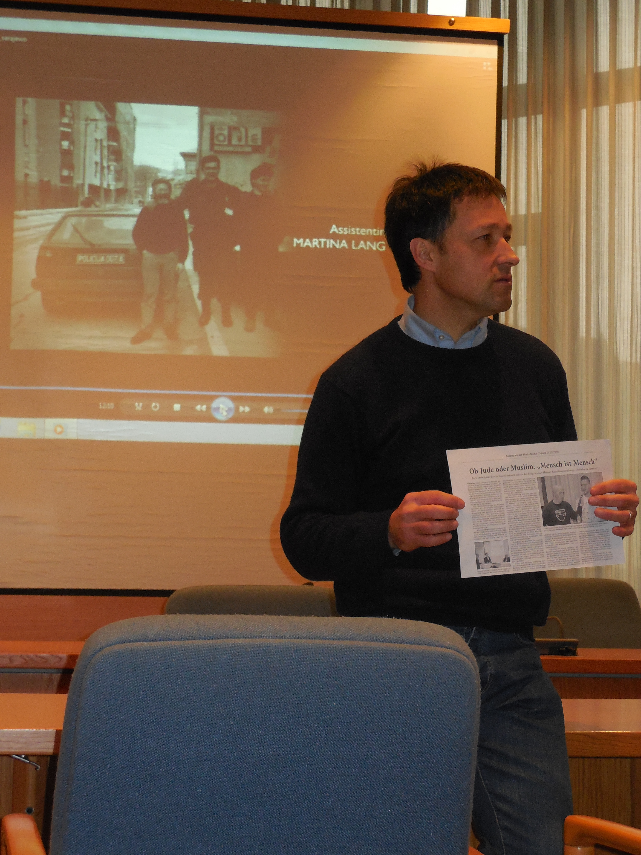
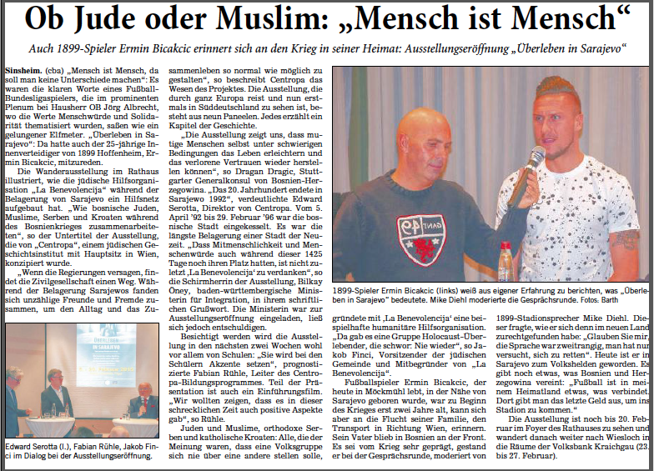
1. Using the exhibition with students

Slide 32
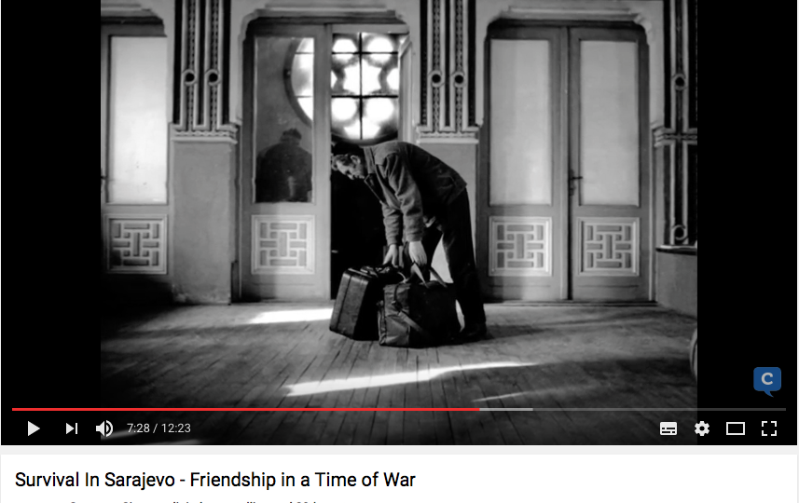
2. Movie (13min)

Slide 33


3. Discovering / Working
with the exhibiton by their own (25-30min)

Slide 34
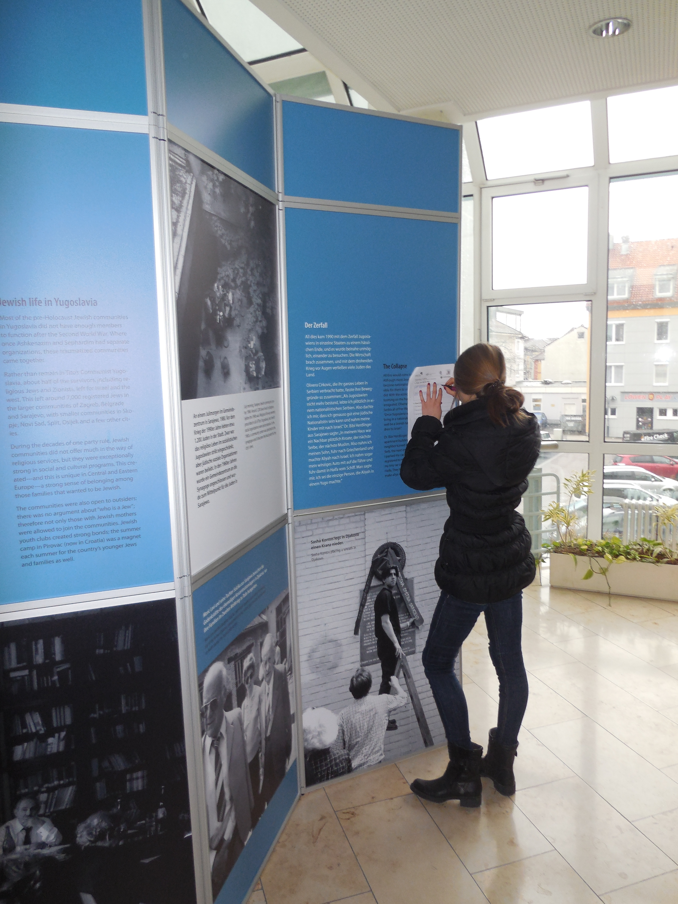

Slide 35
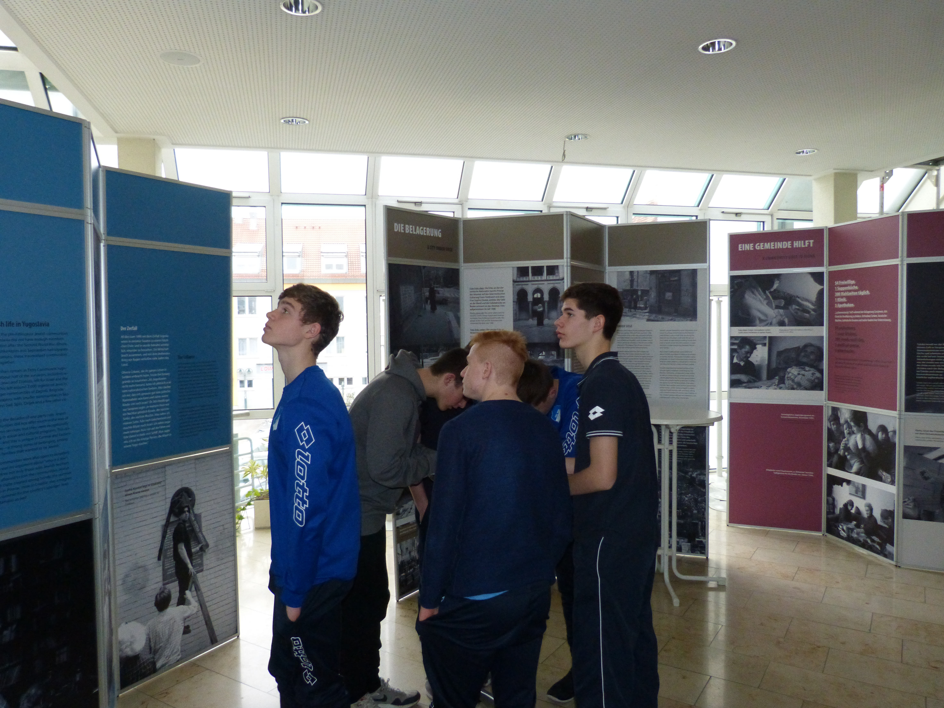
U16 soccer team TSG 1899 Hoffenheim

Slide 36
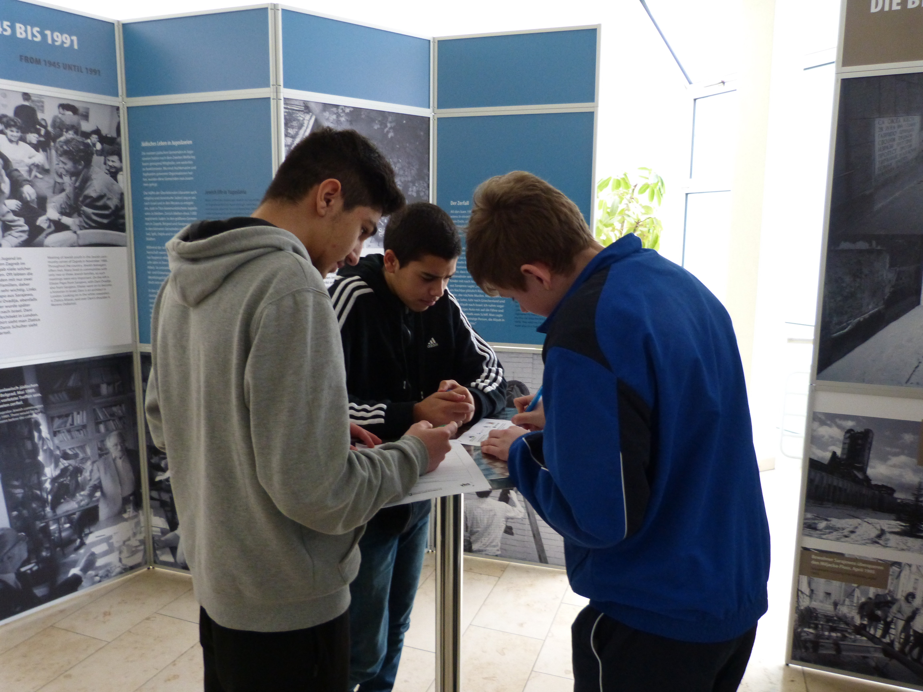

Slide 37
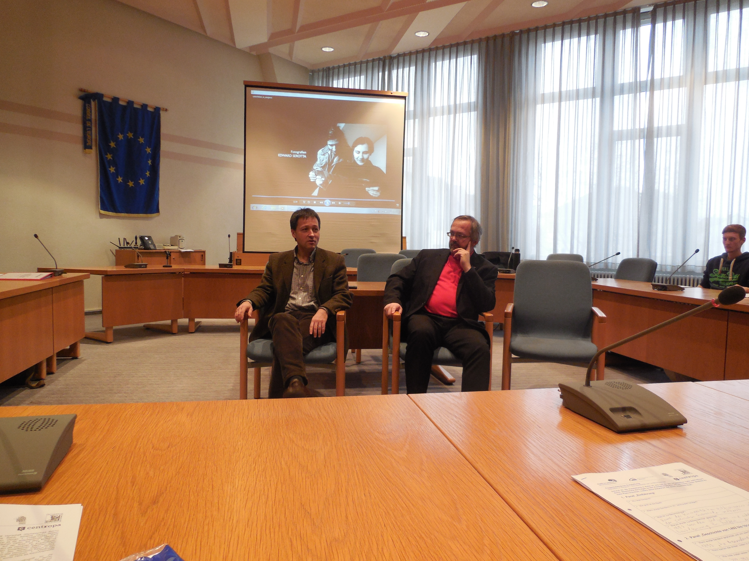
4. Closing meeting (15 min) = Total approx. 1hour
Open questions and final discussion with Thomas Funk, Member of the Parliament of Baden-Wuerttemberg

Slide 38
Result:
1300 registered visitors in Sinsheim
approx. 500 unregistered visitors during the
public opening hours of the town hall
500 registered visitors in Wiesloch Volksbank

Slide 39

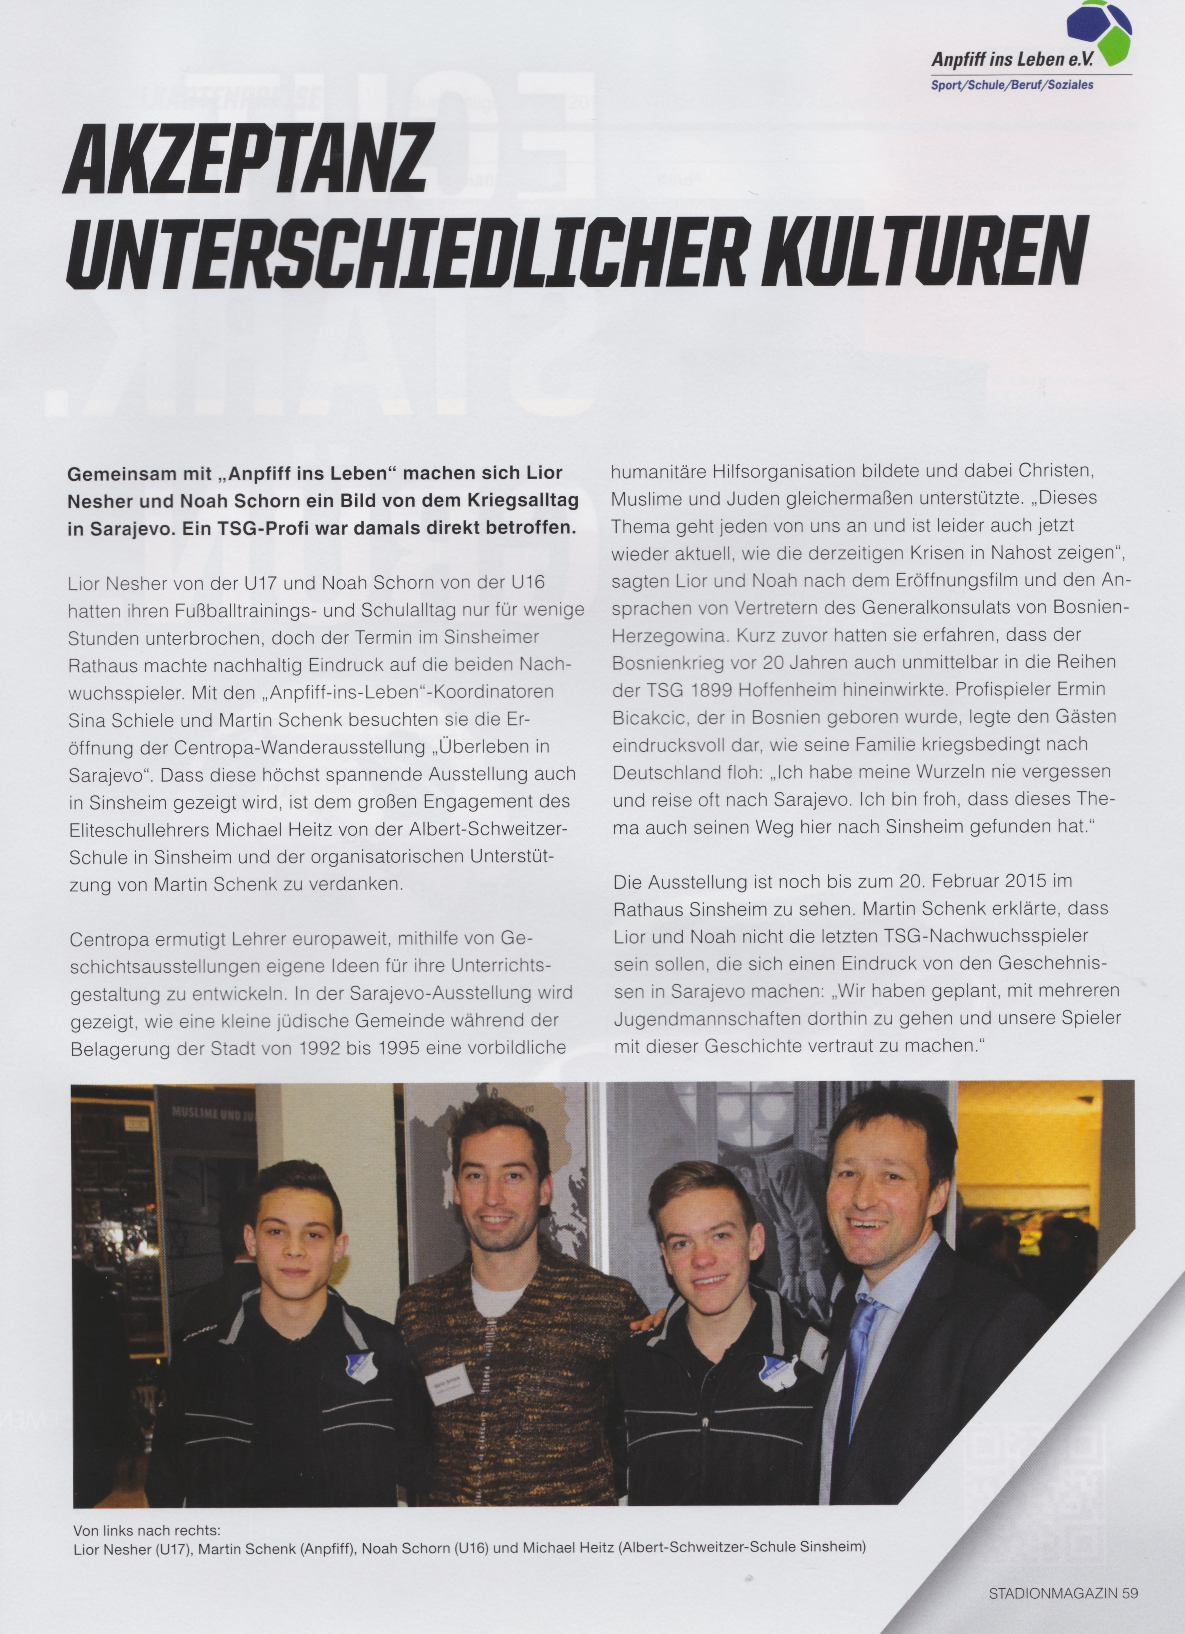
A report of the exhibition was published in the official stadium magazine
of TSG 1899 Hoffenheim

Slide 40
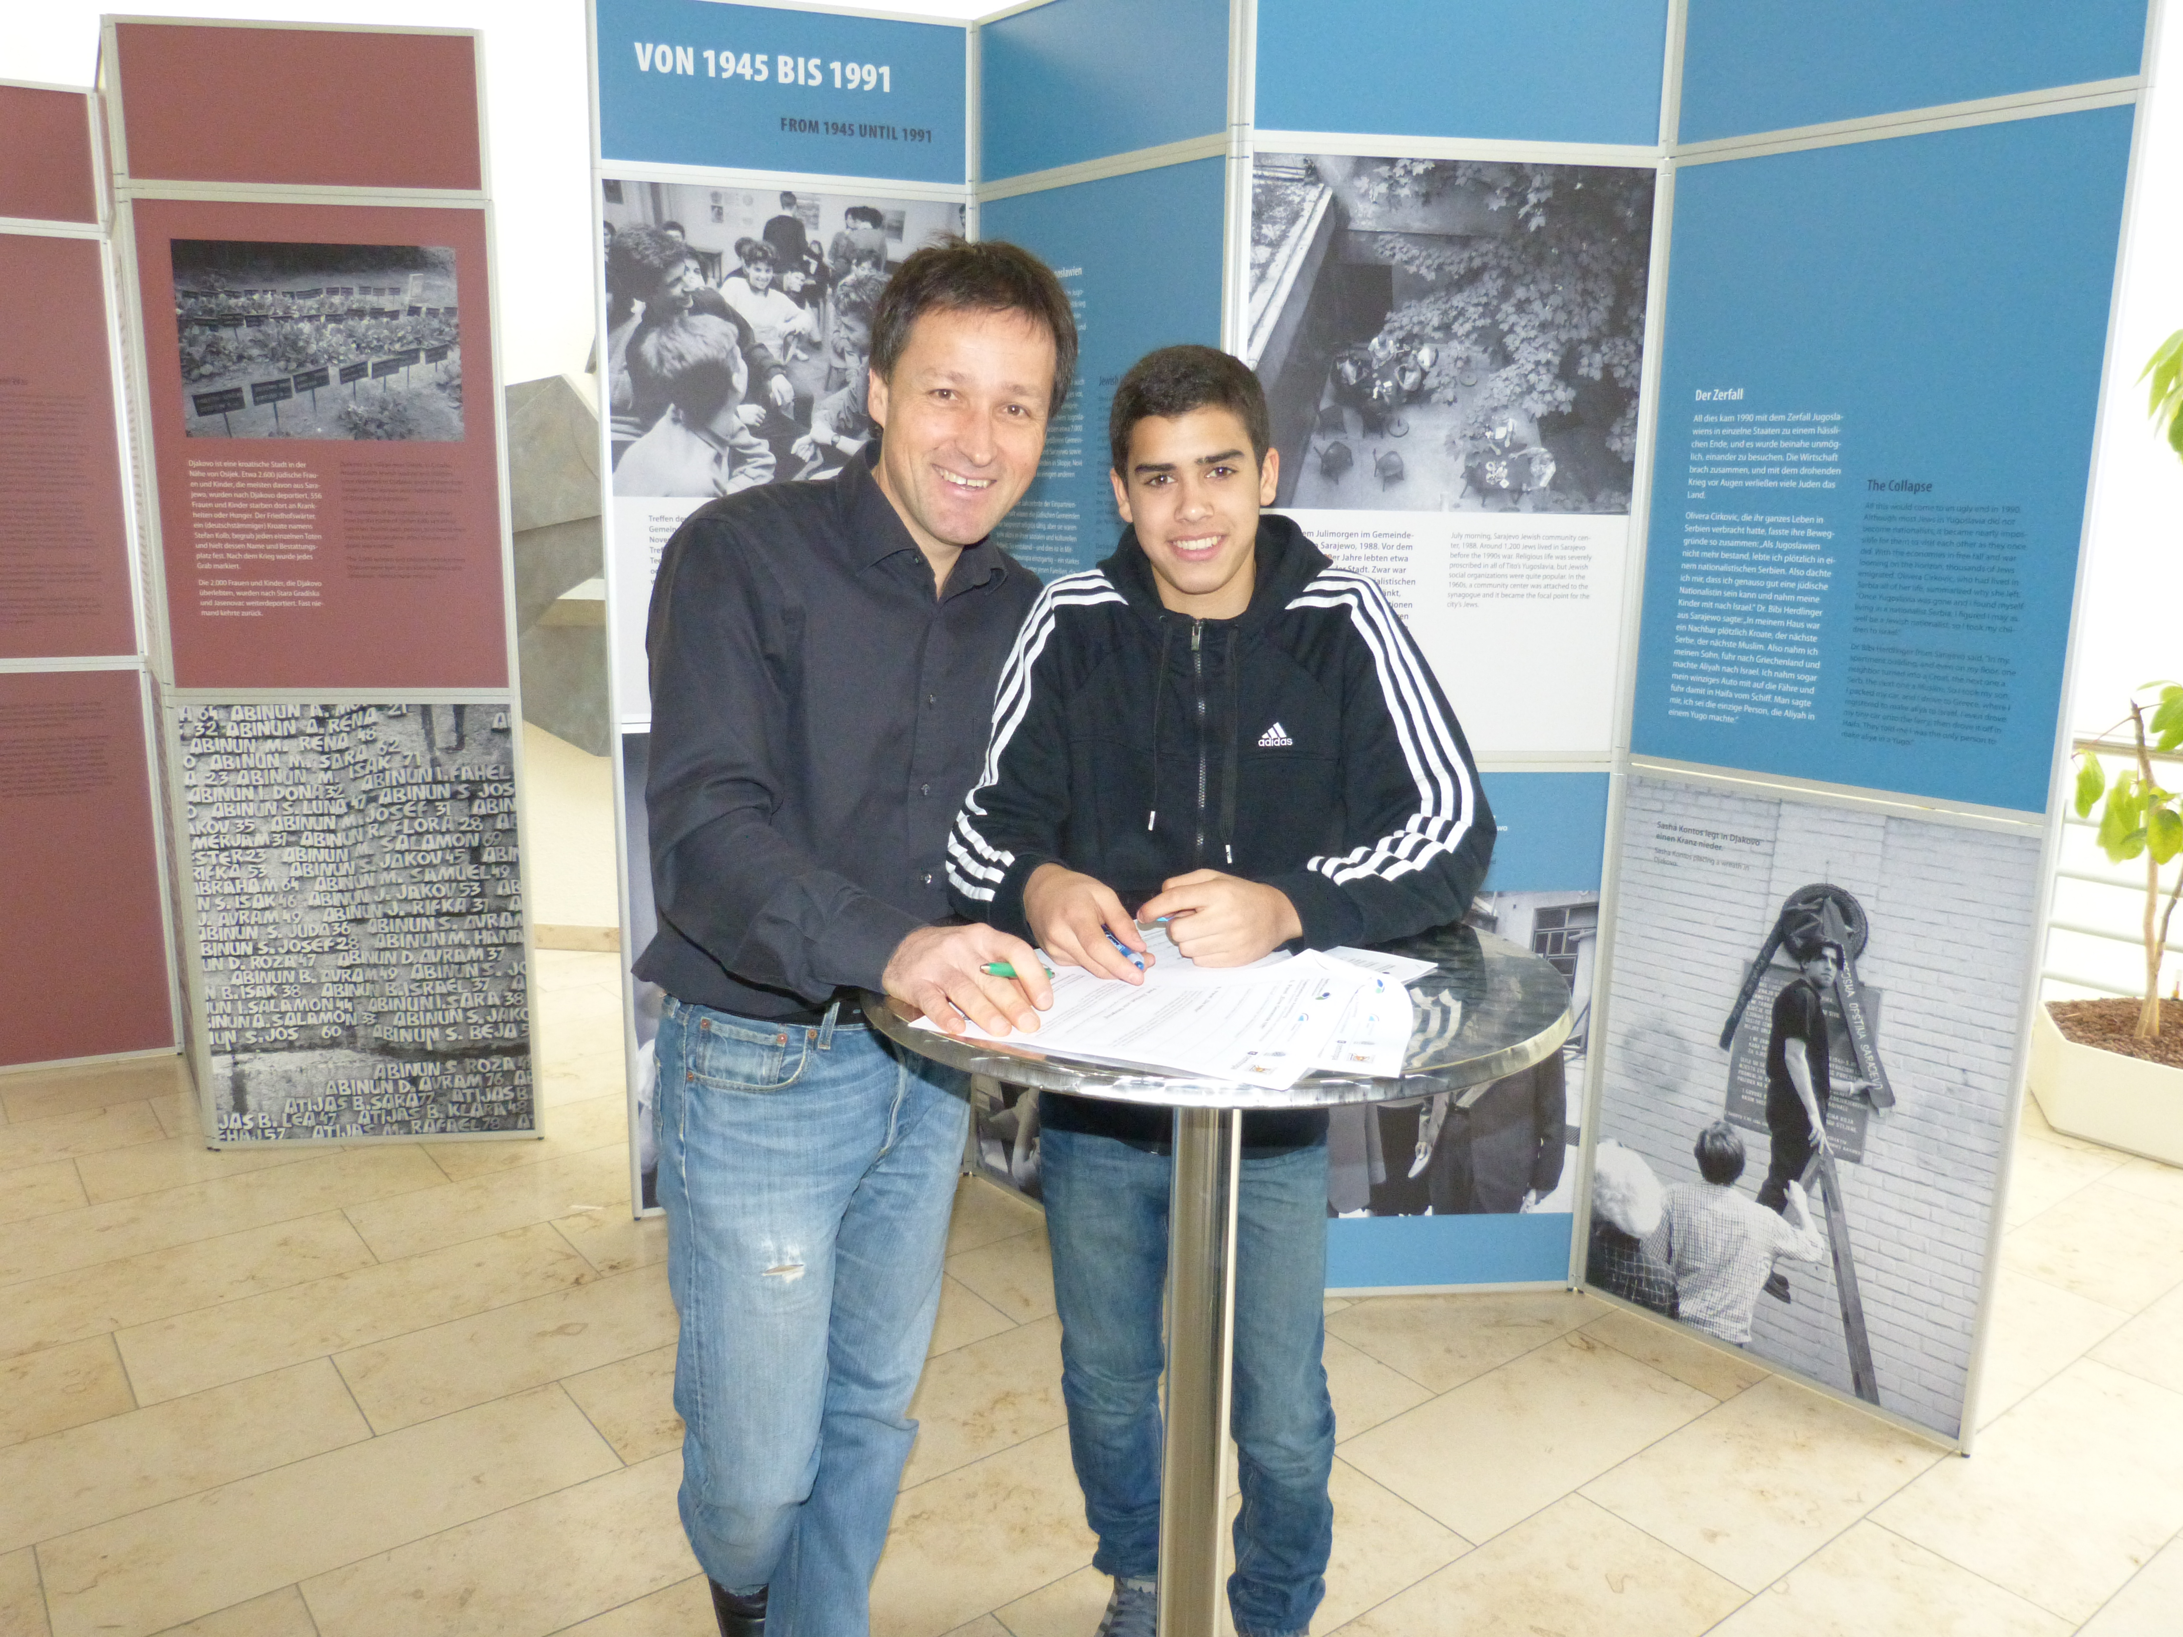
With Israeli soccer player Ilay Elmkies from U15 TSG 1899 Hoffenheim
Ilay just signed a three year contract ...

Slide 41
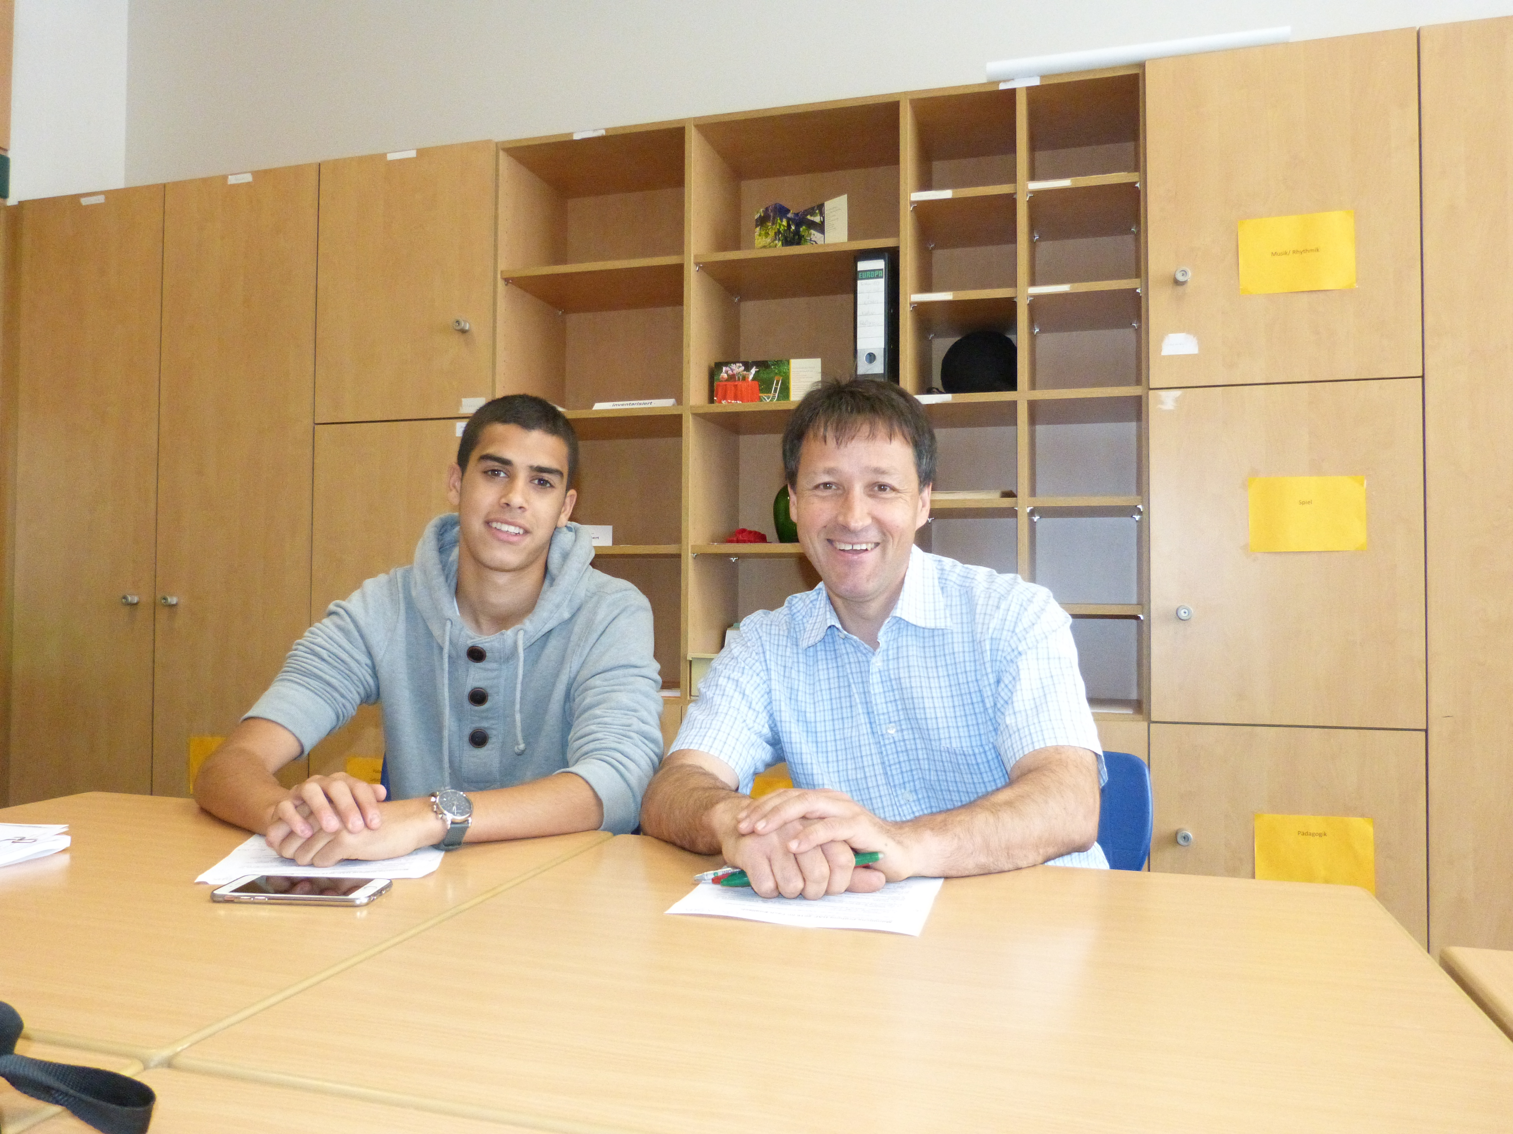
... and finally started to continue his school carrier at our school
in Sinsheim a few months later.

Slide 42
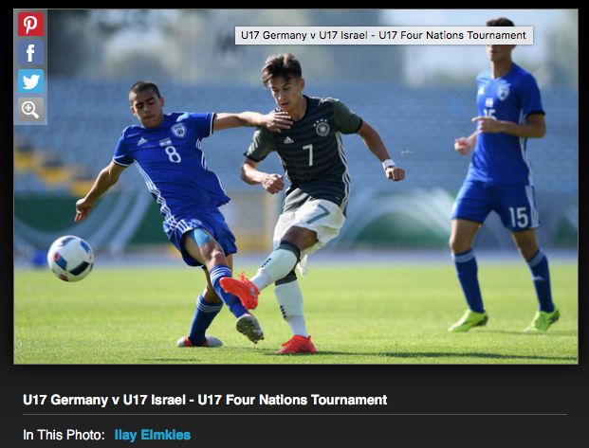

Slide 43
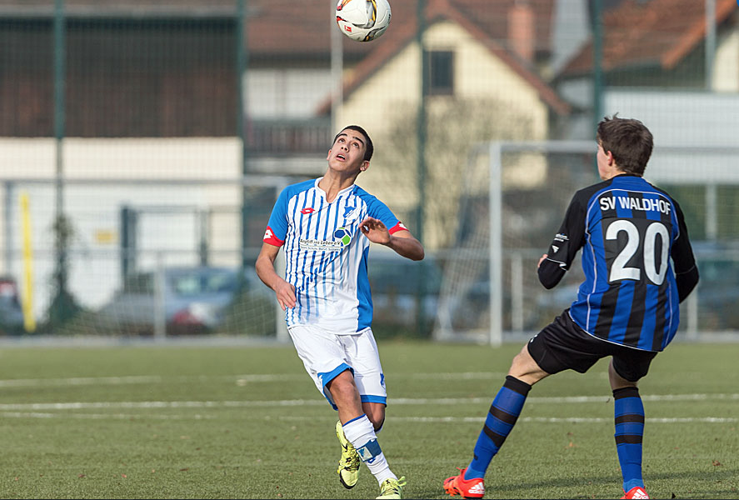
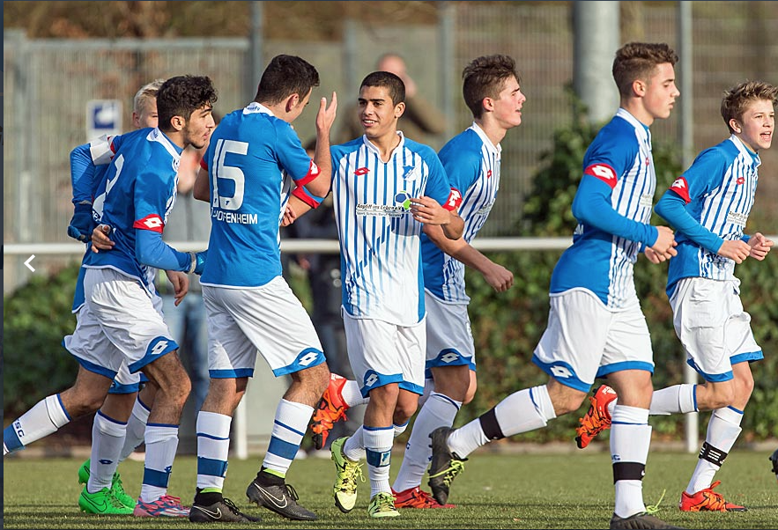

Slide 44
And finally:
The exhibition could trigger Follow-up projects !
e.g.
A new Centropa film: Dr. Menachem Mayer and Fred Raymes,
(Germany – Israel/USA)
Duration: approx. 25 min.
with the probable participation of Ilay Elmkies
Scheduled: August 2017 – June 2018

Slide 45
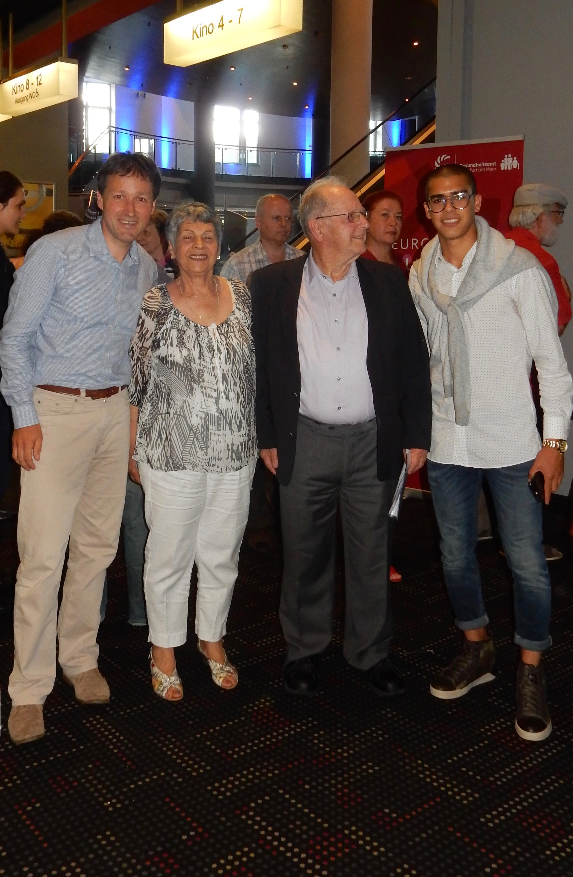
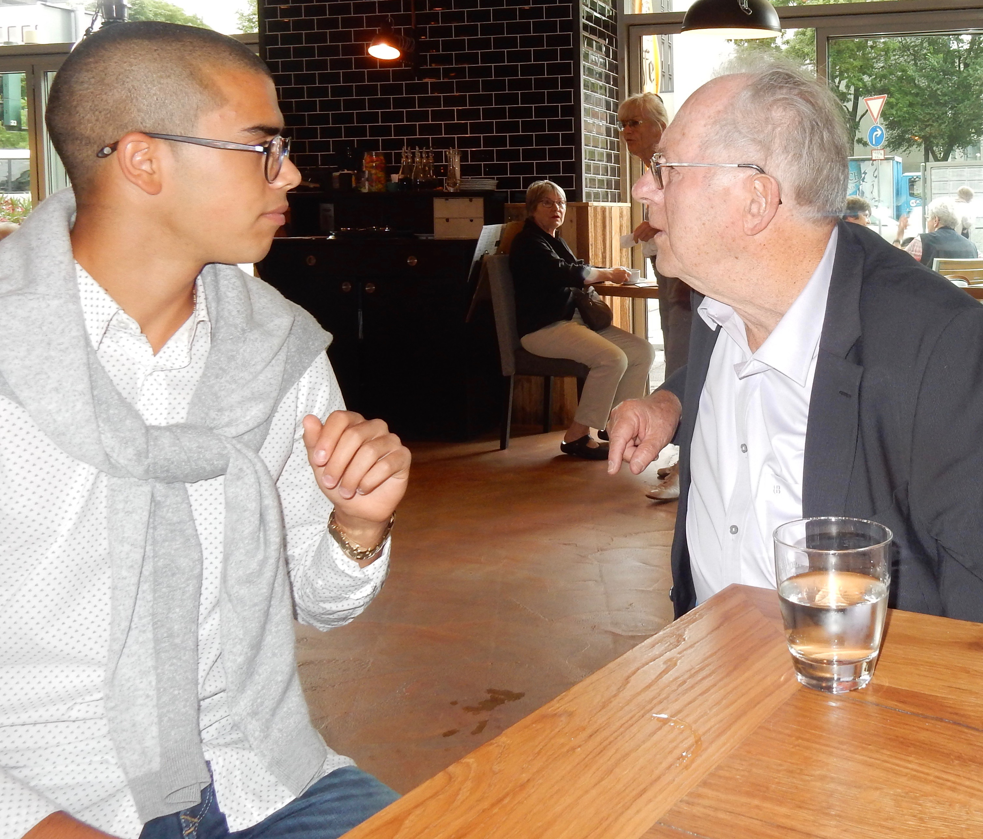
First encounter
of Ilay and Dr. Menachem
Mayer
Frankfurt, Germany
28. June 2017

Slide 46
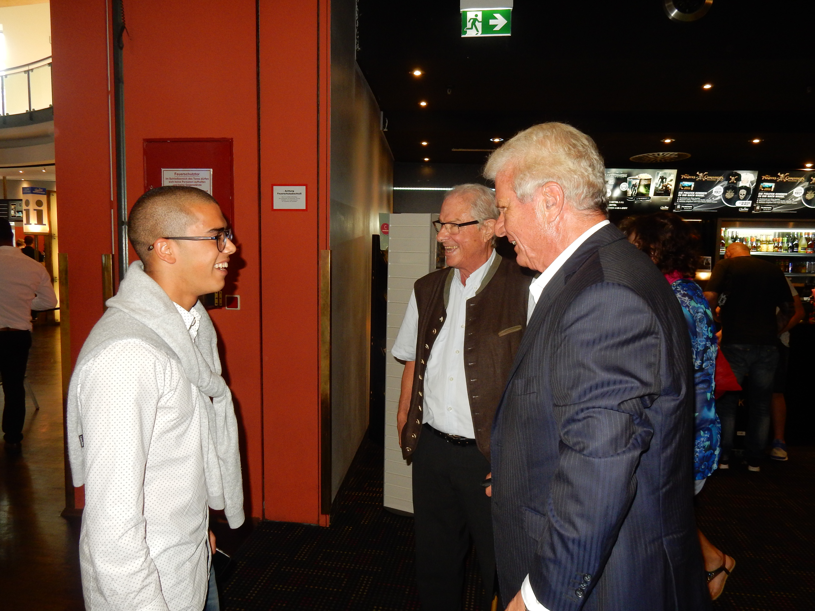
Ilay also met Dietmar Hopp, one of the founders of SAP,
owner of TSG 1899 Hoffenheim and presumable
sponsor of the new Centropa movie

