Slide 1

PROJECT
A Virtual Jewish Cookbook
What says “Jewish” more than food? In this project, Jewish students share traditional family recipes through projects where they talk to family members about favorite family recipes, research that recipe in cookbooks or online, make the recipe in class, and then upload their projects onto a common website so they can teach and learn from each other. We are only waiting for the technology that will allow them to share their cooking with one another across borders.

Slide 2
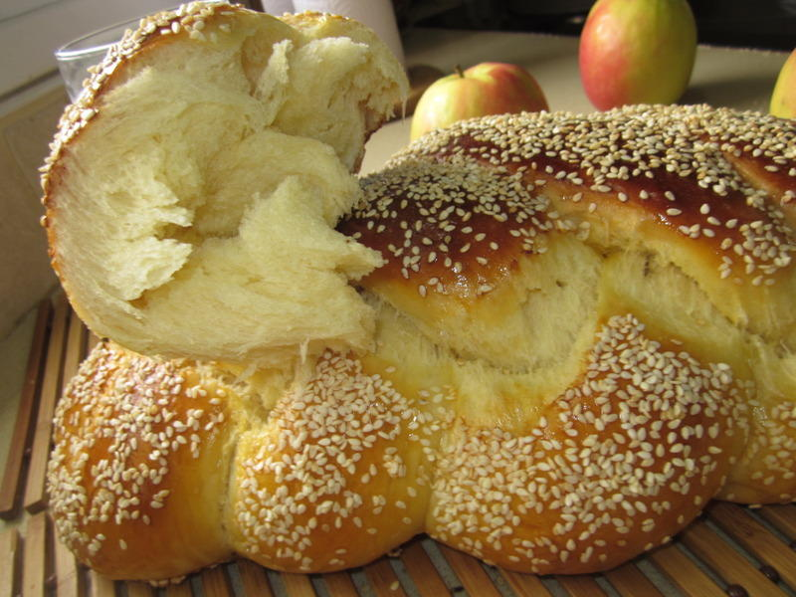

Objectives of the project
“Back to the Family”
Increasing students’ knowledge as for the history of Jewish culinary arts through the individual and team searching for information in the course of practice.
application of modern technologies, plus study of living history of the family, society
- Improving English.
Who is lazy, nothing to eat

Slide 3
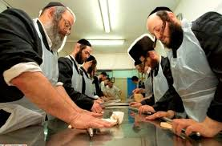
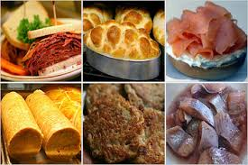
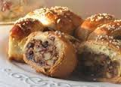
Goals “Study to study”
Developing awareness of the importance of teamwork, along with the individual looking up the material in order to obtain results in the research and the creative process.
Developing ability to assess the acquired knowledge.
Developing research skills
No need to put the whole world into one dumpling.

Slide 4
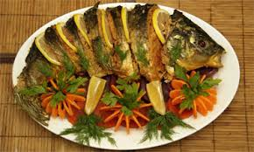


stages of work - start
1.Determining design, themes, titles (holidays, home/family traditions)
2.Defining "target audience" (the age of the students)
3.Determining the type of project - its design (research, creativity)
4.Determining the way to work (group work, individual)
5.Deciding the time period required for the design
Know that if you have to stare at someone else's challah, you can lose your own bread.

Slide 5


Stages of work - Preparatory
Selecting the theme of the project
Gathering the necessary material
Improving language skills.
Conducting advisory work
Bread in your trip, the burden is not heavy.

Slide 6
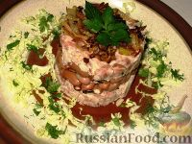
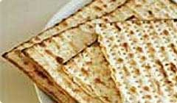
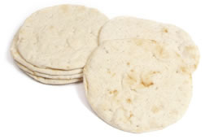

Stages of work - Independent
Students work independently on projects for a specified period of time.
Consultations, correction, discussion.
It is better to eat the chicken together, I and chicken.

Slide 7
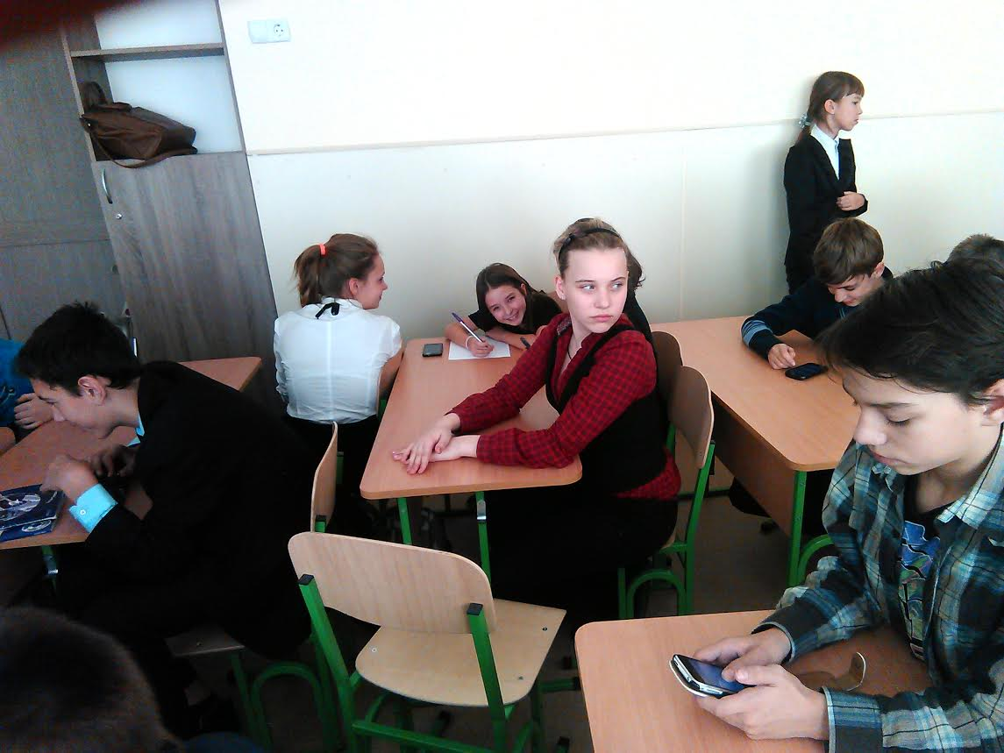
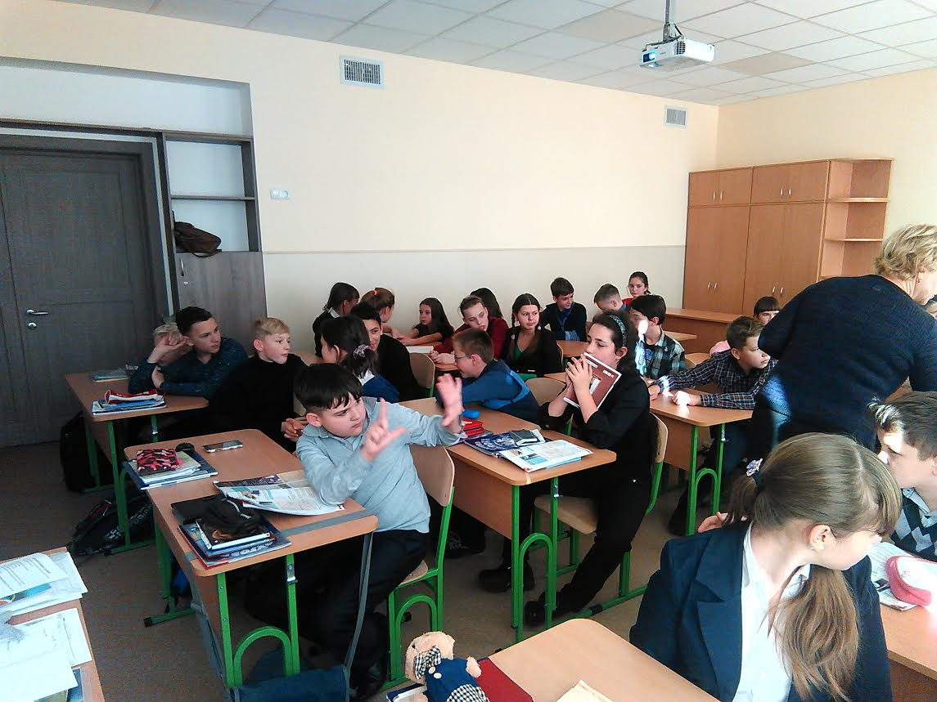
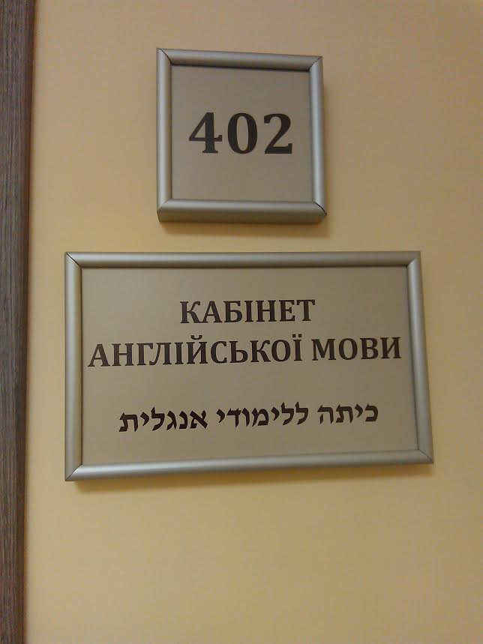

stages of work- final
1 Presentation of the project:
- the lesson is the final lesson on the topic
- within a week of English in school.
- participation in international student projects
Knowledge is not transmitted by inheritance.

Slide 8
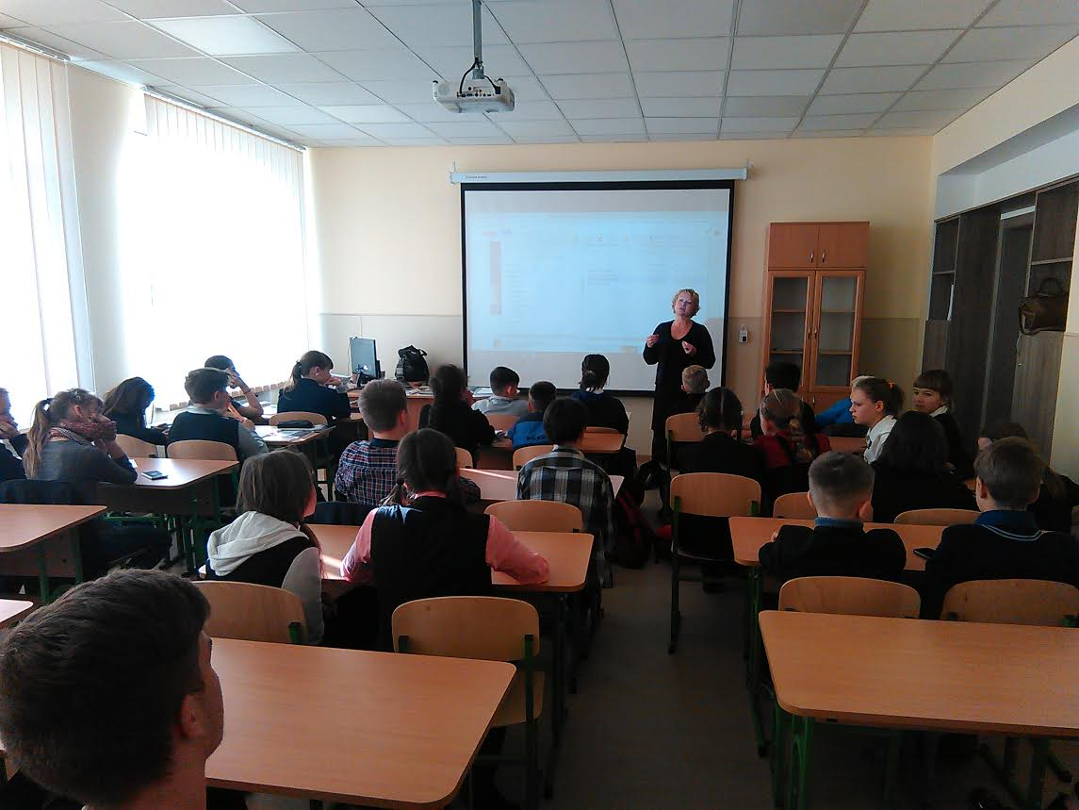
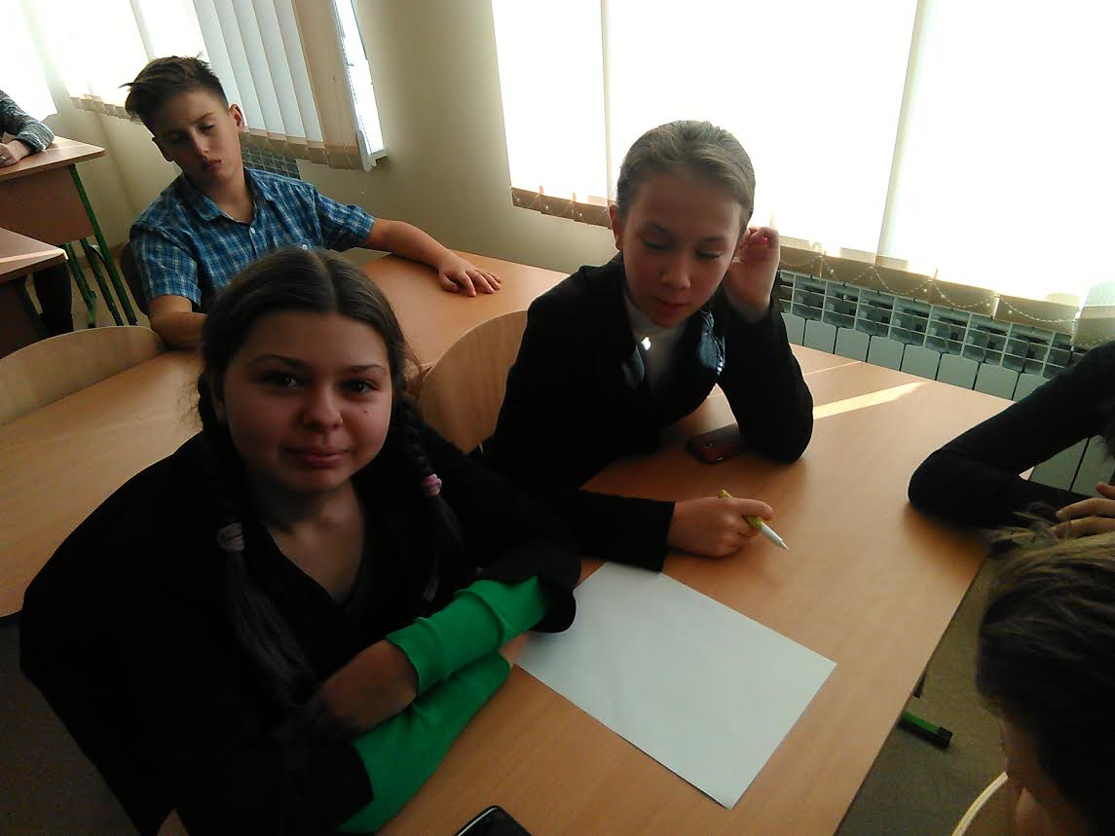
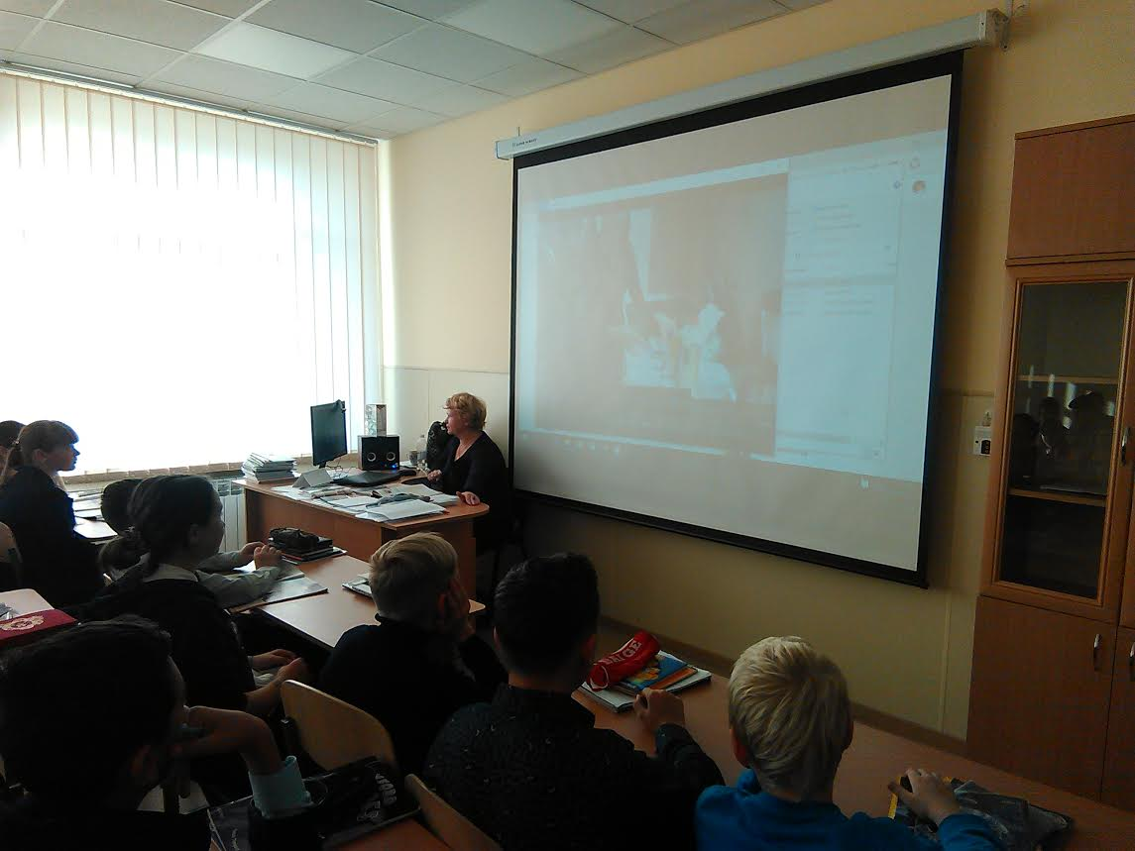
Stages of work - practical application of the project
1 The results of the project are ready for use in educational activities and presentations on international projects.
If we were the same, one of us would not be needed ...

Slide 9
cross-border interaction

Slide 10
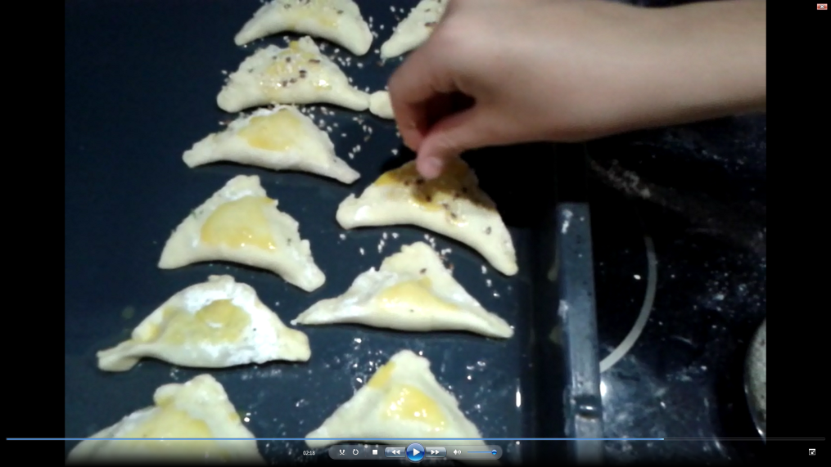
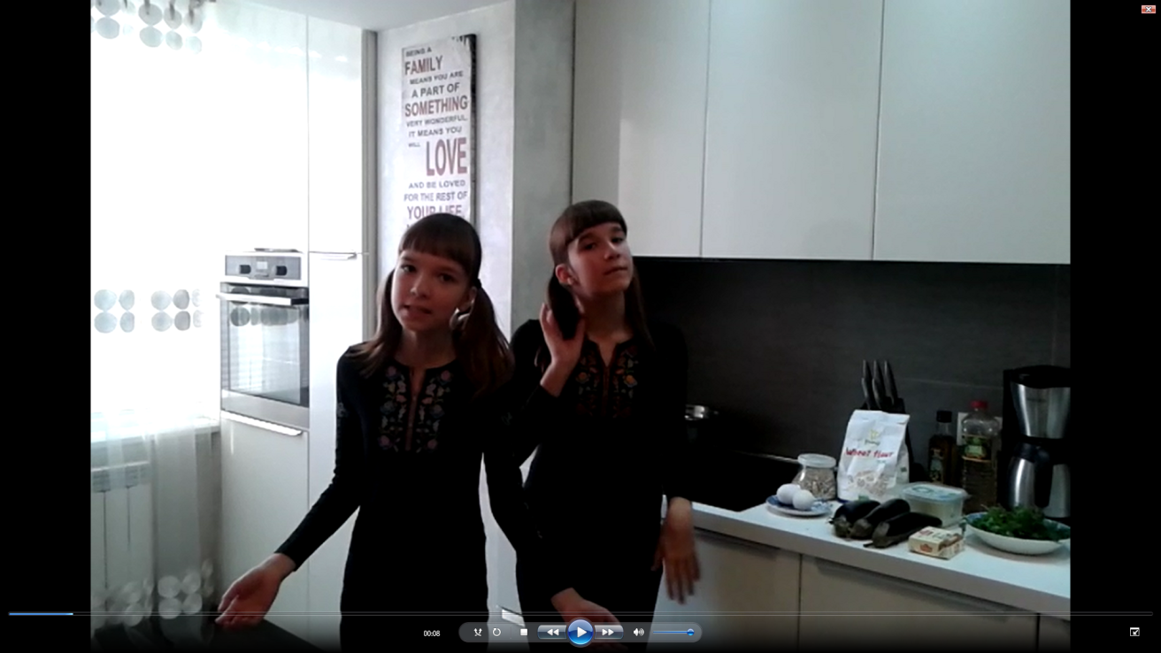
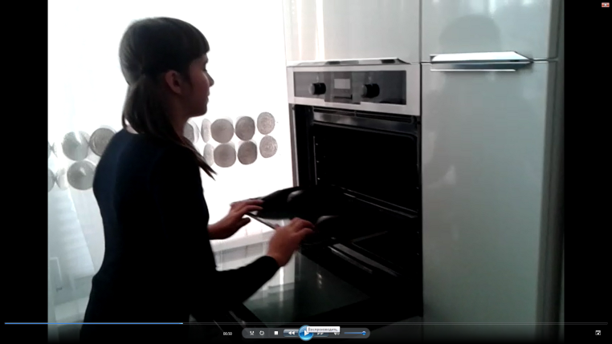
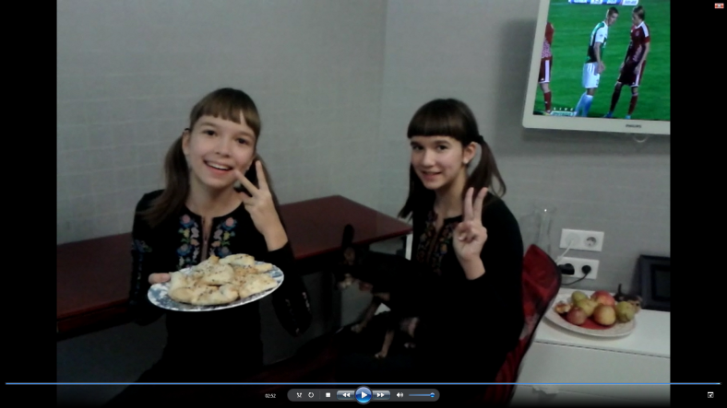
בתיאבון

Slide 11
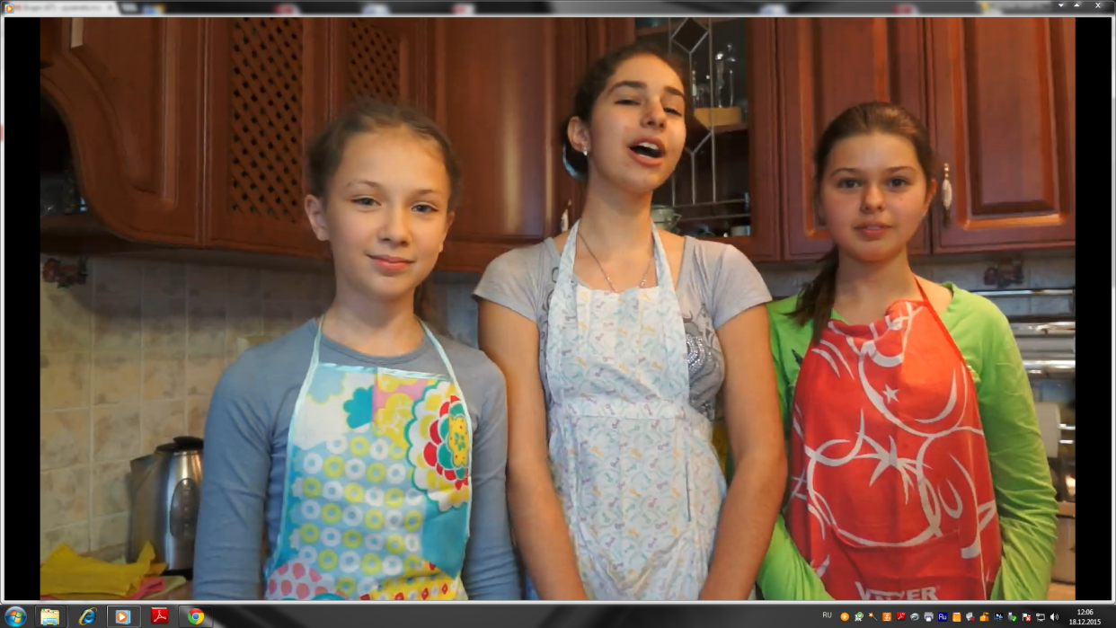
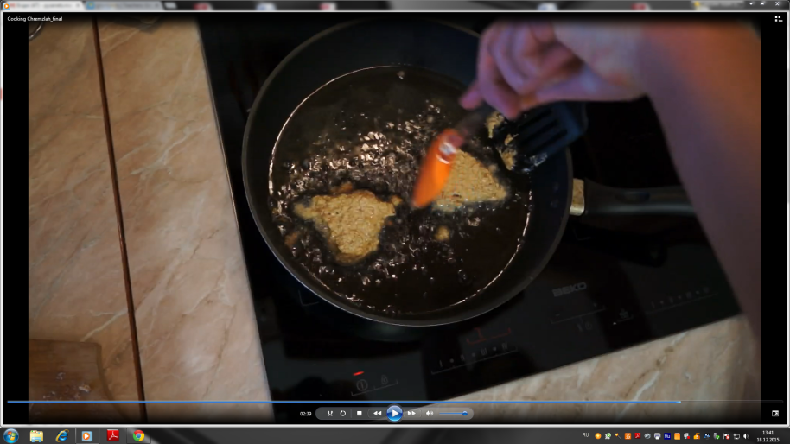
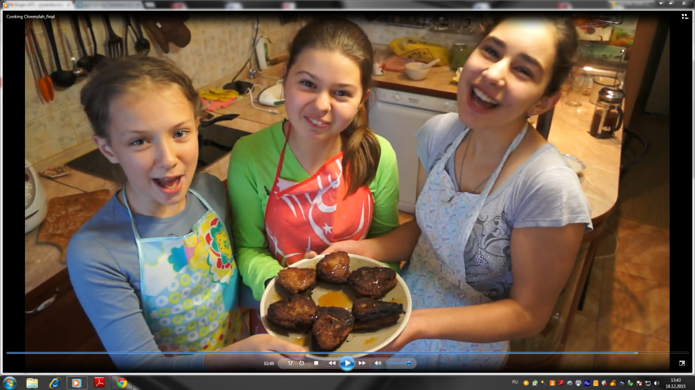
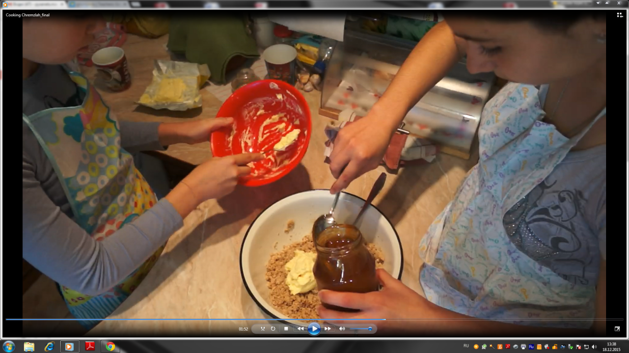
בתיאבון

Slide 12
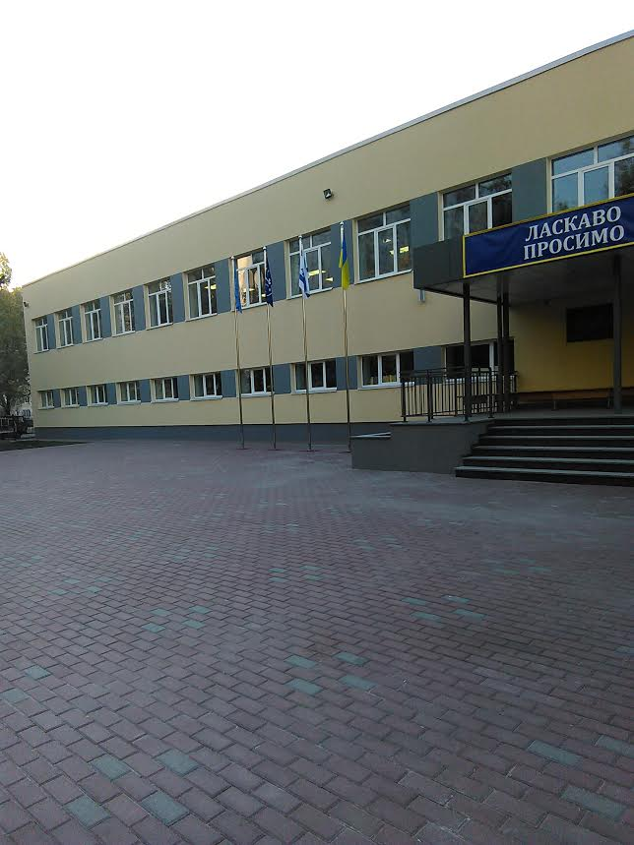
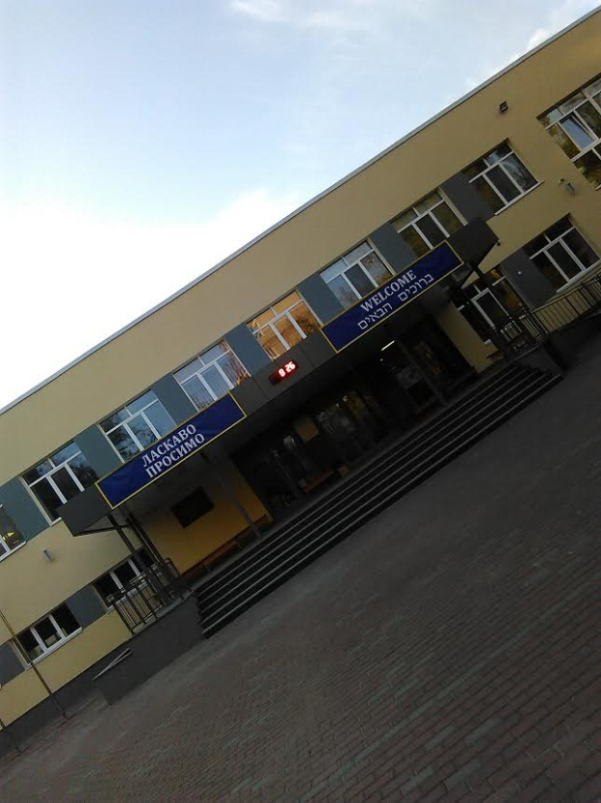
Thanks for your attention!

