Slide 1
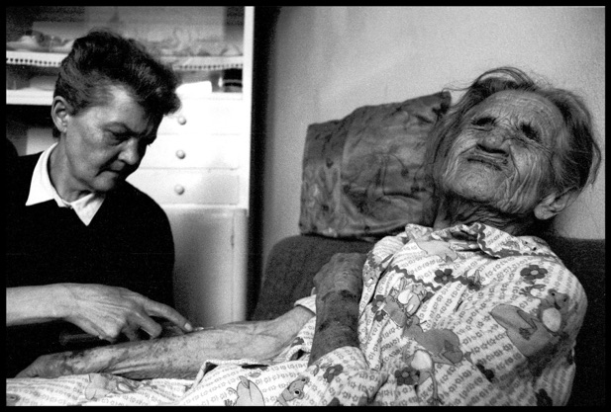

Slide 2
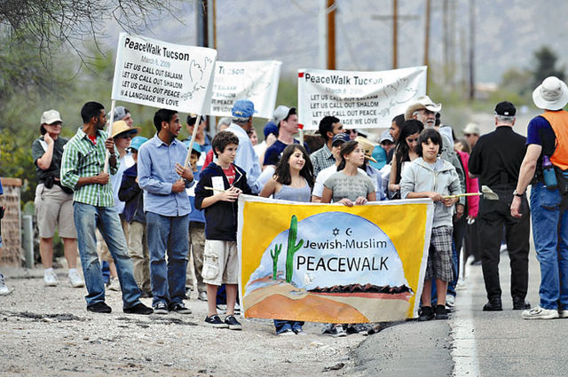

Slide 3
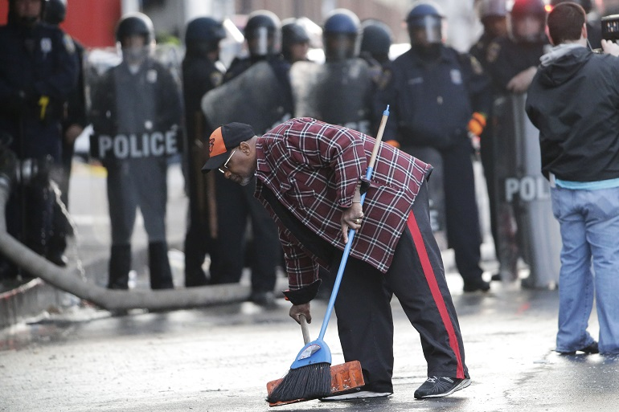

Slide 4
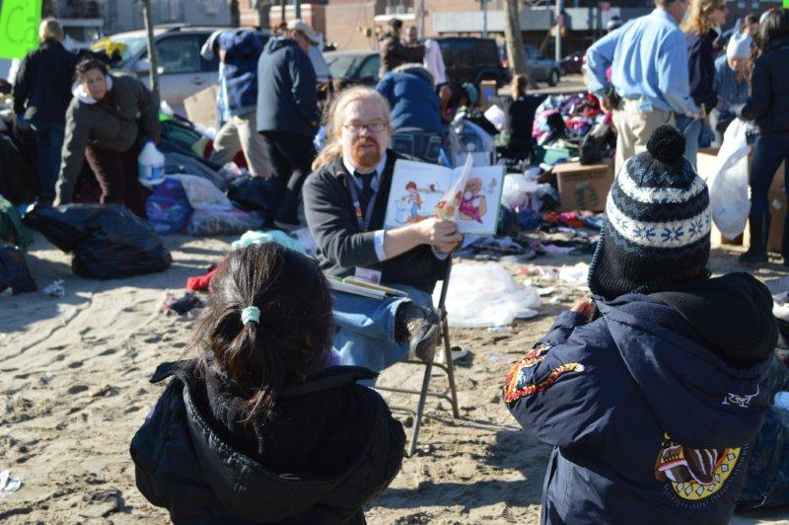

Slide 5
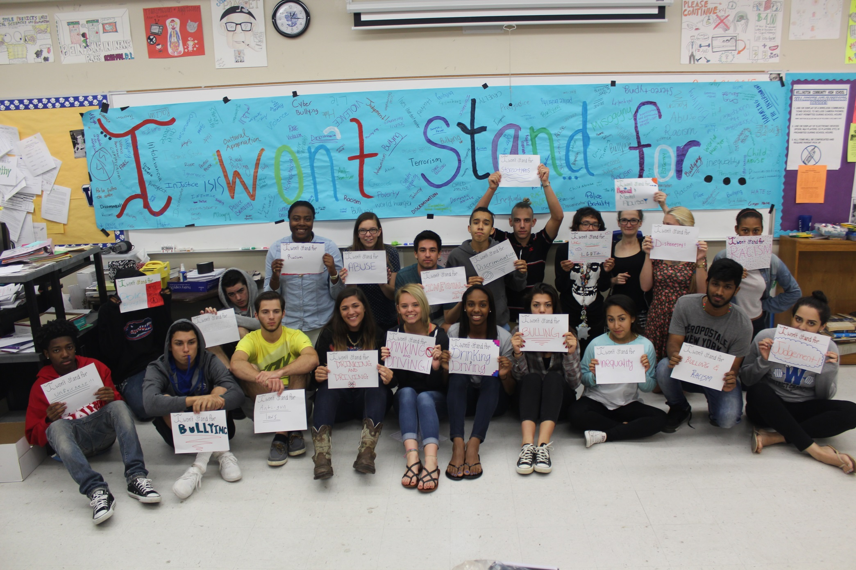

Slide 6
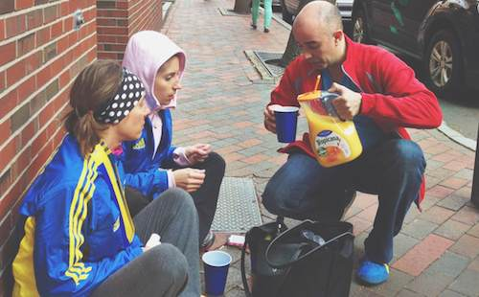

Slide 7
References
1 – Serotta, Edward. A Community Goes to Work. Digital image. Survival in Sarajevo. Centropa, n.d. Web. 22 Oct. 2015.rvival in Sarajevo
  http://www.centropa.org/upload/centropa-sarajevo/Centropa.org___Sarajevo/The_photographs.html
2 - Woolfolk, Daniel (Photographer). (2009, March 09). [digital image]. Retrieved from http://tucsoncitizen.com/morgue/2009/03/09/111724-250-attend-6th-annual-jewish-muslim-peace-walk/
  Jewish-Muslim peace walk
3 – Rourke, Matt (Photographer). (2015, May 28). A Baltimore resident cleans up during the protest Monday [digital image] . Retrieved from http://www.governing.com/topics/public-justice-safety/tns-baltimore-riots-gray.html
  Man cleaning up after Baltimore riots May 2015
4. Courtesy of Queens Borough Public Library . (2012, November 6). [digital image] . Retrieved from http://blog.imls.gov/?p=2171
  Queens library employee reading to children after Superstom Sandy 2012
5. Emmerth, Elizabeth (Photographer). 2015. (2015, April). I Won’t Stand For
  Students expressing what they refuse to tolerate as part of the “I Won’t Stand For” campaign
6. [Untitled image of man serving orange juice after Boston Marathon bombing]. (2014). Retrieved from:
http://www.runnersworld.com/boston-marathon/tragedy-inspired-acts-of-kindness

