Slide 1
Poverty In Education
By: Adaijha Kwot & Brittany Grant

Slide 2
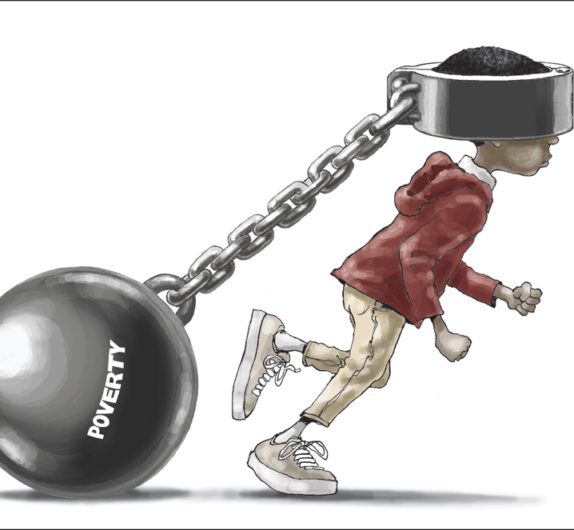
www.urbanchildinstitue.org
Children living in poverty have a higher number of absenteeism.
40% of children living in poverty are not prepared for schooling.

Slide 3
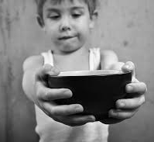
www.parenthood.com
South Carolina has a 27% poverty rate.

Slide 4
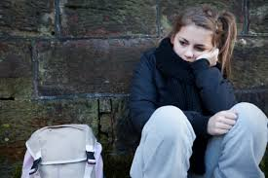
EDUCATION
South Carolina currently ranks 45th in the nation in child well being.
However, Students aged from 16- 24 years old who come from low income families are seven times more likely to drop out than those families with higher incomes.

Slide 5
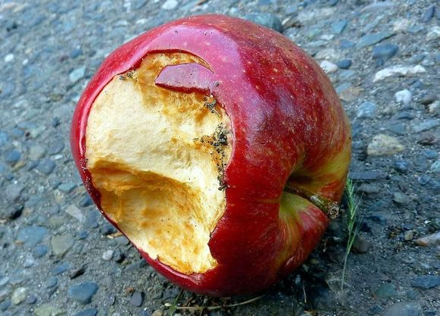
Poverty is something that most people overlook because it is so common.
According to the U.S. Census Bureau, the “Poverty Line” is a family of 4 that earns less than $23, 021 annually.
In 2011, nearly 46.2 million Americans were living in poverty.

Slide 6
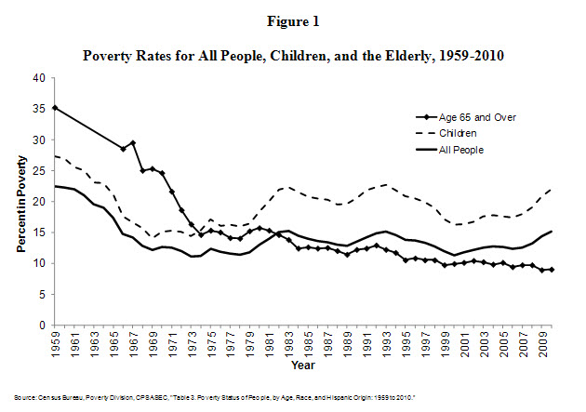
Although the economy of the United States is showing signs of improvement, poverty remains a serious issue in many states, particularly in the South.

Slide 7
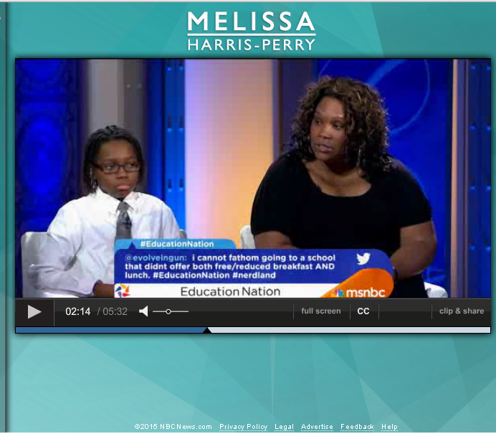

Slide 8
So What?
Poverty can greatly affect a child’s education because it can cause them to lose focus in class.
Poverty can also cause students to be absent from school because they have to work part-time, and in some cases, full-time jobs to support themselves and their family.
Poverty and Education is seen as an urgent problem in some states, including South Carolina.

Slide 9

What is being done?
Lowcountry Food Bank
  BackPack Buddies
  The BackPack Buddies program attacks the issue of weekend hunger for children in our community by sending children home with a backpack full of food.
Children’s Trust of South Carolina
  Organization that specializes in assisting children with and social, mental and economic problems.

Slide 10
Life Lesson
The takeaway from the video and the connection with poverty in education is that sometimes in life people are dealt cards that at the time they may feel like they cannot handle but in reality with the will power and motivation those cards can be handle . Everything happens for a reason. Poverty is something that no one would want or asked for but is something that happens due to various reasons some that cant be explained. The survival of Sarajevo had one thing that I saw connected with poverty in education that even though at the time the people of the city could not see the light at the end of the tunnel the people still did everything in their power to make a way and to make nothing into something. To have a community of people come to gather of different colors and religions to help the people as a whole is what everything is about. People are coming together to make sure that no child has to suffer in poverty and deal with effects that come with it. People in schools churches, neighborhoods, and other communities come together to make shelters, provide food, and other necessities that people in this situation would need that they don’t have access to or having trouble getting access to. The same just as Survival in Sarajevo they made a power teams of doctors, nurses, teacher, pharmacist, book keepers, and etc. They all came together to make sure the families their had things that did not have access to . People like Milton Wolf he fought with all his will power to make sure that he got one special person out of the town to ensure that she was safe that’s what is all about.. The overall message is that when there is an issue at hand that sometimes the best help and thing that could happen is a community of people coming together to fix an issue without looking for something in return. There is light at the end of a very dark tunnel. Togetherness is the best love that can be provided.

Slide 11
Credits
www.childfund.org
www.urbanchildinstitute.org
www.parenthood.com
www.secureteen.com
www.efareport.worldpress.com
www.isescoastalsc.com
www.brookings.edu
www.dosomething.org
www.thestate.com
www.postandcourier.com
www.nbcnews.com

