Slide 1
Accepting the Exceptional
Jasmine Ambrose, Kayla Glover,
Porsha Thompson,Stacy Graham

Slide 2
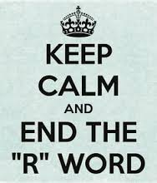

Problem: Labeling Special needs individuals
Many individuals across the nation still use the R word(retarded) to describe individuals with intellectual disabilities.To retard something is the act of delaying it from its accomplishment(dictionary.reference.com).This is exactly what we are doing as a society, delaying these individuals from their potential by separating them based on their limitations. Studies found that children with disabilities were two to three times more likely to be victims of bullying than their non-disabled peers.(A National Study of Youth Attitudes toward the Inclusion of Students with Intellectual Disabilities.)

Slide 3
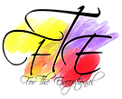

How community member are trying to solve problem
In the community of North Charleston we have organized programs such as For The Exceptional. For The Exceptional is a program that strives to provide interactive social outlets to children and young adults with disabilities, while providing their parents and our communities with information, support, and assistance. Another organization in many states in america as well as South Carolina is Project Unify. Project Unify is an organization where students and educators work together to improve school climate, and make their communities more accepting for all(www.specialolympics.org/projectunify.aspx).

Slide 4
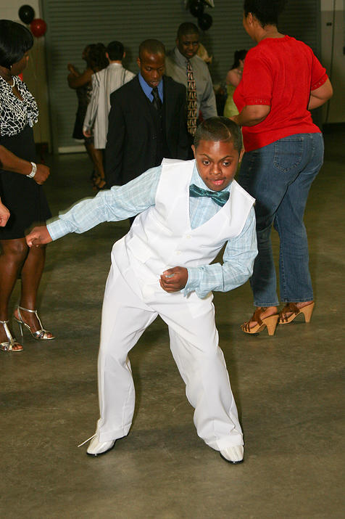
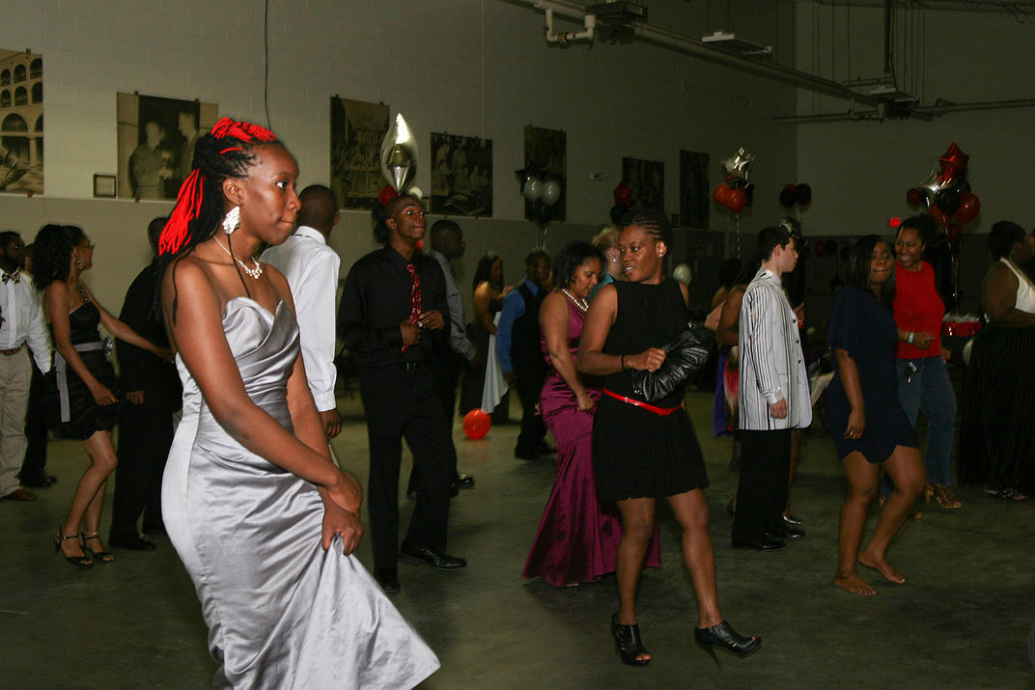
How they Help
Both For The Exceptional and Project Unify unite the disabled and non-disabled through social interaction. For The Exceptional sponsors events like ‘A Very Special Prom’ which allows the exceptional individuals to have a prom to dance and enjoy themselves.They also have ‘Exceptional Saturdays’ which allows these children to do arts and crafts and fun games.

Slide 5

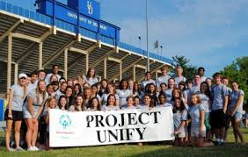
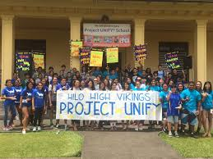
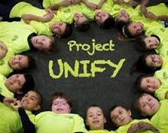
Project Unify sponsors the Special Olympics which provides year-round sports training and athletic competition in a variety of Olympic-type sports for children and adults with intellectual disabilities. This gives them continuing opportunities to develop physical fitness, demonstrate courage, experience joy and participate in a sharing of gifts, skills and friendship with their families, other Special Olympics athletes and the community
(http://www.specialolympics.org/projectunify.aspx).

Slide 6
Right here in North Charleston
At North Charleston High School we have the S.A.F.E. (students advocating for equality) Club for our exceptional children that students attend to make up ideas for awareness and spend time with some of the students. We attend field trips with them such as Bowling and the Special Olympics. We also held an End The R-Word march with posters and chants.

Slide 7
A little like Survival in Sarajevo
Just like Milton Wolf in La Bonevolencia, the founders of project unify believe that we can create a better world by fostering the acceptance and inclusion of all people.Various groups work together to pass on the message to “Disable the label” and “End the R-word”. La Bonevolencia was formed by a few people and word got out of what they were doing and people joined in to help their efforts. Since 1968 project unify has added 2,100 Schools, 42 States, 21,000 Special Olympic Athletes, 8,000 School Age Partners, 11,000 Youth Leaders and 500,000 Young People.

