Slide 1
El Otro Camino
(1492)

Slide 2


Slide 3
The same week that Columbus sailed west in 1492, the last Jews of Spain were being expelled. Even though they had lived there for a thousand years, religious intolerance threw them out. Where did they go? Who took them in?
Most of the Spanish Jews, or the Sephardim, settled in lands ruled by the Ottoman sultans. Around 180,000 lived in the Balkans, and they lived alongside their Christian and Muslim neighbors.

Slide 4
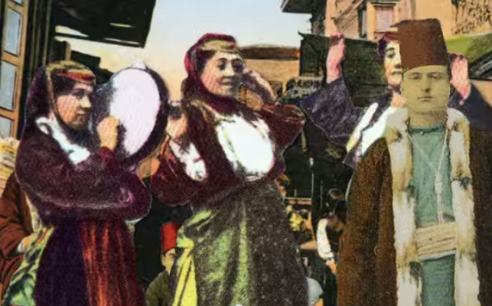
Until 1941 and 1942, when the Germans invaded the region and, with some local collaborators, murdered most of them. But then came the 500th anniversary of the expulsion in 1992, and the very last of the Sephardic Jews in the embattled, war torn city of Sarajevo said: We remember what intolerance did to us. We know what hate does. It is not our way. We travel another path.

Slide 5


Slide 6




Slide 7
Made by:
        Remembering Holocaust club
        Slavejko Arsov Primary School – Shtip
        Mentor: Kiro Jordanov

