Slide 1
THREE PROMISES

Slide 2
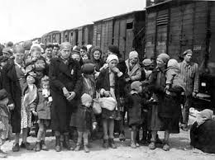
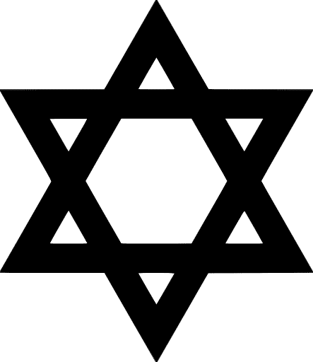
Jews
Jews are an ancient people, the creator of the first monotheistic religion - Judaism. Their countrain historic Palestine. The history of the Jews, is known from texts in the Bible, which is confirmed by archaeological findings in the current state of Israel.
Once Romans choke Jewish uprising in 66 AD and destroyed Solomon's temple, Jews displace around the world. The first Jews in the Balkan Peninsula called Romanjoti, because they came during the Roman Empire. In the Middle Ages in the Balkans arrive Ashkenazim - Eastern European Jews who speak German. In 1492 the territory of the Ottoman Empire settle Sephardi, expelled from Spain.

Slide 3
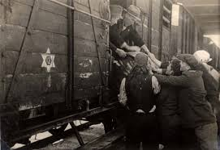
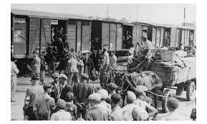
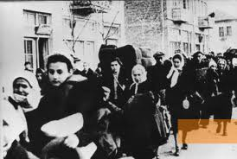
In World War II
On March 18, 1942, a Nazi gas van pulled up in front of the Jewish hospital of Belgrade, and for the first time in Serbia was used on Jewish citizens. This van and others that followed killed everyone within the hospital — patients, nurses, and doctors, all of whom were Jews. The Nazis invaded Yugoslavia in April 1941 and immediately fired all Jewish health care workers. Since it was forbidden for them to practice in the public health care facilities, in May 1941 a Jewish hospital was opened in the building of the Jewish Women’s Society.

Slide 4
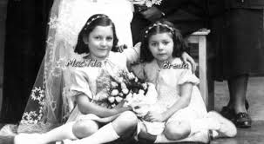
The story of the sisters Matilda and Breda Kalef
The story is narrated by Matilda and Breda Kalef, sisters who lost their father and grandmother in that hospital seven decades ago. The vans were then used over the next few weeks to asphyxiate about 5,000 Serbian Jewish women and children. More than 90 percent of Serbia’s Jewish community was killed by the Nazis.
Matilda and Breda Kalef were just young girls, sent into hiding on falsified papers, when their handicapped father, Avram Kalef, and his mother, Matilda, were sent to the Jewish hospital in Belgrade in March 1942. With their mother, the girls snuck into the hospital to see their father and grandmother.

Slide 5
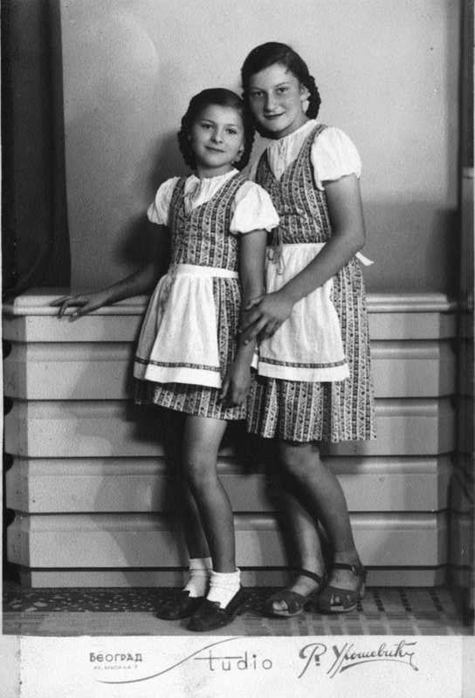
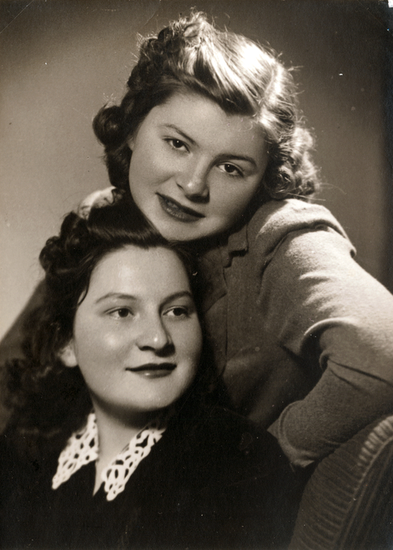
Matilda
and
Breda
Kalef

Slide 6
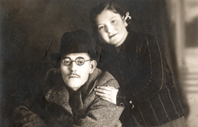
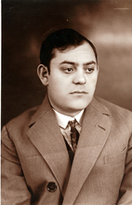
Matilda and Breda never saw her father and grandmother
“My father’s last words were: ‘Dona, protect my children. Take care of my children,’” Matilda Kalef recalled in a 2005 interview. “This was my guiding principle through life. She fought so hard during the war to somehow keep us well, feed and save us.”
The next day, the girls and their mother watched through curtains of a friend’s home across the street as the gas vans began to pull up to the hospital and patients and staff were placed inside. The Kalefs never saw their father or grandmother again.

Slide 7
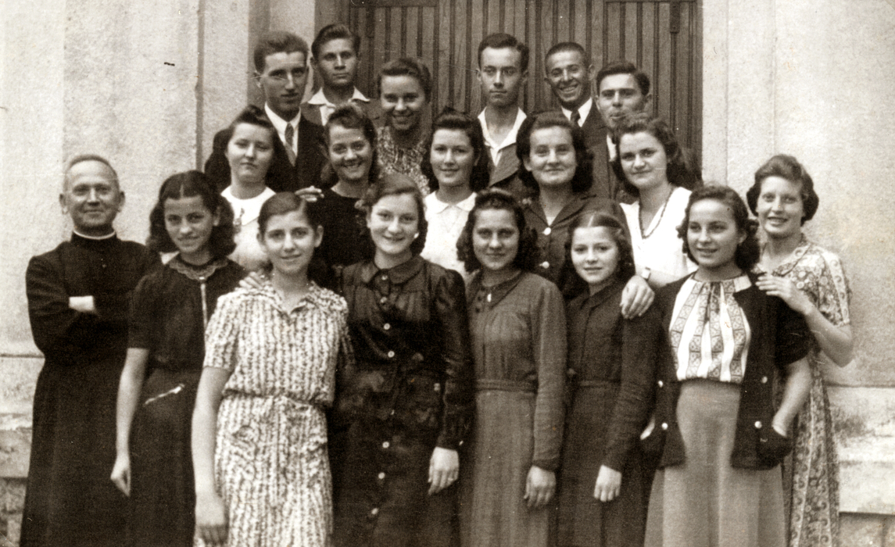
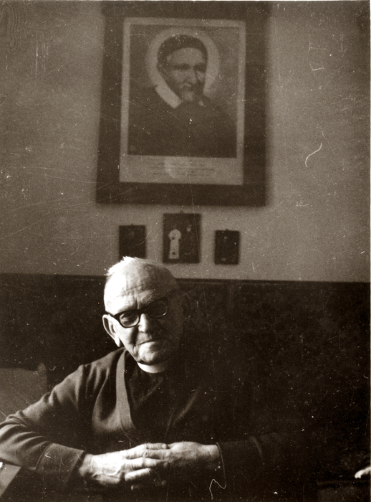
The girls and her mother went to priest Andrej Tumpej
The girls and their mother lived for three months hidden in a Catholic monastery by Slovene priest Father Andrej Tumpej in the town Banovo Brdo. They then moved to an attic space where they spent the remainder of the war years.
After the war Breda became one of Yugoslavia’s most famous opera singers and Matilda a dental technician. Both married and had families, denying the Nazis their Final Solution. The sisters both receive Claims Conference pension payments from the Central and Eastern European Fund.

Slide 8
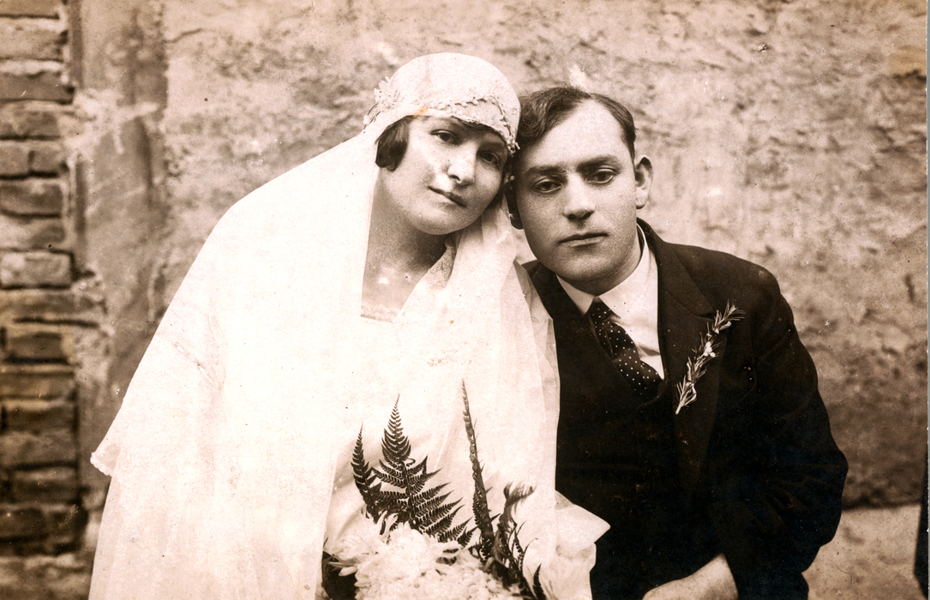
Matilda`s mum and dad
Antonija Ograjensek
Avram Kalef

Slide 9
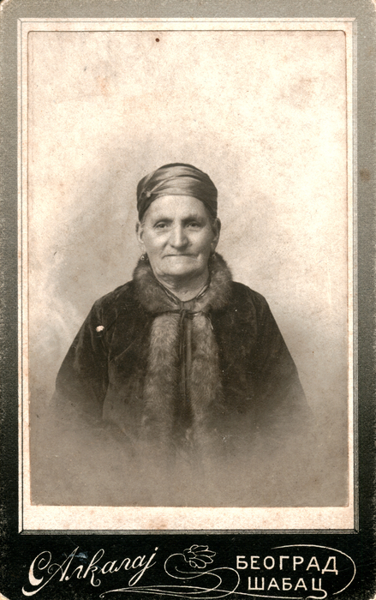
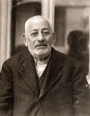
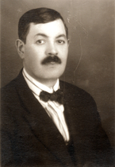
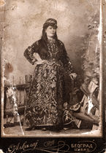
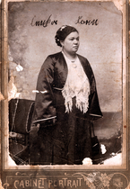
Rahela Kalef
Avram Kalef
Jakov Kalef
Matilda Kalef
Lenka Kalef

Slide 10
Avram and Vukica Kalef
Avram and Vukica started their family first.

Slide 11
Jakov and Lenka Kalef
Here is Jakov Kalef with Lenka Almazino – Kalef. They had two sons: David and Mile

Slide 12
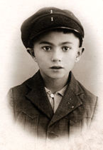
Jakov and Lenka Kalef`s sons
Mile Kalef
David Kalef

Slide 13
Lenka Koen and Josip Koen
Lenka Kalef, Rahela`s daughter, married Josip Koen. They had four children. Three sons and one daughter.

Slide 14
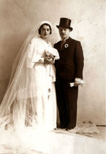
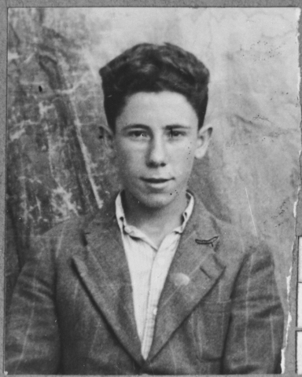
Lenka Koen and Josip`s son Isak Koen
Isak Koen and Regina Koen
Isak and Regina`s son
Isak Koen

Slide 15
Lenka and Josip`s daughter Rahela
Lenka and Josip Koen`s daughter Rahela Elica – Koen married Aunt Elica.

Slide 16
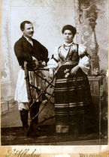
Matilda and Nisim Kalef
Rahela`s doughter, Matilda married Nisim. They had three sons. From them survived only Avram. Matilda continues lived with her son.

Slide 17
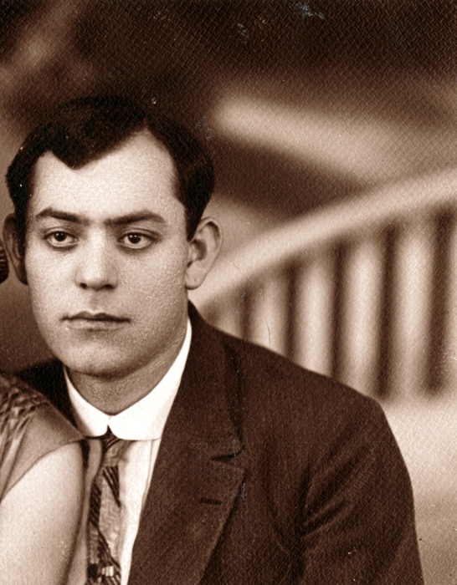
Avram Kalef

Slide 18
Avram and Dona kalef
Antonija Ograjensek married Avram Kalef.Antonija had decided to convert to Judaism and she changed her name to Dona Bat Kalef.

Slide 19
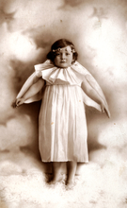
Matilda Kalef
Dona`s doughter Matilda Kalef

Slide 20
Breda Kalef
Dona Kalef`s doughter Breda Kalef.

Slide 21
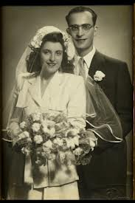
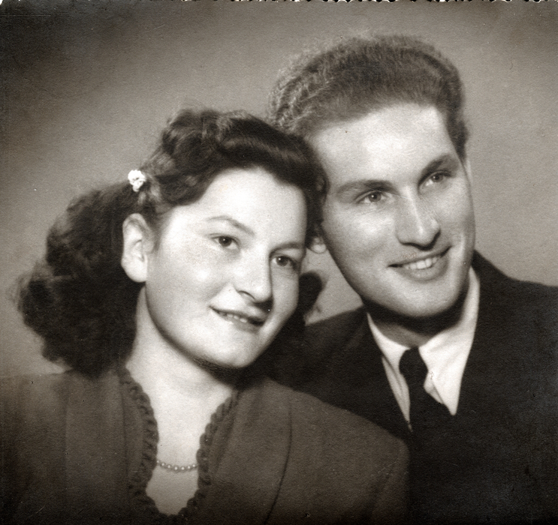
Matilda and Onton Kalef
Dona`s doughter Matilda married Anton in Bitola.

Slide 22
Remembering Holocaust club
Primary School “Slavejko Arsov” – Shtip
Mentor: Kiro Jordanov

