Slide 1

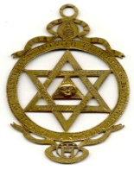
PROJECT WORK
STUDENT EXHIBITION
My town’s Jewish history – digital contents, modern technology and teaching
by:
Petar Pop Arsov Primary School
Skopje, Macedonia

Slide 2
PROJECT WORK
STUDENT EXHIBITION
Who?
Thirty 7th and 8th grade students (aged 13 -14)
When?
September- February 2014

Slide 3
PROJECT WORK
STUDENT EXHIBITION
How?
Extracurricular activities for talented students
Integrated teaching of: history, English language, ethics of religions, civic education, literature, creative writing, art

Slide 4
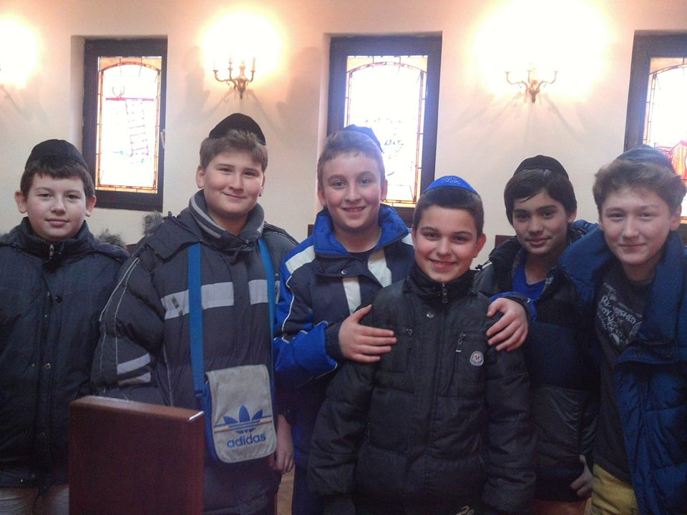
PROJECT WORK
STUDENT EXHIBITION
Program of activities
Do research (textbooks,
internet, documents)
Use CENTROPA database
(watch films, read bios and interviews)
Visit Holocaust Memorial Center of the Jews from Macedonia

Slide 5
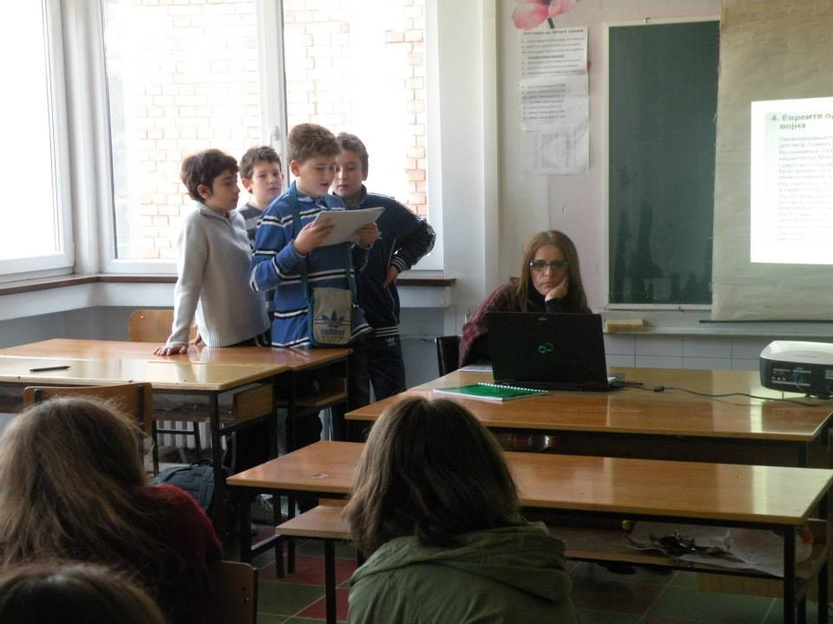
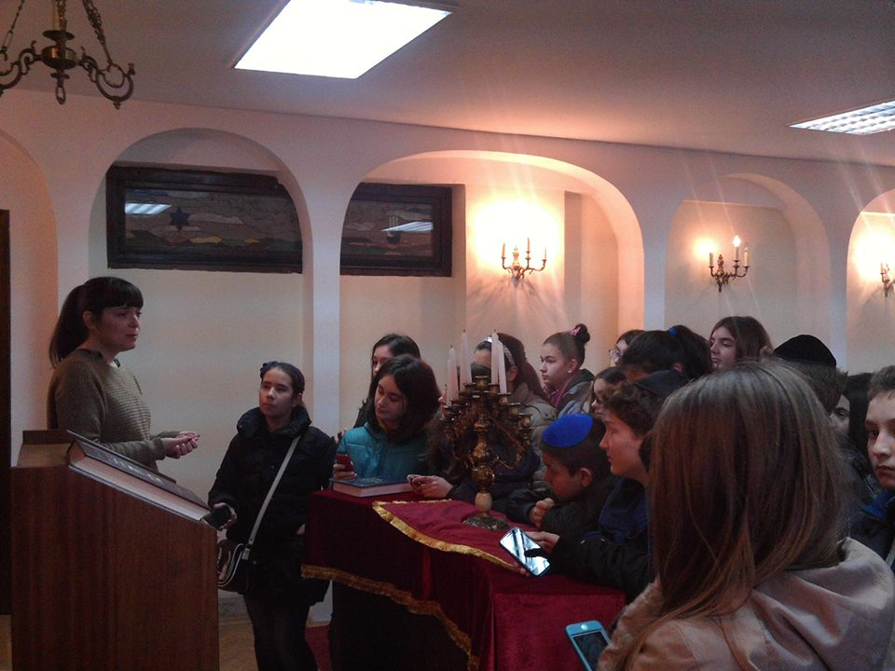
PROJECT WORK
STUDENT EXHIBITION
Program of activities
Visit Jewish Community
Visit the synagogue
Read books
Make presentations
Write essays
Make paintings and drawings

Slide 6
PROJECT WORK
STUDENT EXHIBITION
The Panels
Group 1: Jewish culture, religion and tradition
Group 2: How they came to the Balkans
Group 3: World War 2 and the Holocaust
Group 4: World War 2 and the Holocaust in
Macedonia
Group 5: The Jewish community in
Macedonia today

Slide 7
PROJECT WORK
STUDENT EXHIBITION
Group work roles
Member 1: write texts (in Macedonian)
Member 2: write texts (in English)
Member 3: find/make good photos
Member 4: make paintings/drawings
Member 5: store/print photos and texts

Slide 8
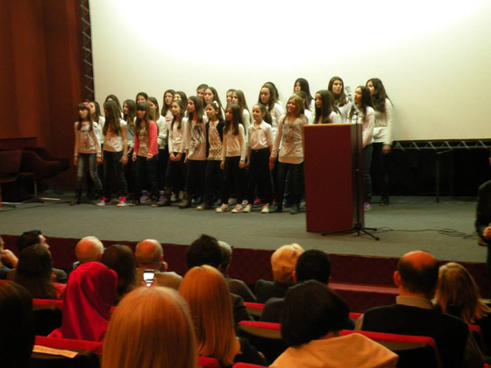
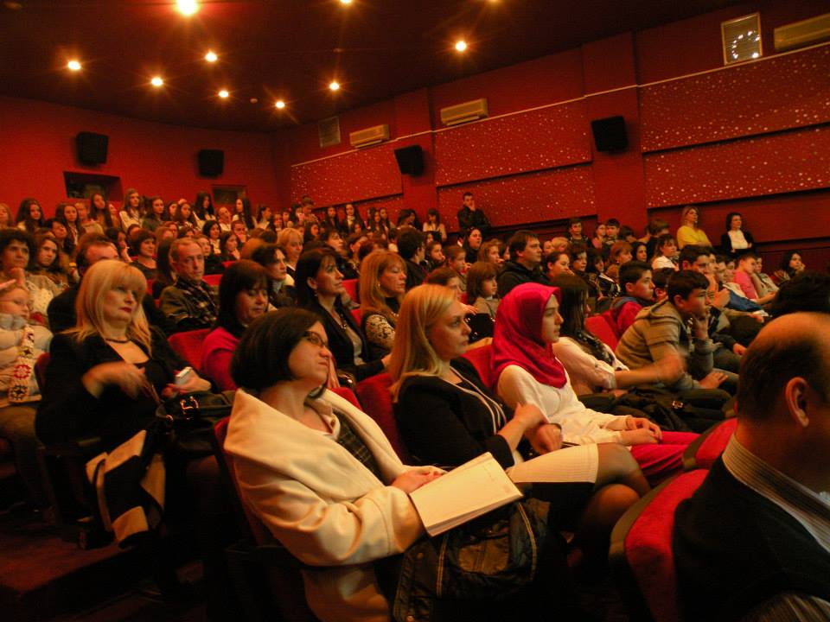
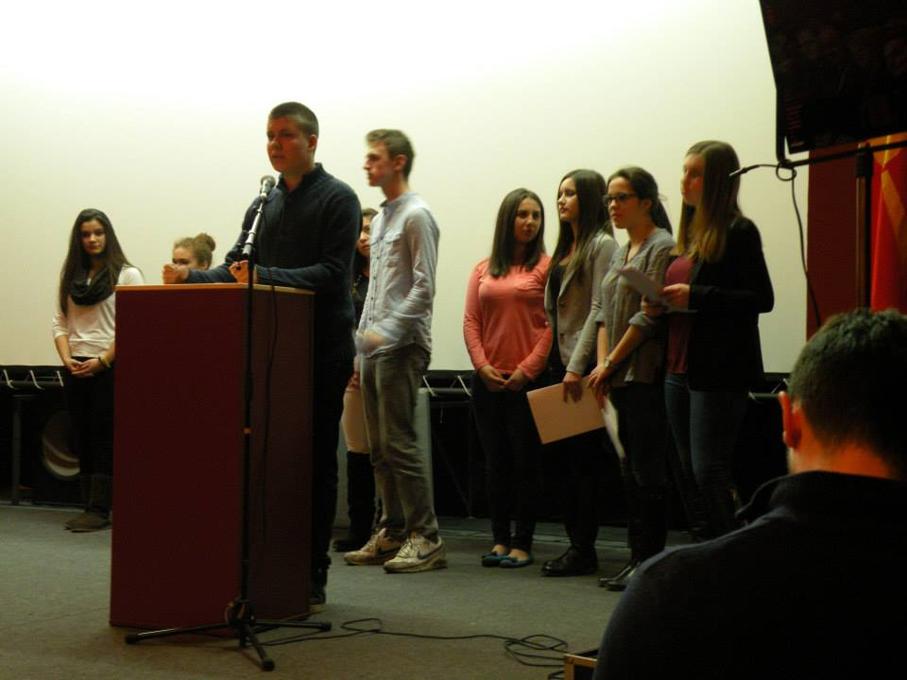
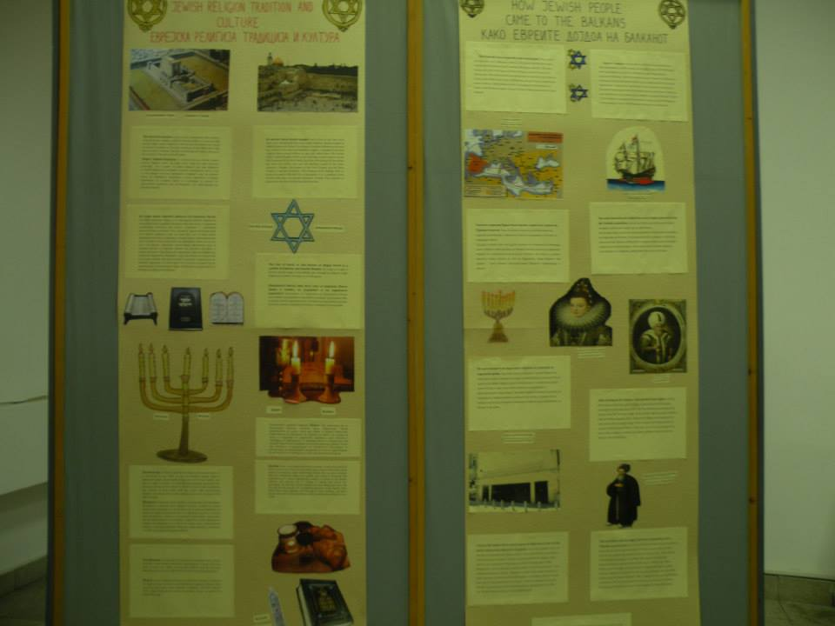
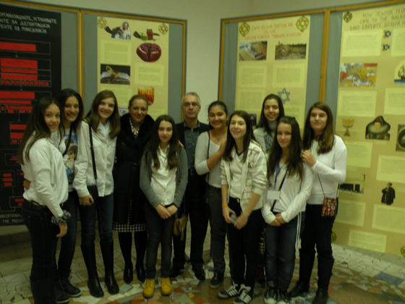
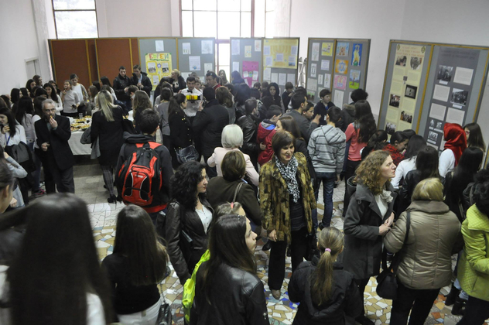
PROJECT WORK
STUDENT EXHIBITION
The event

Slide 9
PROJECT WORK
STUDENT EXHIBITION
EDUCATIONAL AIMS:
Learn Jewish history, culture, religion, tradition and the Holocaust in a non-traditional way
Practice English language skills (reading, listening, writing and speaking)
Practice creative writing, photography and art
Motivate students to learn better by using modern technologies in the classroom
Increase students’ multi cultural/ethic awareness

