Slide 1
Centropa is a tool that can be used to help educators teach differently so that students learn differently
Be creative
Think critically
Be Flexible
Execute ideas

Slide 2
CENTROPA can be used for the following skills
Analytical Skills –
text based knowledge
Students understand basic information from text
Practical Skills-
include classroom material with background knowledge
Students learn a lesson from the text
Wisdom Skills-
critical analysis by personal interpretation and reasoning
students offer advice from the text
Creative Skills-
stretch students’ imagination
students use imagination in learning

Slide 3
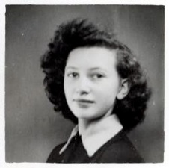
Lili Tauber
Students saw the Centropa movie based on Lili Tauber’s life.
Read passages from Lili’s interview
Had a competition: boys against girls
Created presentations about Lili’s life

Slide 4
Lillie Tauber’s Life by Nikole and Michal Grade 7
Please put here: Lilli Tauber ppt (michal & nikol)

Slide 5
Lillie Tauber’s Life by Eden, Omer & Irena Grade 7
Please put here the ppt לילי טאובר מוחעחעחע

Slide 6
Wislawa Szymborska
Born: July 2, 1923
Place: Poland
Achievements: Awarded Nobel Prize for literature in 1996

Slide 7
poeTRY
Takes students across boundaries of words, imagination and geographic location
Develops cultural identity
Allows for diverse and cross-cultural exchange
Supports understanding and appreciation of others

Slide 8
True Love by Arthur Grade11
Please put here movie truelove (artur)

Slide 9
Going Home by Nur Grade7-low proficiency in English
Please put here הסרטון הטוב- באנגלית(nur)

Slide 10
Going Home by Amit Grade7- Autistic student
Please put here movie by amit

