Slide 1
Using Poetry to Cross Boundaries
Melanie Shaul
Tichon Hadera Bet- Eliezar,
Israel

Slide 2
Personal E-Mail
“If I may be as bold to say: You have no idea how your
work is really changing kid's lives. When I look at
these videos, the kids are so motivated. You opened
the door to something new which enhanced and
created skills that students need in their lives:
analytical, practical creativity and wisdom, as well as
the critical dispositions to use the skills which
they have developed.”

Slide 3
poeTRY
Takes students across boundaries of words, imagination and geographic location
Develops cultural identity
Allows for diverse and cross-cultural exchange
Supports understanding and appreciation of others

Slide 4
Wislawa Szymborska
Born: July 2, 1923
Place: Poland
Achievements: Awarded Nobel Prize for literature in 1996

Slide 5
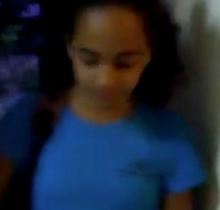
Going Home by Nur Grade7-low proficiency in English

Slide 6
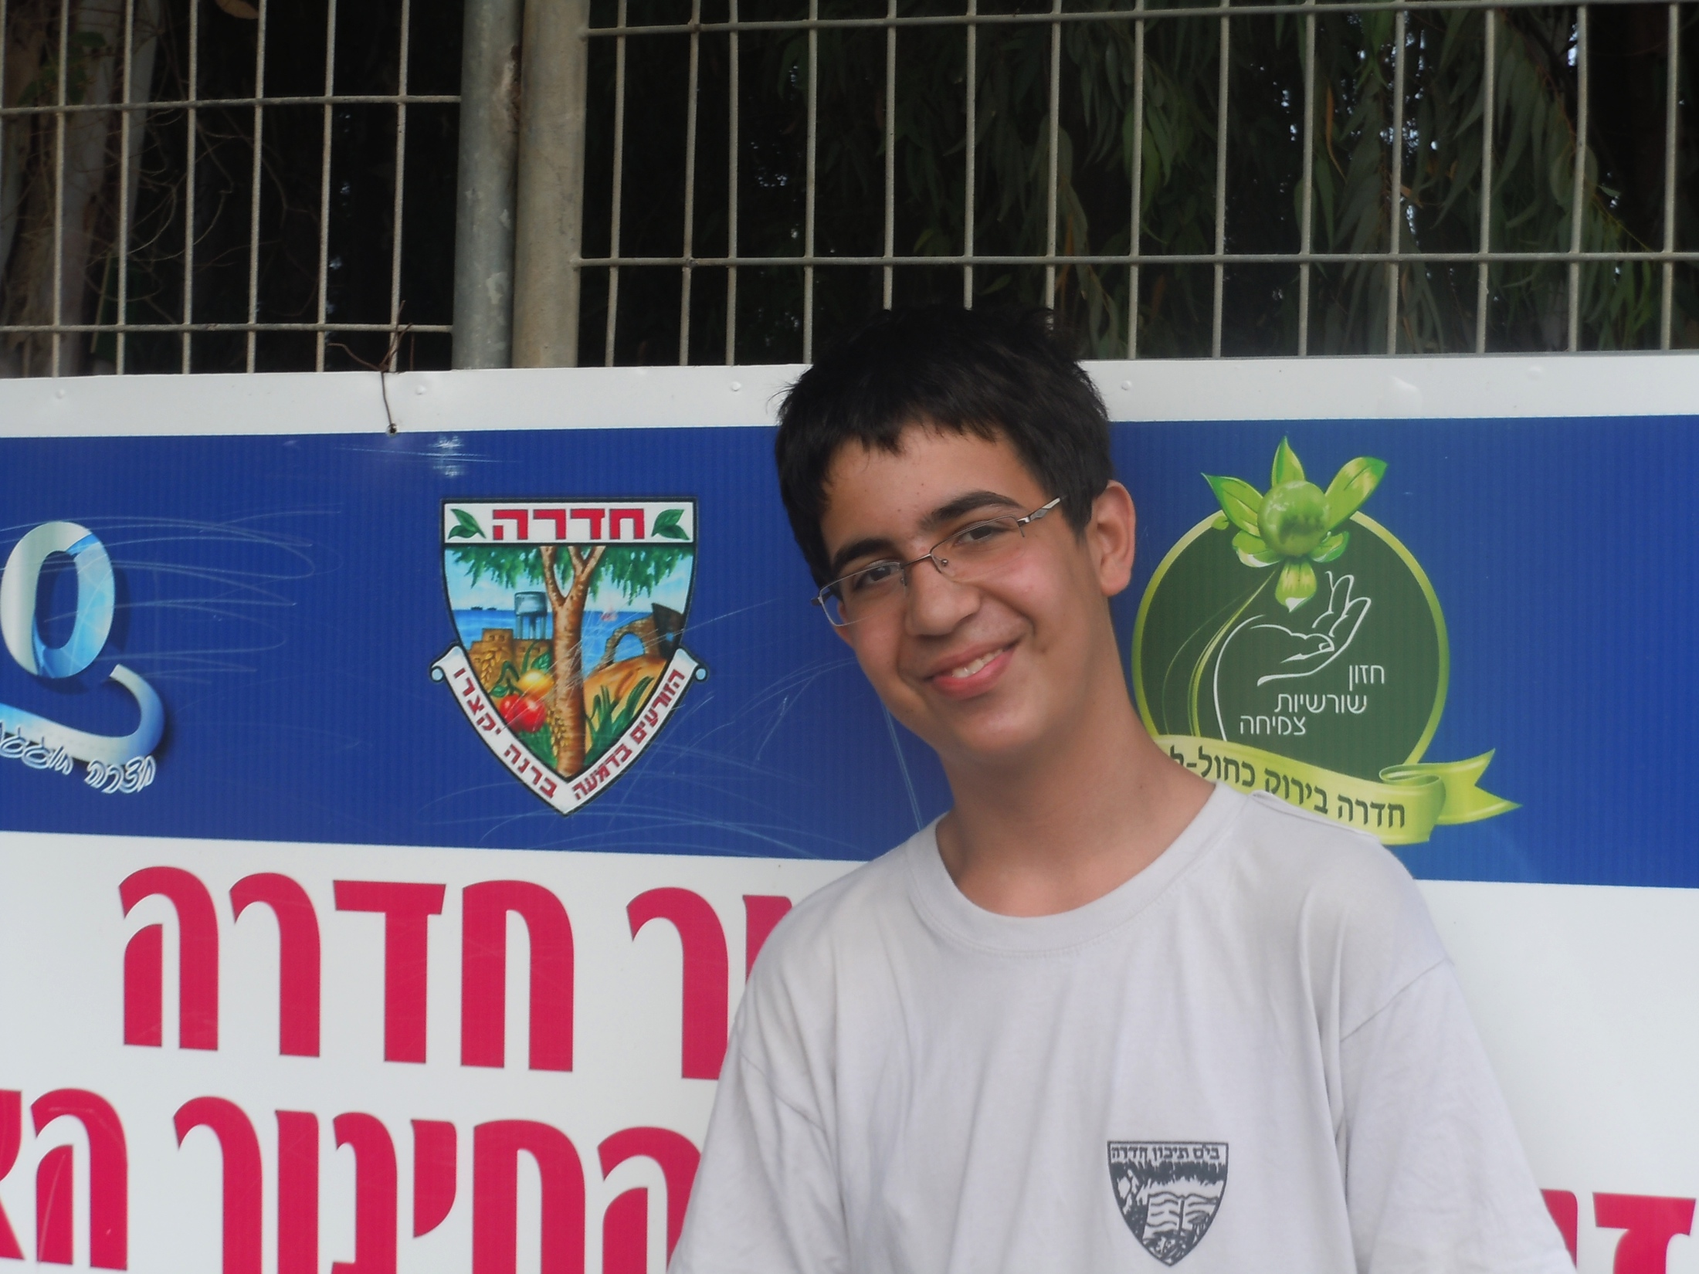
Going Home by Amit Grade7- Autistic student

Slide 7
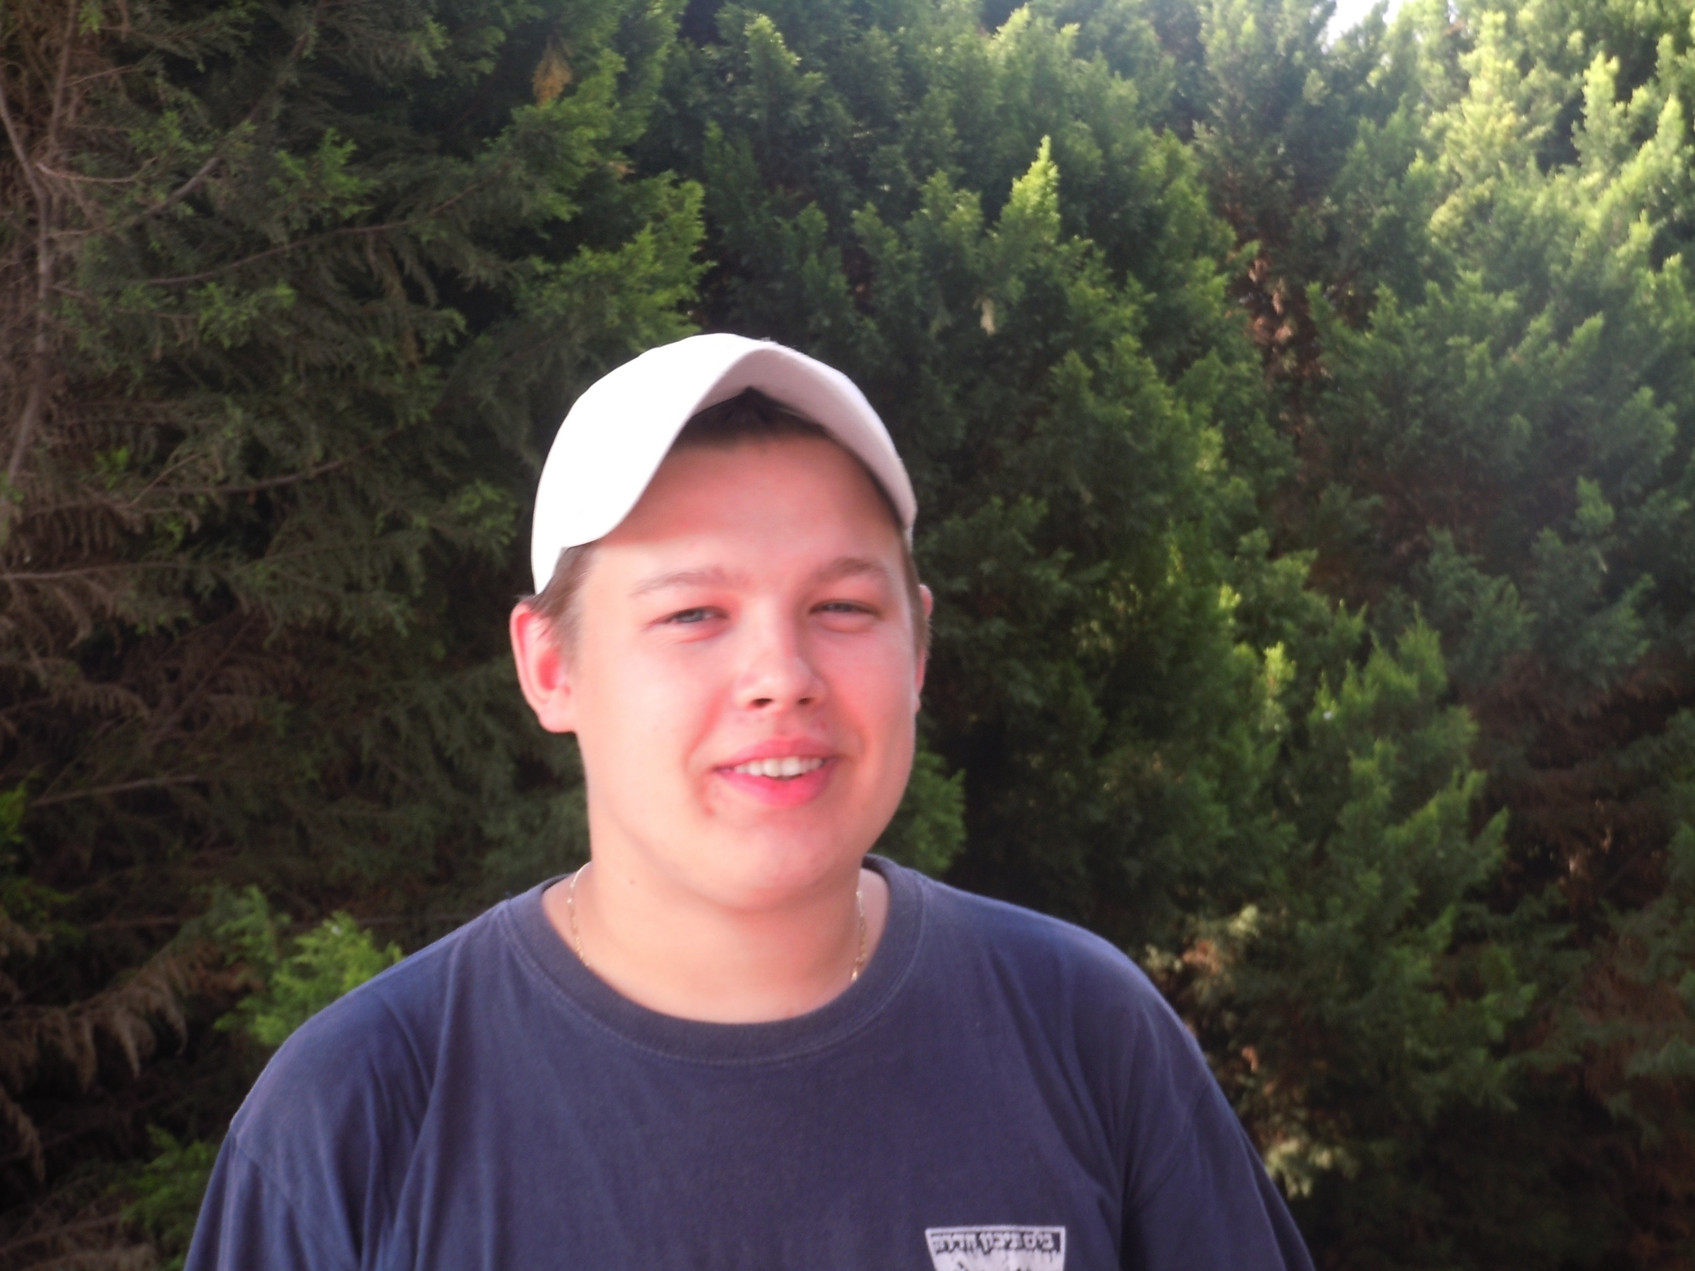
True Love by Arthur Grade11

