Slide 1
Mieczyslaw Weinryb
Born: December 8, 1919 Warsaw, Poland

Slide 2
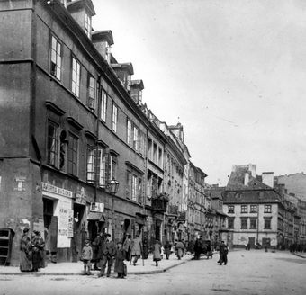
Country Slide
An average street in Zamocs , Poland in 1919.

Slide 3
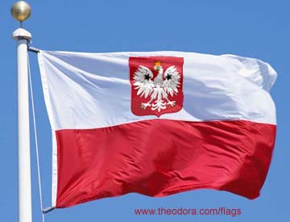
Poland Flag
Red symbolizes the blood shed fighting for Poland, the white represents peace.

Slide 4
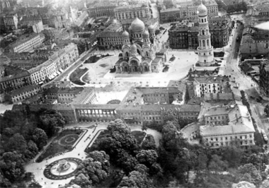
Overview of the city Zamocs in the 1900’s

Slide 5
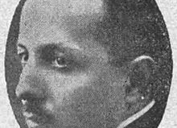
Politics
Maksymilllian Apolinary Hartglass was the political leader at the time Poland was independent. During the invasion everything went downhill. He managed to escape and move to Jerusalem.

Slide 6
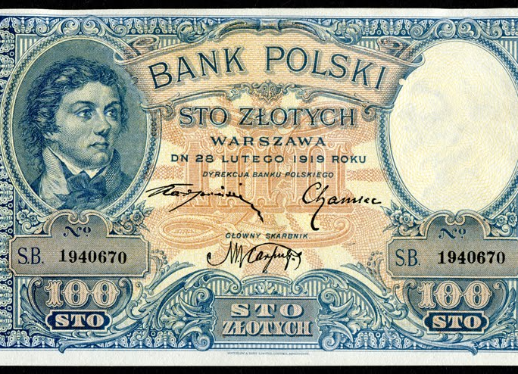
ECONOMY
A picture of how Polish money looked in the 1900’s

Slide 7
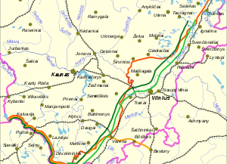
ECONOMY cont….
The Polish population rapidly decreased over numerous different areas as people spread to different places.

Slide 8
RELIGION
He was born and raised to a Jewish household. They were very strong about their Jewish practices.

Slide 9
POPULAR BOOKS
Two of the most popular books about Mieczyslaw and the Polish-Jewish relations.

Slide 10
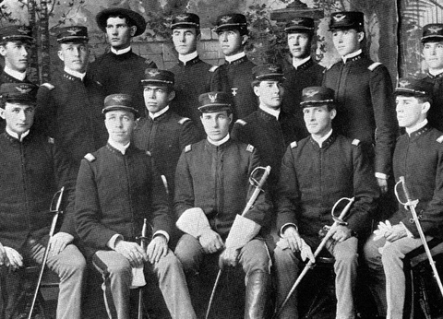
EDUCATION
He was taught a military style education

Slide 11
FAMILY
Picture of his two sisters at the top. Mom and dad on bottom and him in the middle as a young boy.

Slide 12
Born on DECEMBER 8, 1919 in zamocs, Poland.
He entered the service the minute they called.
His family is caught in the Kovel ghetto and killed.
He caught a train and moved to Bashkria.
His so n now teaches Physics at Yale University
his sisters moved to palastine in 1925.
He tries to convince the rest of his family to leave but they don’t listen.
He found some old friends that also survived and they cherish the time they have together.
He was severely diagnosed with gangrene disease and almost lost his arm.
After the war he returned back to Warsaw where he started a family .

