Slide 1
Haya Lea Detinko
March 28, 2012

Slide 2
Country
Haya Detinko lived in Ronvo, Poland, which is now in Ukraine

Slide 3
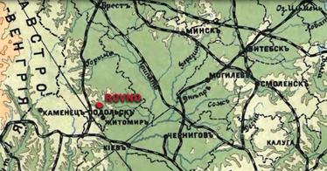
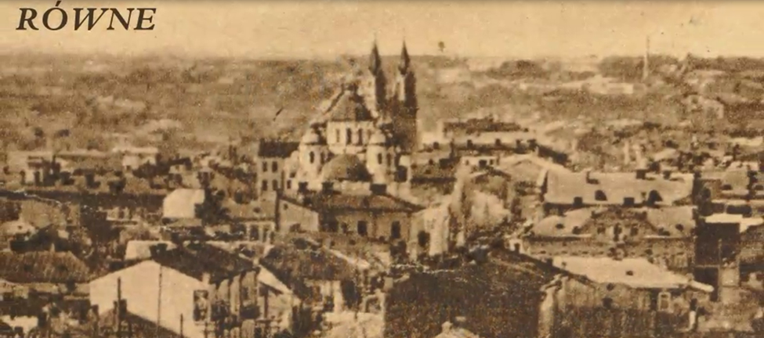

Slide 4
Politics
The Poland of Detinko’s time, was Communist, half under the USSR and half under the Nazis.

Slide 6
Economy
As a Communist state, Detinko had no choice in what her profession would be.
She became a seamstress.

Slide 7
Religion
Detinko and her family were Jewish.
Most of her friends were Jewish
Religion was outlawed when Poland was taken over by the USSR/Nazis, but she kept her faith

Slide 8
Family Photos
Detinko and Husband

Slide 9
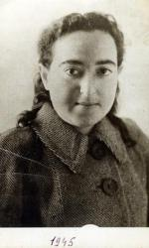
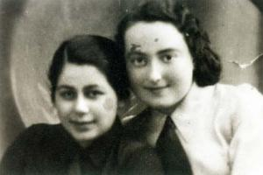
Family Photos
Left: Haya Lea Detinko (1945)
Above: Detinko and her friend, Gisya

Slide 10
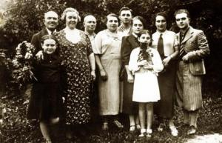
Family Photos

Slide 11
Time Line
Born: 1920
5 June 1941: Arrested by Soviets
Still alive to this day
1945: Sentenced
Age 16: ORT Tailoring School
1938: Joined Hashomer
1961: Haya and husband released
22 June 1941: Transported 8,000 km from her home
Age 6: Tarbut School

Slide 12
The End

