Slide 1
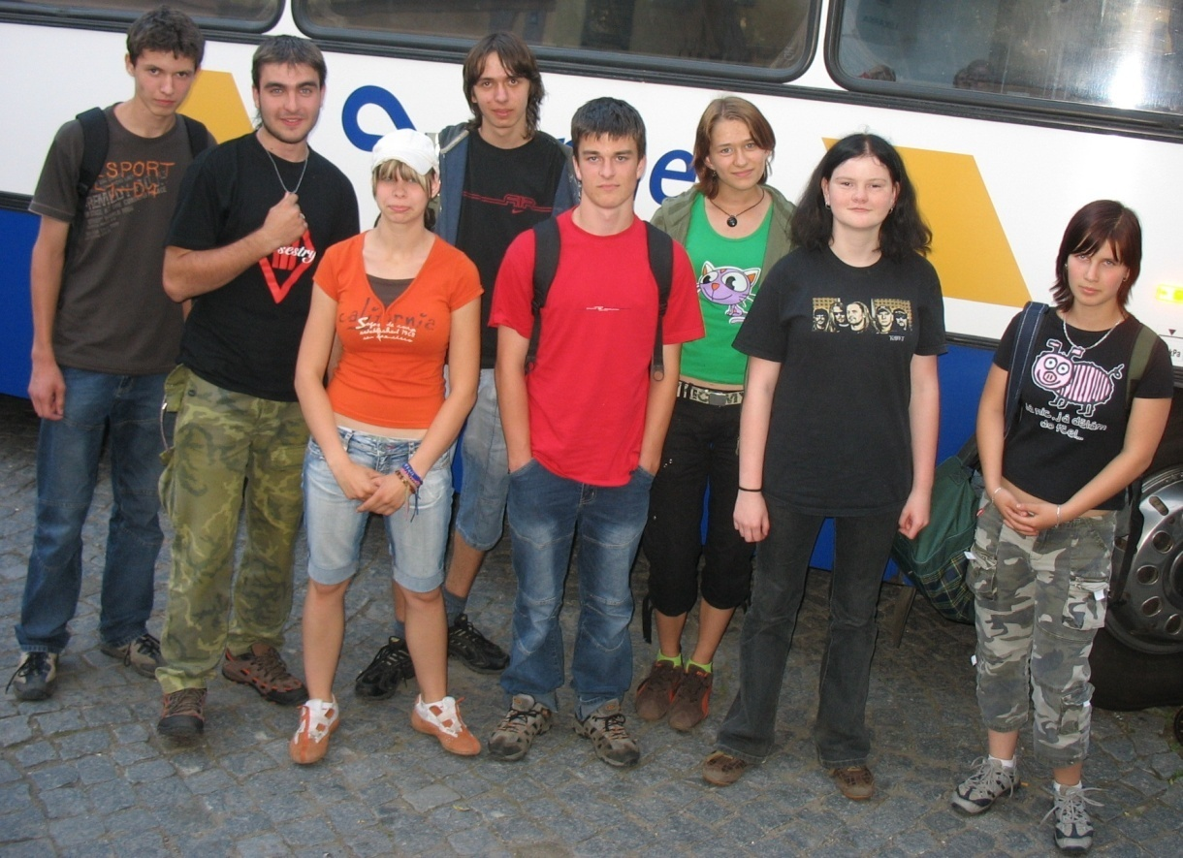
ZŠ a MŠ Maleč

Slide 2
Vilém Bergmann
25.9. 1915 – 10. 9. 2006
Historical events are not just about facts and figures…….

Slide 3
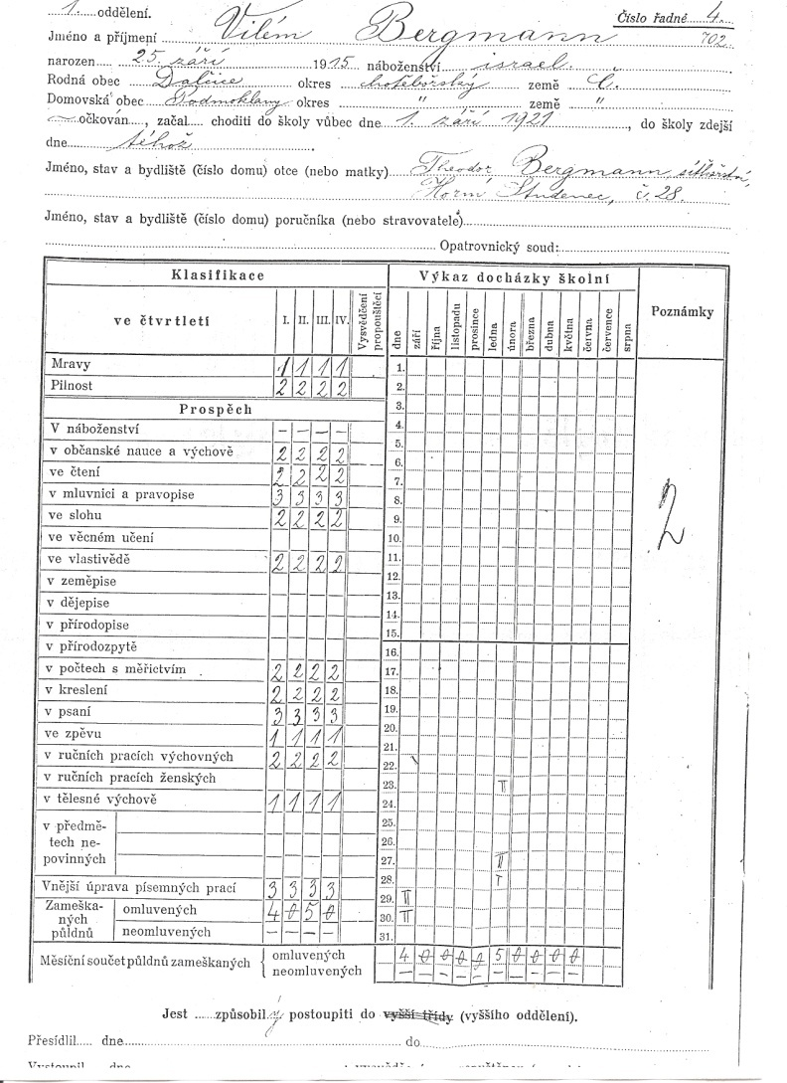
Personal data
Vilém Bergmann
25. September 1915 in Dalčice
Podmoklany 28, Horní Studenec

Slide 4
Parents
Theodor Bergmann
Emily Bergmann
*16.5.1880
in Podmoklany 28, Horní Studenec
Political activities - social democrat, deputy mayor, member of the elecricity commission
1923 –in the municipal elections as a member of the Association of the Republican Party and People elected councilor
Taking over the business-production of hair nets- from his father- in- law Emanuel Weissenstein
autumn 1943 deported to Terezín, where he died
*12.11.1881 in Kohoutov Podmoklany 28, Horní Studenec
born Weissenstein
Parents give them their property and moved to Teplice
homeworker
Theodor and Emily were of Jewish religion

Slide 5
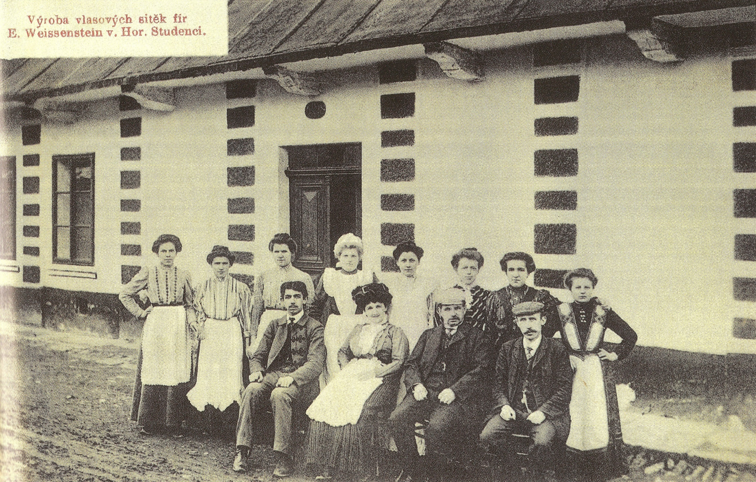

Slide 6
Siblings
Otto
Karolína
*11.11.1909 in Bystřice
1942 Deported to Terezín
20.1.1943 Deported to Osvětim, where he died
*24.7.1911 in Bystřice nad Pernštejnem
1936 christened by curate Tošovský
Married to F. Polívka from Vlkanov
Died in 1987

Slide 7
Josef
Jiří
*22.7.1913 in Dalčice
1943 deported to Terezín
28.9.1944 deported to Osvětim, where he died
*28.9.1919 in Horní Studenec
1943 deportation to Terezín
28.9. 1944 deported to Osvětim, where he died

Slide 8
Miroslav
*14.4.1923 in Horní Studenec
5.12.1942 deported to Terezín
1943 deported to Osvětim, where he died

Slide 9
The validity of the Noremberg Laws
Formation of the Protectorate of Bohemia and Moravia
1940 he left Africa and came to Palestine
Formation of Czechoslovak foreign troops in the Middle East under the leadership of Karel Klapálek
Czechoslovak soldier. Foreign troops in the Middle East
Defence of Tobruk

Slide 10
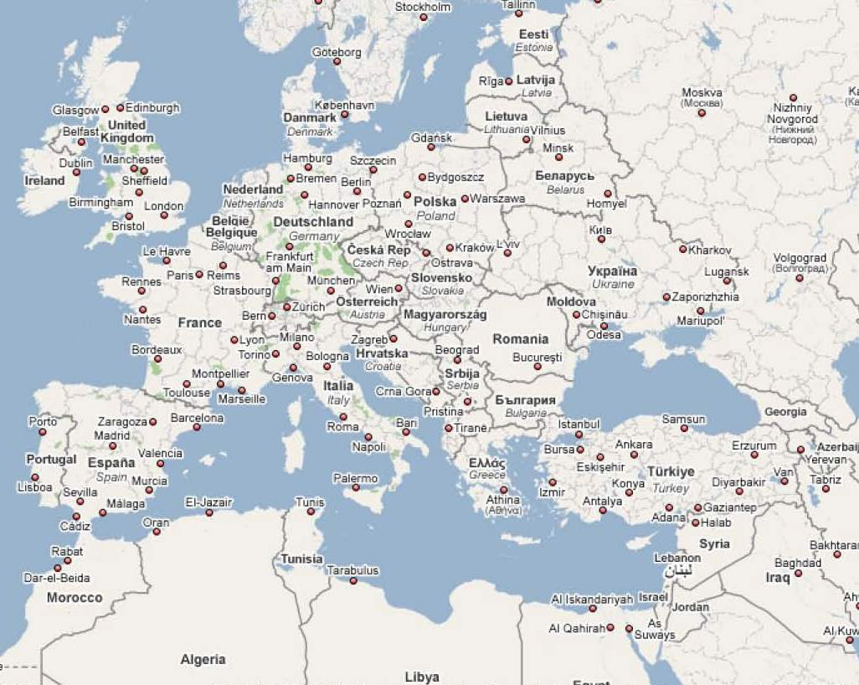

Slide 11
Opening a second front in Western Europe
Participation in Operation Overlord
Advance of allied troops to the territory of Czechoslovakia
The end of the second World War
Leaving the Army
Business- hairdressing in Karlovy Vary
February 1948
Emigration to the United States of America, Florida

Slide 13
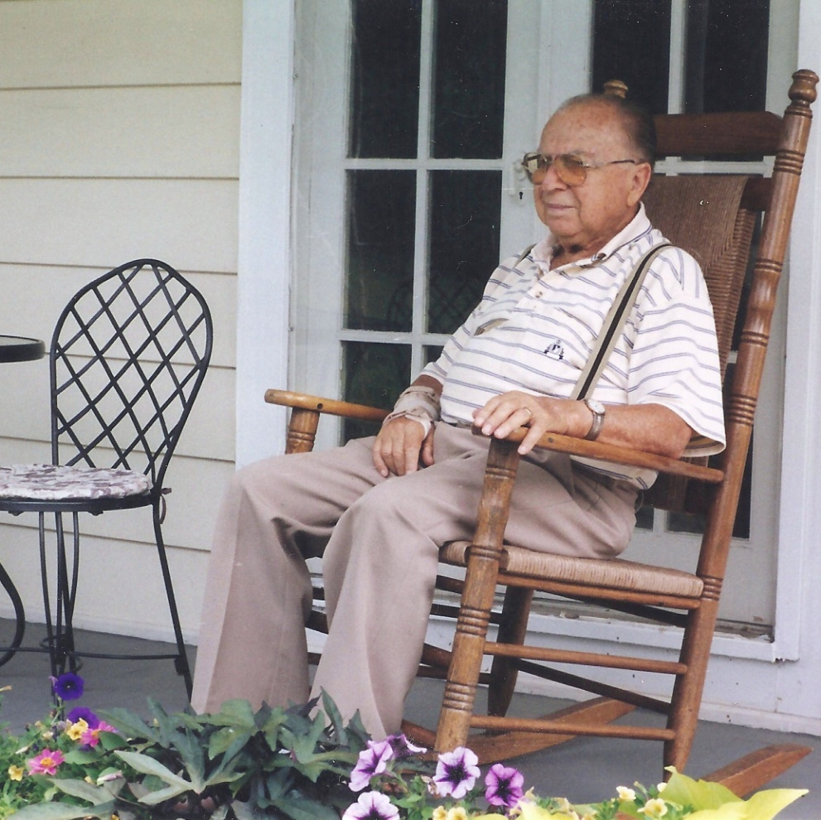
Mr. Vilém Bergmann died in Florida 10.9.2006

