Slide 1
WORLDELICOUS
RON BAHARI, SAPIR DAEL, HADAR ZIV, IDAN ZILBERMAN, ROMI PETEL

Slide 2
CHOOSE A COUNTRY TO WATCH IT’S JEWISH TRADINIONAL DISH

Slide 3
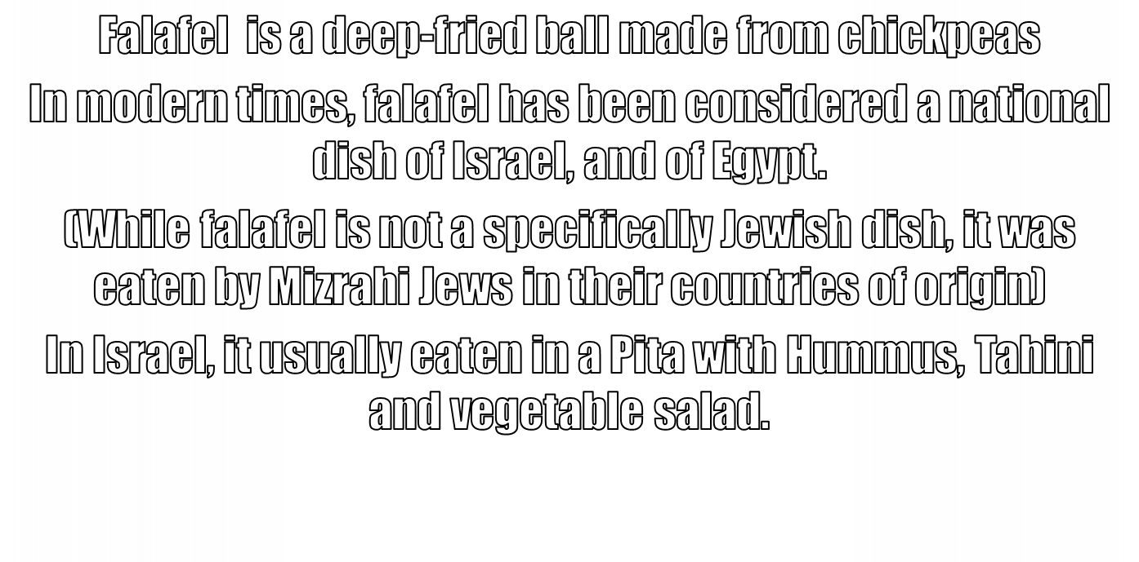

Slide 8
